Slide 1
Global Evaluation of Websites for
Acceptance of E-mail Addresses in 2019
9 August 2019
UASG025

Slide 2
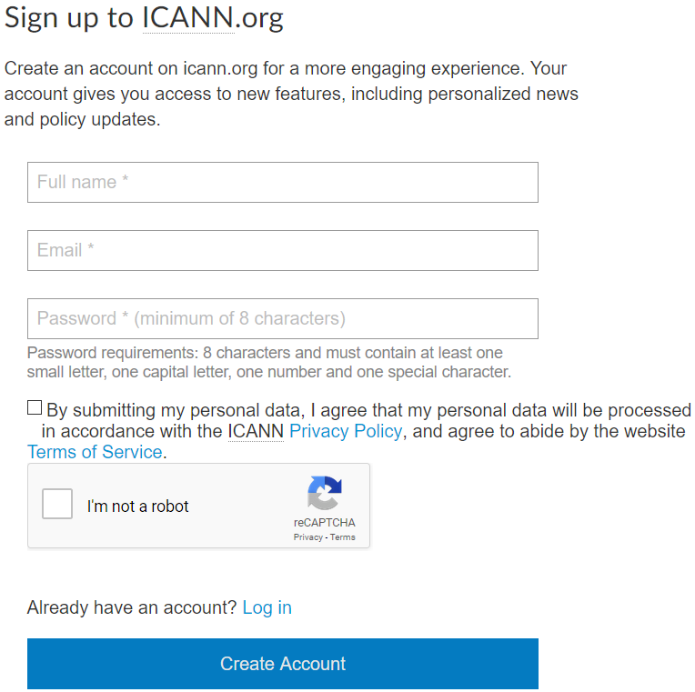
Introduction
In Web development, newer use-cases of e-mail are often not considered when form fields are concerned.
People who want to use innovative addresses or simply type in their own languages can’t interact properly with many websites.

Slide 3
About the Survey
Goal
Evaluate the UA compliance of the top 1,000* websites in the world.
Approach
Sample the practices and development approaches to the e-mail field in forms by testing them in practice.
Potential Failure Points
HTML standards and implementation.
Use of JavaScript and other Web-oriented languages.
*According to Alexa: https://www.alexa.com/topsites

Slide 4
Methods: Part 1
Manual assessments of the websites were performed to check for the acceptance of the following increasingly complex address formats in their forms:
ascii@ascii.newshort test@test.exp | ascii@ascii.newlong test@test.example | ascii@idn.ascii test@普遍接受-测试.org
unicode@ascii.ascii 测试1@test.org | unicode@idn.idn 测试5@普遍接受-测试.世界 | arabic.arabic@arabic (RTL) دون@رسيل.السعودية

Slide 5
Methods: Part 2
On a MongoDB database, each test was rated as “accepted” or “rejected” according to the following criteria:
Marked as “accepted” when:
  Submission resulted in a success message.
  Submission was accepted and no error was reported.
  An “already registered” e-mail message was displayed.
Marked as “rejected” when:
  The website displayed an error once the address was inputted.
  Submission returned an error message.
  Submission was not allowed.

Slide 6
Metadata Schema
{ "_id": {"$oid": "00001"} "domain": "test.org", "url": "https://www.test.org/signup", "rank": "1000", "testable": "Yes", "code": "<input type="email">", "comments": "Field triggers a captcha", "mailboxes": { "mail1": "Accepted", "mail2": "Accepted", "mail3": "Accepted", "mail4": "Rejected", "mail5": "Rejected", "mail6": "Rejected" } }
_id: Auto-generated unique identifier within the entire database.
domain: Domain, not prefixed by “www”.
url: URL containing the full path to the page containing the form.
rank: Ranking of the website within that particular collection.
testable: Indicates if the team ultimately managed to test the website.
code: Contains the string that validates the form, if found.
comments: Any relevant comment.
mailboxes: List of ratings for each test case.

Slide 7
2019 Results

Slide 8
Comparison of Test Acceptance Rates (2017 to 2019)

Slide 9
Sample Failure
/^[-a-z0-9~!$%^&*_=+}{\'?]+(\.[-a-z0-9~!$%^&*_=+}{\'?]+)*@([a-z0-9_][-a-z0-9_]*(\.[-a-z09_]+)*\.(aero|arpa|biz|com|coop|edu|gov|info|int|mil|museum|name|net|org|pro|travel|mobi|[a-z][a-z])|([0-9]{1,3}\.[0-9]{1,3}\.[0-9]{1,3}\.[0-9]{1,3}))(:[0-9]{1,5})?$/i
This Regular Expression (RegEx) does a hard check for very specific parameters that define the structure of a legacy e-mail address, also whitelisting some of Sponsored TLDs and legacy TLDs such as “.edu” and “.org”.
It does not make much sense, but variations of this were also found in other instances.

Slide 10
Regional Correlation Tests
Is there a correlation between a higher UA compliance and top websites from countries that employ writing scripts different from Latin?
Testing against the mild “unicode@ascii.ascii”, this correlation does not seem to exist at this level.
Han Case
Pool of 47 websites from China, 8 from Hong Kong, 2 from Singapore, and 12 from Taiwan.
Only 4 websites from China were able to handle the test case.
Cyrillic Case
Pool of 37 websites from Russia and 2 from Ukraine.
Only 5 websites from Russia were able to handle the test case.

Slide 11
HTML5 and Limitations Regarding UA
Current pattern of acceptance for <input type="email">:
Test case | Result
ascii@ascii.newshort | Accepted
ascii@ascii.newlong | Accepted
ascii@idn.ascii | Accepted
unicode@ascii.ascii | Rejected
unicode@idn.idn | Rejected
arabic.arabic@arabic (RTL) | Rejected
If 20-30% of websites use this string, the same number of websites fail validation at the browser level due to a lack of proper standards in HTML5.

Slide 12
Future of HTML5
The 5.3 draft of the specification predicts compliance with UA.
However, this revision has been in “first draft” status since 2017 with no predicted date for it to become a “final recommendation.”
Steps need to be taken now with the W3C, WHATWG, and browser vendors to speed up implementation of this aspect of the specification.
Relevant parties must be encouraged to add an “eaimail” option to websites that are UA-ready.
Major browser vendors should also be encouraged to signal that they are interested in making this option viable.

Slide 13
Conclusions
Of the top 100 websites in the world, only five accepted all test cases.
  Even without the difficult “unicode@idn.idn” and Arabic (RTL) test cases, we would still end up with only nine websites accepting the first four test cases.
While optimistic about the prospect of newshorts and eventually newlongs reaching full compliance, it is clear that the internationalized domains need a boost and that proactive action needs to be undertaken for them to thrive.
Stronger policies need to be developed and the Internet ecosystem needs to be made more aware of the existence of such e-mails and domains.
  Active outreach is required.

Slide 14
Relevant Links
More information and additional UASG documents: https://uasg.tech/information/
Contact the UASG: https://uasg.tech/contact/
Meet the people of the UASG: https://uasg.tech/about/people/
Participate in UASG Discussions: https://uasg.tech/subscribe
Report UA problems with other applications: https://uasg.tech/global-support-centre/

