Slide 1
Analysis of EAI Software Support (UASG030A) July 2021 | Standcore LLC
John Levine, john.levine@standcore.com

Slide 2
What is EAI?
Email Address Internationalization (EAI)
UTF-8 in email addresses
测试@电子邮件测试.中国
اختبار@اختبارالبريد.شبكة
yés@nø.sp.am
Notes:
These are all actual addresses we used to test EAI compatibility.

Slide 3
What is not EAI
Subject lines
Address comments
Message bodies
- MIME provides all those in conventional mail
Any character set other than UTF-8
Notes:
address comments are like this:
From: address comment <user@dom.ain>

Slide 4
EAI Level 1 and Level 2 Support
Level 1: can exchange mail with EAI addresses
bob@examp1e.com ⬄ 测试@电子邮件测试.中国
Level 2: Level 1 + supports EAI addresses
yés@nø.sp.am ⬄ 测试@电子邮件测试.中国

Slide 5
Different Components
Mail software has many components
A package may provide EAI support in some components but not others
Some software without formal EAI support handles EAI mail anyway

Slide 6
Components: User-Facing
Mail User Agent (MUA)
Desktop mail program
Phone or tablet mail
Webmail
Notes:
Some MUAs are integrated with a specific mail provider, some can connect to any MSA and MDA

Slide 7
Components: Mail Submission and Transfer Agents (MSA and MTA)
MSA accepts mail from MUA for further handling
MTA transfers mail to other systems
MSA+MTA often combined in the same package

Slide 8
Components: Mail Delivery Agent (MDA)
Stores incoming mail
Clients manage with POP or IMAP
Generally used by MUAs to retrieve mail

Slide 9
Components: Spam Filters
Incoming: keeps mailboxes clean
Outgoing: keeps others’ mailboxes clean
We tested two kinds:
- Proxy: separate system filters and then relays
- Host: runs directly from MTA or MDA

Slide 10
The Test Approach

Slide 11
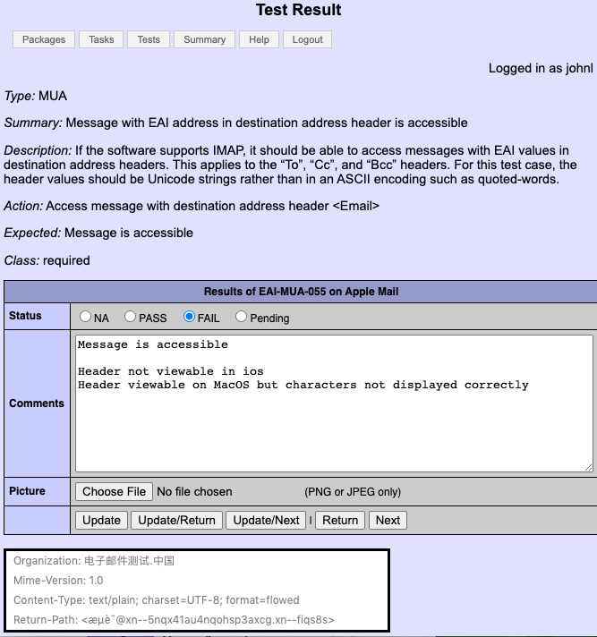
Test Approach: MUA, MSP, Webmail
Test manually
Record results in database
Export from database to report

Slide 12
Test Approach: MSA, MTA, MDA
Script for each test
Fast, reliable results
Automatically logged in database, then export to report
Target system
Test controller
Reference server

Slide 13
Test Approach: Spam Filters
Partly automated
Partly manual
Target system
Test controller
Reference server

Slide 14
Test Results

Slide 15
Summary Results
Notes:
This does not include the previous tests

Slide 16
Thunderbird 89 beta
Open-source desktop mail
EAI L1 support
Still no L2 support in 90 beta

Slide 17
Sendmail 8.17 alpha
The oldest open-source Linux/BSD mail
After fixing a few early bugs ...
EAI L2 ready MSA and MTA
Separate MDA needed for a full mail system

Slide 18
Halon
Highly configurable mail package
We used default MTA and MSA setups
EAI L2 ready
Can relay to MDA or separate MDA software needed

Slide 19
Xgenplus
Hosted mail system
MUA, MTA, MSA, MDA are L2 ready
Non-EAI bugs in MSA and MDA may affect compatibility

Slide 20
Spamjadoo / XgenPlus
Spam filter provided with XgenPlus or separate proxy
- Tested as separate proxy
Passed all relevant tests, L2 ready

Slide 21
Mailchannels
Proxy spam filter
L1 ready now
Working with vendor to fix bugs, then will be L2 ready

Slide 22
Spamassassin
Popular open-source scoring filter
- Admin or user can add filter rules
Called from MTA or MDA
Fully L2 ready
body EAIBODY /发送邮件.电子邮件测试.中国/
score EAIBODY 1 1 1
Notes:
Sample rule to look for a UTF-8 string in message bodies and add 1 to the score if found

Slide 23
Dovecot
Popular open-source IMAP/POP MDA
No EAI support at all
Still surprisingly usable for EAI mail
- Stores and retrieves EAI mail
- UTF-8 searches and folder names via legacy character set support
Notes:
Sample rule to look for a UTF-8 string in message bodies and add 1 to the score if found

Slide 24
Final Thoughts

Slide 25
Software Tools
Updated web application and test scripts written in python3
Released on Github with BSD license https://github.com/jrlevine/eaitesttools

Slide 26
Summary
L1 ready MUA
L2 ready webmail and spam filters
L2 ready open-source and paid MSA, MTA
Still only one L1/L2 ready MDA

Slide 27
Analysis of EAI Software Support (UASG030A) July 2021 | Standcore LLC
John Levine, john.levine@standcore.com

