Slide 1
UA-Readiness Evaluation of Browsers
Tests conducted by Oxford Information Labs 2021

Slide 2
Previous Tests 2017 - Summary
No special language settings
Only Internet Explorer desktop fully compliant
17 URLs, 8 browsers, 6 oss (4 desktop, 2 mobile)
Most desktop browsers worked very well
Issues with rtl1.ascii in title bar
Issues with open dot “.” as a delimiter
Firefox and Opera on mobile – poor
Https certificate issues

Slide 3
2021 – Test Criteria
No special language settings and following from the 2017 tests.
Paste entire URL in location bar then press ‘enter’
Does the correct page load following ‘enter’?
  Note: behavior before pressing ‘enter’
Does URL display correctly in location bar?
  Note: some truncate the full path in all cases
Does the page title display correctly in the tab title bar?

Slide 4
Methodology
Paste entire URL in location bar, press ‘enter’
Does the correct page load following ‘enter’?
  Note: behaviour before pressing ‘enter’
Does URL display correctly in location bar?
  Note: some truncate the full path in all cases
Does the page title display correctly in the tab title bar?
Additional tests for 2021
  Add to bookmark/favorite
  Confirm display of bookmark

Slide 5
Key Findings
The results showed an encouraging picture.
Strong support for display and navigation of IDN domains across most browsers.
  Some right-to-left scripts displayed differently than what was pasted but this could be interpreted as display preference.
Strong support for bookmarking IDN domains.
  Many browsers display IDN bookmarks as Punycode leading to limited usefulness.

Slide 6
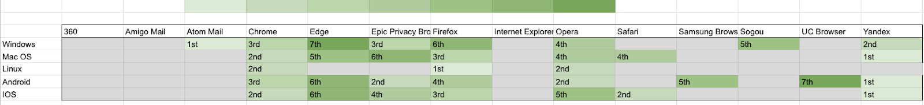
Summary of Results
Light green represents the most successful browsers in terms of UA-readiness.
Yandex and Chrome score highly across all platforms.
Edge and and UC Browser scored the lowest.

Slide 7
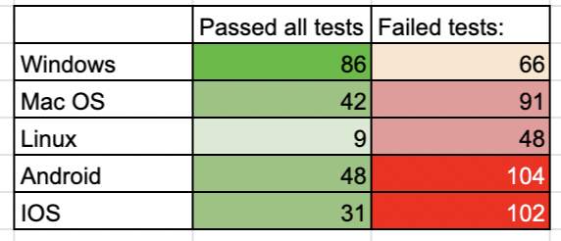
Summary of Results – Desktop vs. Mobile Device
More Universal Acceptance difficulties with mobile device environments.
Most failures were due to tests F and C (confirm that the URL display is in the correct format as added and confirm that the URL is displayed correctly in the bar).

Slide 8
Caveats and Conclusions
Limited platform support for some browsers.
Some identified study browsers untestable due to security concerns.
The general outlook for the UA-readiness of modern web browsers is largely positive.
One area of improvement for browser vendors is the handling of bookmarking for IDNs. A number of vendors listed previously stored bookmarks using Punycode conversions which have little or no significance to the reader.

