Slide 1
EAI Acceptance Rates of the Top 2,000 Global Websites in 2022
UA Tech Working Group / 2022

Slide 2
Objective
To develop a prototype process for UA remediation campaigns, gain experience with the process, and to learn lessons about the process.

Slide 3
Scope
Ascertain the current EAI acceptance rates of the previously tested websites in UASG025 and UASG027 and compare the results.
Website List Preparation
Review the UASG025 and UASG027 reports and their test datasets.
Check for duplicates and redundancies.
Prepare a final list of the websites that failed testing.
Email Address Internationalization (EAI) Acceptance Testing
Carry out testing for EAI acceptance with various categories of email IDs as per the UASG004 document.
Report Preparation
Prepare comparative reports for possible remediation of websites that failed testing.

Slide 4
Current Activities
Re-testing of 1,630 websites for EAI acceptance and testing of 380 top global websites (according to Alexa Top Global Websites extracted as on 1 December 2021), totaling 2,010 websites.
Creation of a database of contact email IDs for 2,010 websites.

Slide 5
Email IDs Used for Testing
Seven different types of email addresses were used for testing all 2,010 websites.
 | Email Category | Email ID
Category-1 (C1) | ascii@ascii.newshort | web-test@universal-acceptance-test.icu
Category-2 (C2) | ascii@ascii.newlong | web-test@universal-acceptance-test.international
Category-3 (C3) | ascii@idn.ascii | web-test@ሁለንአቀፍ-ተቀባይነት-ሙከራ.com
Category-4 (C4) | ascii@ascii.idn | web-test@universal-acceptance-test.קום
Category-5 (C5) | Unicode@A-label.A-label | वेब-परीक्षण@xn-----lnfbb8fe3cvkui0de0bcg5hxagsg7d5lwail.xn--i1b6b1a6a2e
Category-6 (C6) | Unicode@idn.idn | 电子邮件测试@普遍适用测试.我爱你
Category-7 (C7) | arabic.arabic@arabic (RTL) | تجربة-الويب@تجربة-القبول-الشامل.موريتانيا

Slide 6
Previously Used Email ID Categories for EAI Acceptance
 | Email Category | 9 August 2019 (UASG025) | 21 April 2020 (UASG027) | January 2022 | Jan. 2022 Email Categories
1 | ascii@ascii.ascii | NA | test@ua-test19.com | NA | NA
2 | ascii@ascii.newshort | test@test.exp | test@ua-test19.bet | web-test@universal-acceptance-test.icu | Category-1 (C1)
3 | ascii@ascii.newlong | test@test.example | test@ua-test19.technology | web-test@universal-acceptance-test.international | Category-2 (C2)
4 | ascii@idn.ascii | test@普遍接受-测试.org | test@普遍适用.com | web-test@ሁለንአቀፍ-ተቀባይነት-ሙከራ.com | Category-3 (C3)
5 | ascii@ascii.idn | NA | NA | web-test@universal-acceptance-test.קום | Category-4 (C4)
6 | Unicode@A-label.A-label | NA | NA | वेब-परीक्षण@xn-----lnfbb8fe3cvkui0de0bcg5hxagsg7d5lwail.xn--i1b6b1a6a2e | Category-5 (C5)
7 | Unicode@ascii.ascii | 测试1@test.org | 广场@ua-test19.com | NA | NA
8 | Unicode@idn.idn | 测试5@普遍接受-测试.世界 | 测试@普遍适用.公司 | 电子邮件测试@普遍适用测试.我爱你 | Category-6 (C6)
9 | arabic.arabic@arabic (RTL) | دون@رسيل.السعودية | عنوان@يو-اي-اختبار.شبكة | تجربة-الويب@تجربة-القبول-الشامل.موريتانيا | Category-7 (C7)
In the 2019 report (UASG025), six email ID categories were used; in the 2020 report (UASG027), seven email categories were used.
In the 2022 report (UASG039), seven email ID categories were used for EAI acceptance testing.
Email categories 1, 2, 3, 6, and 7 were used to compare EAI acceptance rates between the 2020 report and 2022 report.

Slide 7
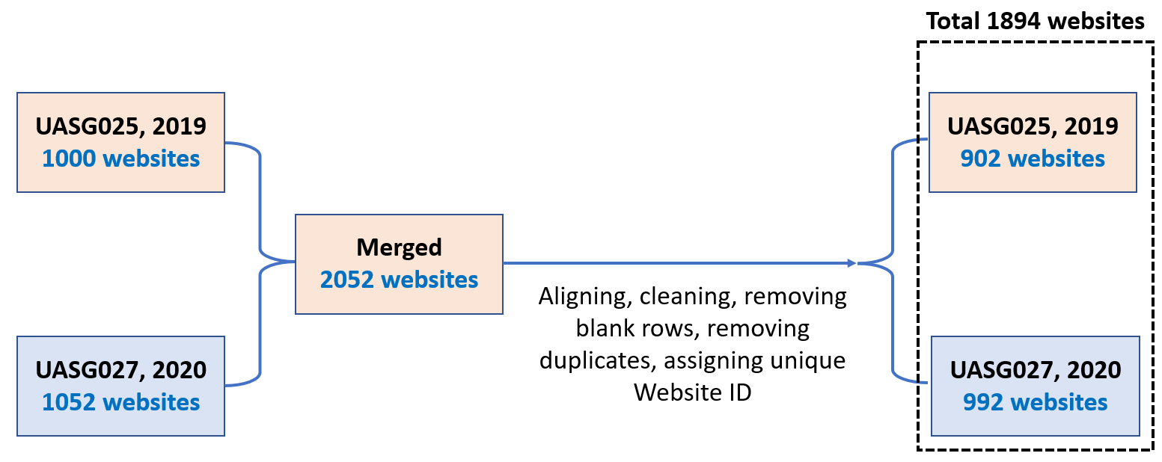
A) Merging and Duplicate Removal
P - Series
N - Series
  Identified duplicates in all 2,052 sites and removed duplicates per the following priority:
  Removed duplicates from UASG025 if the duplicates were present across both UASG025 and UASG027 data.
  Removed duplicates from lower serial numbers if the duplicates happen to be present within the same data set.

Slide 8
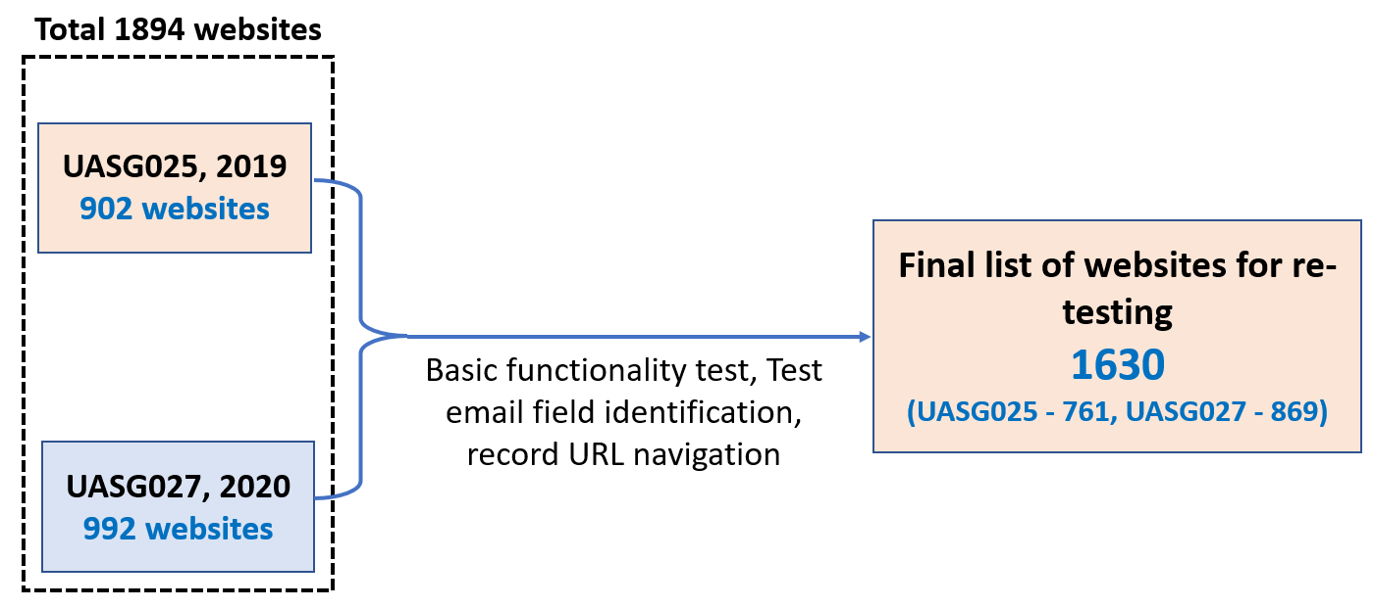
B) Basic Functionality and Test Email Field Identification
P - Series
N - Series
  It was observed that a few of the websites do not exist as of the date, have trouble opening, or are banned in the region. Some had illicit content and were untestable websites (for want of email field, mandatory mobile number requirements, other reasons, etc.)

Slide 9
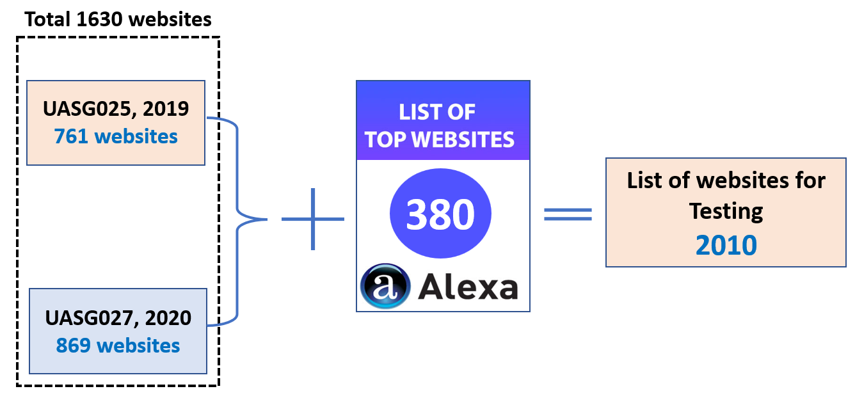
C) Identifying Alexa Top Ranked Global Websites, Functionality and Test Email Field Identification
Paid subscription was taken from Amazon for “Alexa Top Sites services APIs”.
Written webservice in Python to extract list of around 2,000 websites, ordered by Alexa Traffic Rank as on 1 Dec 2021.
These were cleaned and checked for duplicates against the 1,630 previously obtained websites (of UASG025 and UASG027). After removing duplicates, a total of 550 websites, were subjected to basic website “Functionality” and “Test Email Field Identification”.
Out of 550 websites, a few of the websites were not reachable, had illicit content, or did not have a testable email field.
After filtering, 380 websites were identified for testing, bringing the total of websites to 2,010.
A - Series
P - Series
N - Series
A - Series

Slide 10
Observations Related to Retesting of Websites
  Certain websites needed a valid mobile number of the specific country and upon receipt of OTP* the rest of the form appears to have a testable email field. These websites mostly belonged to banking, telecom, e-commerce, and government sectors.
  Country-specific sites (e.g., ministries) required valid phone for enrollment or subscription.
  Certain websites had mandatory ID fields viz. CPF, CNPJ, SSN numbers. For testing purposes, the same were generated temporarily using https://theonegenerator.com
* OTP: One Time Password
CPF stands for Cadastro de Pessoas Físicas (Brazil), which is virtual equivalent of the social security number in the United States.
CNPJ is the national registry that administers 14-digit Registration Number issued by the Ministério da Fazenda
SSN is the nine-digit Social Security Number used in the U.S.

Slide 11
Observations Related to Retesting of Websites
  For valid email IDs, a few of the sites did not provide a visual or other kind of success/failure response, but upon success redirected to home page. In such cases, we faced the challenge of taking a screenshot.
  However, whenever EAI emails were subjected to testing, the same websites gave clear indication of "Valid" or "Invalid" input. As a result, we have reversed the order of testing, i.e., from mail category C7 to C1.

Slide 12
Observations Related to Retesting of Websites
  Wherever possible, complete registration was done for C1 and C2 categories of email IDs. To complete the registration process, it was expected to click on the link sent via email, however, since we did not have credentials, the registration process was not completed.
  Most of the websites had forms (for feedback, support, subscription, etc.) which consisted of several fields including personal information. In such cases we had a strategy to input the email field only and check for any client/server-side validation. On top of this, certain fields were compulsory, which were filled.
  It was noticed that certain websites were tracking activities and did not allow multiple registrations or subscriptions from the same system, even after clearing browsing history and/or using another browser.

Slide 13
Observations Related to Retesting of Websites
  The email field in the forms of most of websites displayed error messages either on focus change from email field, or while inputting email and/or submission of email IDs in forms.
  Some sites showed error messages for all input fields at once when submitted. We tried filling the email address field only. Accordingly, results were mentioned.
  Some sites required credit card details, passport numbers etc., and were unable to complete the registration process for C1 and C2 categories of email
  Some of the sites had form submission buttons which get activated only after entering the requisite fields.

Slide 14
Observations Related to Functionality and Email Testability
Websites use JavaScript-based validation either on moving the cursor away from email field to another field (on focus change), or while inputting email or on submission of email IDs in forms.
Websites had ASCII email validation (example: [a-z]@[a-z].[a-z]) while implementing HTML input type TEXT which treats email ID as text input.
40%
40%
Websites use the HTML required Attribute for input type EMAIL, which specifies that the input element must be filled out before submitting the form and has ASCII email validation.
10%
Websites use the HTML input type as default (if input type is not mentioned, then browser considers the input as default "text"), which treats email ID as text input.
10%

Slide 15
Observations Related to Functionality and Email Testability
Certain sites had redirections, and in few cases redirection changed dynamically.
A few websites have “Login/Registration” page view on dialog/popup. Multiple clicks and views are required to reach to the registration page to locate the email field. However, the URL remains the same, and so it is necessary to note all the steps to carry out retesting.
A few of the websites had “email-based login and registration, however, it seems they have now changed login to a mobile plus OTP combination. Also, for new users, registration with email is disallowed, but existing users continue to use mail/userID/mobile for login.

Slide 16
Observations Related to Functionality and Email Testability
A few websites have upgraded to mobile plus OTP based login instead of email. Also, the email field was not observed on the contact/support/feedback pages, so these were marked and non-testable (N).
Testing team not conversant with the language of the websites faced challenges during navigation and email field identification.
Combination of a machine translation plugin such as Google Translate, and Google Lens Android applications were used for translation.
Google Translate as well as Google Lens did have their own issues. For example, Google Lens does not provide translations for placeholders of input fields.

Slide 17
Observations Related to Functionality and Email Testability
Certain sites had redirections, and in few cases, redirection changed dynamically.
Most of the banking/educational (university) sites expect an account number/unique ID/CPF/CPR to login or register and is country-specific. A CPF number generation tool (https://theonegenerator.com) was used as a temporary measure to locate the email field (CPR - civil registration number).
Certain websites were found to have:
  Illicit content
  Accessible only in a specific region
  Blocked as per region specific IT policies / Act.

Slide 18
Observations Related to Functionality and Email Testability
Tried to identify email fields at various places, such as Login/Registration, Subscribe, Contact Us, Feedback, Careers, Complaints, Newsletter pages and more. In most cases, the Contact Us page did not have a form and only provides simple email for communication.
One site uses HTML input element type as “search”.
A few of the websites have disabled copy and pasting and right clicking.
For some websites, HTML input element type is “email”, however, validation happens on defocus or at time after submission of the form by clicking Submit/Register button.
Some sites require a specific TLD/domain, e.g., gmail or .cz or @rambler.ru.

Slide 19
General Observations
Mobile number-based validation seems to be an increasing trend for online services related to e-commerce, education, banking, and government.
Additionally, email is being used to verify the authenticity of the user.

Slide 20
EAI Acceptance Rates: UASG025 and UASG027
 |  |  | C1 | C2 | C3 |  | C6 | C7
Websites | Type | test@ua-test19.com | test@ua-test19.bet | test@ua-test19.technology | test@普遍适用.com | 广场@ua-test19.com | 测试@普遍适用.公司 | عنوان@يو-اي-اختبار.شبكة
P & N series | Not tested | 761 | 0 | 0 | 0 | 0 | 1 | 1
 | Accepted | 857 | 1581 | 1374 | 810 | 260 | 152 | 150
 | Rejected | 12 | 49 | 256 | 820 | 1370 | 1477 | 1479
 | Total | 1630 | 1630 | 1630 | 1630 | 1630 | 1630 | 1630
 | Not tested % | 46.7% | 0.0% | 0.0% | 0.0% | 0.0% | 0.1% | 0.1%
 | Accepted % | 52.6% | 97.0% | 84.3% | 49.7% | 16.0% | 9.3% | 9.2%
 | Rejected % | 0.7% | 3.0% | 15.7% | 50.3% | 84.0% | 90.6% | 90.7%
 | Total % | 100% | 100% | 100% | 100% | 100% | 100% | 100%
A series | Accepted | No Previous Data
 | Rejected
 | Total
 | Accepted %
 | Rejected %
 | Total %
P Series websites ID - UASG025, 2019 websites
N Series websites ID - UASG027, 2020 websites
A series websites ID - additional Alexa top websites included in 2022

Slide 21
EAI Acceptance Rates: 2022 Results (UASG039)
 |  | C1 | C2 | C3 | C4 | C5 | C6 | C7
Websites | Type | web-test@universal-acceptance-test.icu | web-test@universal-acceptance-test.international | web-test@ሁለንአቀፍ-ተቀባይነት-ሙከራ.com | web-test@universal-acceptance-test.קום | वेब-परीक्षण@xn-----lnfbb8fe3cvkui0de0bcg5hxagsg7d5lwail.xn--i1b6b1a6a2e | 电子邮件测试@普遍适用测试.我爱你 | تجربة-الويب@تجربة-القبول-الشامل.موريتانيا
P & N series | Not tested | 0 | 0 | 0 | 0 | 0 | 0 | 0
 | Accepted | 1511 | 1310 | 855 | 563 | 125 | 137 | 124
 | Rejected | 119 | 320 | 775 | 1067 | 1505 | 1493 | 1506
 | Total | 1630 | 1630 | 1630 | 1630 | 1630 | 1630 | 1630
 | Not tested % | 0.0% | 0.0% | 0.0% | 0.0% | 0.0% | 0.0% | 0.0%
 | Accepted % | 92.7% | 80.4% | 52.5% | 34.5% | 7.7% | 8.4% | 7.6%
 | Rejected % | 7.3% | 19.6% | 47.5% | 65.5% | 92.3% | 91.6% | 92.4%
 | Total % | 100% | 100% | 100% | 100% | 100% | 100% | 100%
A series | Accepted | 354 | 316 | 195 | 138 | 38 | 38 | 40
 | Rejected | 26 | 64 | 185 | 242 | 342 | 342 | 340
 | Total | 380 | 380 | 380 | 380 | 380 | 380 | 380
 | Accepted % | 93.2% | 83.2% | 51.3% | 36.3% | 10.0% | 10.0% | 10.5%
 | Rejected % | 6.8% | 16.8% | 48.7% | 63.7% | 90.0% | 90.0% | 89.5%
 | Total % | 100.0% | 100.0% | 100.0% | 100.0% | 100.0% | 100.0% | 100.0%

Slide 22
EAI Acceptance Rates: 2022 Results (UASG039)
Email Category |  | C1 | C2 | C3 | C4 | C5 | C6 | C7
 |  | ascii@ascii.newshort | ascii@ascii.newlong | ascii@idn.ascii | ascii@ascii.idn | Unicode@ascii.ascii | Unicode@idn.idn | RTL@RTL.RTL
Year 2022 |  | web-test@universal-acceptance-test.icu | web-test@universal-acceptance-test.international | web-test@ሁለንአቀፍ-ተቀባይነት-ሙከራ.com | web-test@universal-acceptance-test.קום | वेब-परीक्षण@xn-----lnfbb8fe3cvkui0de0bcg5hxagsg7d5lwail.xn—i1b6b1a6a2e | 电子邮件测试@普遍适用测试.我爱你 | تجربة-الويب@تجربة-القبول-الشامل.موريتانيا
 | Accepted | 1865 | 1626 | 1050 | 701 | 163 | 175 | 164
 | Rejected | 145 | 384 | 960 | 1309 | 1847 | 1835 | 1846
 | Total | 2010 | 2010 | 2010 | 2010 | 2010 | 2010 | 2010
 | Accepted% | 92.79% | 80.90% | 52.24% | 34.88% | 8.11% | 8.71% | 8.16%
 | Rejected% | 7.21% | 19.10% | 47.76% | 65.12% | 91.89% | 91.29% | 91.84%
 | Total% | 100% | 100% | 100% | 100% | 100% | 100% | 100%

Slide 24
EAI Acceptance Rates: 2019 (UASG025) vs. 2022 (UASG039)
Email Category |  | C1 | C2 | C3 | C4 | C5 | C6 | C7
 |  | ascii@ascii.newshort | ascii@ascii.newlong | ascii@idn.ascii | ascii@ascii.idn | Unicode@ascii.ascii | Unicode@idn.idn | RTL@RTL.RTL
UASG025 Year 2019 | Type | test@test.exp | test@test.example | test@普遍接受-测试.org | NA | 测试1@test.org | 测试5@普遍接受-测试.世界 | دون@رسيل.السعودية
 | Accepted | 741 | 647 | 395 |  | 92 | 51 | 47
 | Rejected | 20 | 114 | 366 |  | 669 | 710 | 714
 | Total | 761 | 761 | 761 |  | 761 | 761 | 761
 | Accepted% | 97% | 85% | 52% |  | 12% | 7% | 6%
 | Rejected% | 3% | 15% | 48% |  | 88% | 93% | 94%
 | Total% | 100% | 100% | 100% |  | 100% | 100% | 100%
UASG039 Year 2022 |  | web-test@universal-acceptance-test.icu | web-test@universal-acceptance-test.international | web-test@ሁለንአቀፍ-ተቀባይነት-ሙከራ.com | web-test@universal-acceptance-test.קום | वेब-परीक्षण@xn-----lnfbb8fe3cvkui0de0bcg5hxagsg7d5lwail.xn—i1b6b1a6a2e | 电子邮件测试@普遍适用测试.我爱你 | تجربة-الويب@تجربة-القبول-الشامل.موريتانيا
 | Accepted | 697 | 627 | 403 | 256 | 47 | 54 | 45
 | Rejected | 64 | 134 | 358 | 505 | 714 | 707 | 716
 | Total | 761 | 761 | 761 | 761 | 761 | 761 | 761
 | Accepted% | 92% | 82% | 53% | 34% | 6% | 7% | 6%
 | Rejected% | 8% | 18% | 47% | 66% | 94% | 93% | 94%
 | Total% | 100% | 100% | 100% | 100% | 100% | 100% | 100%

Slide 25
EAI Acceptance Rates: 2019 vs. 2022
Note: email ID: वेब-परीक्षण@xn-----lnfbb8fe3cvkui0de0bcg5hxagsg7d5lwail.xn—i1b6b1a6a2e (category unicode@A-label.A-label) is included in unicode@ascii.ascii for comparison purposes

Slide 26
EAI Acceptance Rates: 2020 (UASG027) vs. 2022 (UASG039)
Email Category |  | C1 | C2 | C3 | C4 | C5 | C6 | C7
 |  | ascii@ascii.neshort | ascii@ascii.newlong | ascii@idn.ascii | ascii@ascii.idn | Unicode@ascii.ascii | Unicode@idn.idn | RTL@RTL.RTL
UASG027 Year 2020 | Type | test@ua-test19.bet | test@ua-test19.technology | test@普遍适用.com | NA | 广场@ua-test19.com | 测试@普遍适用.公司 | عنوان@يو-اي-اختبار.شبكة
 | Accepted | 840 | 727 | 415 |  | 168 | 101 | 103
 | Rejected | 29 | 142 | 454 |  | 701 | 767 | 765
 | Total | 869 | 869 | 869 |  | 869 | 868 | 868
 | Accepted% | 97% | 84% | 48% |  | 19% | 12% | 12%
 | Rejected% | 3% | 16% | 52% |  | 81% | 88% | 88%
 | Total% | 100% | 100% | 100% |  | 100% | 100% | 100%
UASG039 Year 2022 |  | web-test@universal-acceptance-test.icu | web-test@universal-acceptance-test.international | web-test@ሁለንአቀፍ-ተቀባይነት-ሙከራ.com | web-test@universal-acceptance-test.קום | वेब-परीक्षण@xn-----lnfbb8fe3cvkui0de0bcg5hxagsg7d5lwail.xn—i1b6b1a6a2e | 电子邮件测试@普遍适用测试.我爱你 | تجربة-الويب@تجربة-القبول-الشامل.موريتانيا
 | Accepted | 814 | 683 | 452 | 307 | 78 | 83 | 79
 | Rejected | 55 | 186 | 417 | 562 | 791 | 786 | 790
 | Total | 869 | 869 | 869 | 869 | 869 | 869 | 869
 | Accepted% | 94% | 79% | 52% | 35% | 9% | 10% | 9%
 | Rejected% | 6% | 21% | 48% | 65% | 91% | 90% | 91%
 | Total% | 100% | 100% | 100% | 100% | 100% | 100% | 100%
Note: email ID: वेब-परीक्षण@xn-----lnfbb8fe3cvkui0de0bcg5hxagsg7d5lwail.xn—i1b6b1a6a2e (category unicode@A-label.A-label) is included in unicode@ascii.ascii for comparison purposes.

Slide 27
EAI Acceptance Rates: 2020 vs. 2022

Slide 28
EAI Acceptance Rates: 2017 to 2022

Slide 29
EAI Acceptance Rates: P-N Series vs. A Series
 |  | C1 | C2 | C3 | C4 | C5 | C6 | C7
Websites | Type | web-test@universal-acceptance-test.icu | web-test@universal-acceptance-test.international | web-test@ሁለንአቀፍ-ተቀባይነት-ሙከራ.com | web-test@universal-acceptance-test.קום | वेब-परीक्षण@xn-----lnfbb8fe3cvkui0de0bcg5hxagsg7d5lwail.xn--i1b6b1a6a2e | 电子邮件测试@普遍适用测试.我爱你 | تجربة-الويب@تجربة-القبول-الشامل.موريتانيا
P-N series | Accepted % | 92.70% | 80.40% | 52.50% | 34.50% | 7.70% | 8.40% | 7.60%
A series | Accepted % | 93.20% | 83.20% | 51.30% | 36.30% | 10.00% | 10.00% | 10.50%

Slide 30
EAI Acceptance Rates: P-N Series vs. A Series

Slide 31
Observations
It was observed that there is no major difference between the EAI acceptance rates of the 2020 and 2022 reports. However, the 2022 EAI acceptance rates are marginally lower than in the 2020 report (UASG027), which may be attributed to:
  The use of a different URL PATH for email field testability since the previous path failed in providing email fields for testing.
  Certain websites found to be non-working and non-responsive (which were removed from retesting).
  In certain cases, forms that had an email field underwent changes.
  It is interesting to note that for the email category ascii@idn.ascii there is an increasing trend in acceptance of 2019 vs 2022 and 2020 vs 2022.

Slide 32
Observations
  Certain websites have put limits on the maximum number of characters the user can enter in the email ID field.
  The test email ID of the category ascii@ascii.long used in previous UASG025 and UASG027 testing had a maximum of 25 characters, while the test email ID of the same category in the current study had around 48 characters.
  The test email ID of category Unicode@ascii.ascii used in previous UASG025 and UASG027 testing had a maximum 16 characters, while the email category used in current 2022 testing, Unicode@A-label.A-label, with which the previous results were compared had 71 characters.
  Because of the limit on the number of characters in the email field, we see a decrease in the EAI acceptance rate from 12% (2019) to 6% (2022) for the websites tested in UASG025.
  Similarly, because of a limit on the number of characters in the email field, we see a decrease in the EAI acceptance rate from 19% (2020) to 9% (2022) for the websites tested in UASG027.

Slide 33
Observations
  The comparison of acceptance rates of UASG025 (P-Series), UASG027 (N-Series) vs. A Series (newly added websites as of 1 December 2021) shows an overall increase, which is encouraging.
  It is observed that a few of the websites have whitelisted specific TLDs (i.e., only emails from those domains are permissible).
  While inspecting the email field in various forms of websites, it was observed that the email field had values for HTML <input> element “Type” attribute as shown.
HTML <input> element “Type” attribute

Slide 34
Recommendations for the Next Round of Testing
  Check the email field size for the maximum number of characters, and more specifically, A-label form domain names.
  Technology stack used for front and back end to better understand all IDNA libraries that are required to achieve EAI compliance.
  HTML input element type’s attribute used.
  Validation mechanisms used.
  If a given website accepts EAI, then figure out in broad terms how the same is being achieved.
  If a given website accepts EAI, then undertake testing of sending and receiving EAI emails.

Slide 35
Recommendations for the Next Round of Testing
  Undertake a focused study of government websites from different countries. Such a list can be obtained from public portals or the respective country’s ministries/ IT departments/ agencies.
  Conduct UA remediation outreach to these websites by taking help from the respective country’s ministries/IT departments/agencies/organizations. If required, get help from UA Ambassadors, ICANN Governmental Advisory Committee (GAC) members, observers, and their country representatives.
  UA-ready websites should be models for others in different industries.
  Academic websites can also be included in UA compliance and remediation, since a large number of students/users are accessing the same sites on a day-to-day basis.

