Slide 1
Measuring the Universal Acceptance (UA) Readiness of Popular Web Hosting Tools
UASG 042

Slide 2
Project purpose
The purpose of the project is to determine to what extent cPanel, Plesk and ISPConfig ("Web Hosting Tools") offer the capacity for customers to build websites and host emails in accordance with Universal Acceptance.

Slide 3
High-Level Test Plan and Methodology
All basic functions relevant to UA for domain names and email addresses were tested for input, validation, storage, processing, and display:
Domain names can be entered using native script and the correct encoding schemes are followed.
  Supporting Unicode input, processing, and display in UTF-8 format.
  Normalization of Unicode string into NFC form.
  Conversion between U-label and A-label forms of the domain name.
  Validating labels based on Unicode.
Email addresses can be entered using native script and are encoded correctly.
  Validating internationalized email addresses based on Unicode and IDNA2008.
  Storing IDNs and internationalized email addresses.
Email can be sent, received, and read in the appropriate script.
  Sending out an email message using internationalized email addresses.
Web service can be set up using native script.
Management visualizes all these settings correctly and in the original script.
The purpose of the assessment was to determine if native scripts are accepted and handled correctly throughout the setup. This includes management of services as well as the services.

Slide 4
Environment Configurations Used for Testing
We initially installed all Linux distributions and then tried to install the web hosting tools in the configurations chosen above. It turns out that the web hosting tools are either not available on some of the chosen Linux distributions, or only available on a different OS version. Additionally, some web hosting tools do not support either the proposed email server or database.
NOTE: The testing revealed that the environment configuration is not that relevant for the project scope.

Slide 5
Environment Configurations Used for Testing
Web Hosting Tool | OS | Web Server version | Email Server | Database
cPanel 104.0.7 | Rocky Linux 8.6 (Green Obsidian) | Apache 2.4.54 | Exim 4.95 (Dovecot 2.3.18) | MySQL 8.0.29 for Linux on x86_64 (MySQL Community Server - GPL)
 | Ubuntu 20.04 LTS | Apache 2.4.54 | Exim 4.95 (Dovecot 2.3.18) | MySQL 8.0.29 for Linux on x86_64 (MySQL Community Server - GPL)
 | CentOS Linux 7 (Core) | Apache 2.4.54 | Exim 4.95 (Dovecot 2.3.18) | MySQL 5.7.38, for Linux (x86_64) using EditLine wrapper
Plesk Obsidian Web Host Edition Version 18.0.45 | AlmaLinux 8.6 (Sky Tiger) | Apache 2.4.37 - serves Plesk admins and resellers nginx 1.20.2 - serves end users | Postfix 3.5.14 (Dovecot 2.3.18) | MariaDB 10.3-32, for Linux (x86_64) using readline 5.1
 | Debian GNU/Linux 11 (bullseye) | Apache 2.4.54 - serves Plesk admins and resellers nginx 1.20.2 - serves end users | Postfix 3.5.13 (Dovecot 2.3.18) | MariaDB 10.5-15, for debian-linux-gnu (x86_64) using EditLine wrapper -for Plesk management PostgreSQL 13.7 - for end users
 | Windows 10 | Microsoft IIS 10.0 | MailEnable Standard 10.34 | MariaDB 10.6
ISPConfig 3.2.2 | openSUSE Leap 15.4 | Apache 2.4.51 | Exim 4.94.2 (Dovecot 2.3.15) | MySQL 8.0.29 for Linux on x86_64 (MySQL Community Server - GPL)
 | Oracle Linux Server 8.6 | Apache 2.4.37 | Postfix 3.5.8 | MySQL 8.0.26 for Linux on x86_64 (Source distribution)
 | Fedora Linux 36 (Server Edition) | Apache 2.4.54 | Postfix 3.6.4 | MariaDB 10.5-16, for Linux (x86_64) using EditLine wrapper

Slide 6
Executive Summary
The assessment reveals that none of the web hosting tools tested (cPanel, Plesk and ISPConfig) comply with the defined objectives of the Universal Acceptance Steering Group (UASG). Since a number of underlying services are not ready to support local scripts, the creators of the web hosting tools block any non-ASCII characters throughout most of their interfaces.
When it comes to the support of the underlying tools, we were surprised to see several frequently used tools lag behind in native script support. Dovecot as a POP/IMAP providing service should not interfere with anything encoding related although that is easier said than done. When looking through their code stack, it seems they have mainly been focusing on providing a rich feature set and supporting UTF-8 would be quite a task. No quick fix there.

Slide 7
Executive Summary
Considering the three web hosting tools tested, we believe that Plesk has the highest chance of providing a full local script experience because it offers a file access tool. As such, the whole user experience could be driven through a web interface. With Plesk, email, domain name, user, database, and files can be managed using various web services all available from a local native script supporting web browser.
Such tools could also be installed on the other web hosting tools making them fully web browser managed but this would require additional installation and configuration steps.
On the other hand, ISPConfig has the advantage of being an open-source web hosting tool and allows making ad hoc changes. For those willing and capable of doing their own patches and updates, this might be a good way forward to implement a full native script experience.

Slide 8
Executive Summary
The three web hosting tools tested are aware of local scripts as they provide additional services to translate their interface into any language. A decent set of already supported languages in various scripts does exist or can be accessed on demand. Overall, many of the underlying services have been made UTF-8 aware. This should drive the web hosting tools to support more local scripts in the future and provide a full local script experience.

Slide 9
Test Results: Overall Test Scenario Status
The assessment reveals that none of the “Web Hosting Tools” in the specified configurations (or any other configuration) are in full compliance with the UASG defined objectives.
It is worth mentioning that none of the web servers and Email servers have UTF-8 enabled by default. They require additional steps to enable it. However, although UTF-8 support was enabled for email servers, the Email tests didn’t pass.
After we set up the environments, we first tested the environment UTF-8 compliance, then performed additional steps where needed, and only afterwards, started the actual testing of the web hosting tools. One notable exception is Exim on openSUSE (ISPConfig). We could not enable STMPUTF8 for Exim as openSUSE’s Exim package is not build with SMTPUTF8 support. The openSUSE team must have compiled the wrong Exim file. There was nothing we could do to fix this.
The table on the next slide provides the overall results per web hosting tool feature, including the UTF-8 compliance of the environment in default installation. To understand how the overall status has been provided, we refer to the test scenarios and see how they are broken down into high-level test cases. If for example, a test case needs additional steps (work) to pass, the overall feature status is “Test passed after additional steps (W)”. The exception is the situation when a test case within a test scenario fails, and in this case, the overall feature status is “Failed / F”.

Slide 10
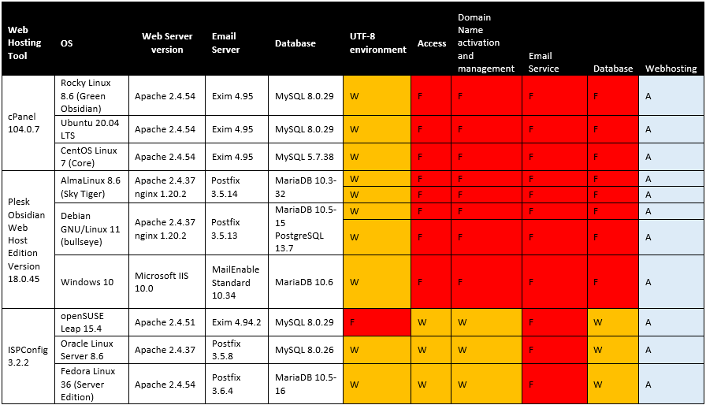
Test Results: Overall Test Scenario Status

Slide 11
Test scenarios and test cases
# | Test Scenario | Category | Test Case Summary
1 | Test environment configuration | ENV | 1.1 Check if the web server supports UTF-8 in default installation. 1.2 Check if the DB supports UTF-8 in default installation. 1.3 Check if Email system is UTF-8 compliant.
2 | Test access | ACC | 2.1 Create accounts with different roles using UTF-8 credentials. 2.2 Check that those accounts can log in.
3 | Test Domain | DN | 3.1 Create domain names, check that they are properly visualized and manage zones.
4 | Test Email | MAIL | 4.1 Create UTF-8 mailboxes that allow sending and receiving emails. 4.2 Create UTF-8 email aliases for the mailboxes. 4.3 Send and read emails to/from UTF-8 mailboxes and UTF-8 email aliases and check their content is ok.
5 | Test Database | DB | 5.1 Create DB user accounts with UTF-8 credentials and check that you can access the DB with those accounts. 5.2 Check that you can store and extract data in native scripts into and from the DB.
6 | Test Website Hosting | WEB | 6.1 Publish a website for the web domain names.

Slide 12
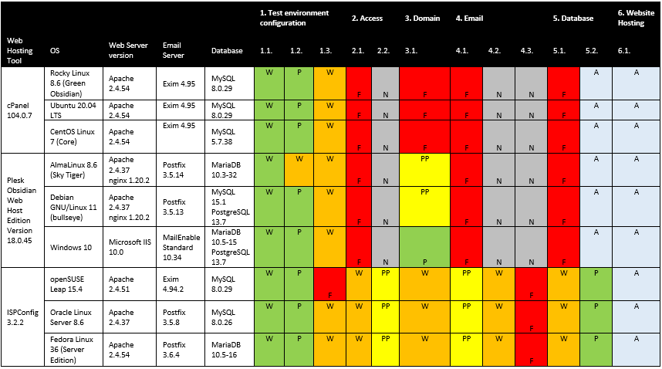
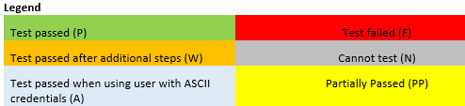
Test Results: Detailed Test Result per Test Case

Slide 13
1. Test environment configuration results
When installing the different Linux distributions, it is apparent that installing any of these has become quite straightforward. Most of the underlying software does support UTF-8 character sets in some form either out of the box or by some simple changes in the configuration. For instance, all installed FTP services are configured to use a database. The link with this database is UTF-8 compliant if the database is set to be UTF-8 compliant.
The same goes for tools such as virus scanner, SPAM protection, database, DNS, and file storage. Even the Linux user management system allows for UTF-8 compliant users albeit with the note that you would have to supply the “--badname” flag to create the user (see manpage about useradd).
Some of the tools installed already embrace the UTF-8 character set and various global languages. Most notably, phpMyAdmin, a tool to manipulate the database and its content via a web interface, and RoundCubeMail, a tool to read and manage your personal email box via a web interface.

Slide 14
2. Access (accounts creation) results
Visiting the web hosting tools shows that all three take the prudent approach of blocking UTF-8 characters when it comes to user identification and email addresses. A decision that considering the above arguments is certainly understandable.
We took the liberty to circumvent a number of these on ISPConfig. Since this tool is open source, it can easily be adapted and changed at will. If one does make this type of change, it shows the strengths and the weaknesses of the underlying system and services. Some are quick and easy fixes as with the DNS provided system.
Here the accept, validate, process, and store cycle have been ironed out already. Both UTF-8 as well as IDNA A-labels can be provided. The only thing missing is the display step where the names are visualized in the ASCII-based format rather than the desired UTF-8 format. By simply adding the filter that is already provided, the display part can be fixed to do the right thing.

Slide 15
2. Access (accounts creation) results
At this point most of the services have embraced UTF-8 to a certain extent. With little effort, some of the experiences can be made a lot less painful. All web hosting tools do provide a set of languages they support and allow a specific language to be added on demand.
Some of the tools allow for an almost 100 percent web-based experience. If all underlying services would support UTF-8, it would be possible for small businesses to create and manage their web presence and email through an all-native interface. However due to the lack of support of some tools at this point, none of the web hosting packages are close to providing such an experience.

Slide 16
3. Email results
There were certainly some disappointing pain points where the lack of compliance shows. One of the major pain points is email. Postfix, the most widely used tool to send and receive email, can be configured to support SMTPUTF8. However, only the local part of the email address can be shared in UTF-8 format. The part specifying the domain name must be converted to IDNA A-label to be accepted.
Going further down the email path, the service that provides POP and IMAP delivery services does not support UTF-8. So even if the tool sets described above would be made UTF-8 compliant and the web-hosting tool would allow for UTF-8 email addresses, the delivery still would fail.
Getting the email system to work turns out to be difficult. Even though setting up the web interface to accept UTF-8 email addresses turns out to be just a small challenge, getting the full-service stack to work is a daunting task. Note that even the build-in PHP email check on which ISPConfig relies does not allow UTF-8 characters (neither in the local part, nor in the domain name part).

Slide 17
4. Domain results
cPanel does not allow creation of IDNs and zone records in native scripts. You must use an external IDN converter and create domain names and add zone records in Punycode. This affects the user experience heavily as it would make it nearly impossible to manage your DNS records from within the provided web hosting tool.
Plesk on Windows allows the creation of IDNs and zone records in native scripts and their proper visualization in the interface; Plesk on Linux allows it, except for Malayalam. For Malayalam, Plesk on Linux fails in some situations (it does not work out for some domain names). The Plesk team will investigate this.
ISPConfig requires installation of an additional patch for the proper visualization of IDNs in the web interface.

Slide 18
5. Databases results
Both cPanel and Plesk do not allow the creation of databases and DB users in native scripts.
When allowing native script databases to be generated from the ISPConfig web interface, a double or mismatching encoding problem arises. Although the metadata such as database name and database user seem to be validated and stored consistently, we can clearly see it is not visualized correctly. We are not sure if this is due to a misconfiguration in the PHP MySQL layer or if this is related to a MySQL library mismatch problem. Further examination is needed but deemed out of scope for this study.

Slide 19
6. Web Hosting results
Another thing to consider is the client tools that must be used to access the web hosting tools. Notably, if you try to upload files you will need an FTP/SFTP client. Although there are many of these tools available, are they providing this service in native scripts and are they allowing UTF-8 login credentials?
Obviously, these are questions that are out of scope for this particular report.

Slide 20
Conclusion
None of the “Web Hosting Tools” (cPanel, Plesk and ISPConfig) are in compliance with the UASG defined objectives.
These tools rely on other underlying tools to be UTF-8 compliant and they are not.
Bug Reports and Feature Requests were submitted to cPanel and Plesk – while Plesk assigned two of the feature requests to their development (marking two as being duplicates), cPanel added all feature requests to their backlog (status NOT PLANNED).
ISPConfig – The patches we created to allow UTF-8 accounts, email and IDN creation do not provide a 100 percent working solution, we think it is not worth submitting these patches to the ISPConfig on GitHub.

