Slide 1
UA-Ready Code Samples in Java, Python, and JavaScript
Cofomo Inc. / October 2022

Slide 2
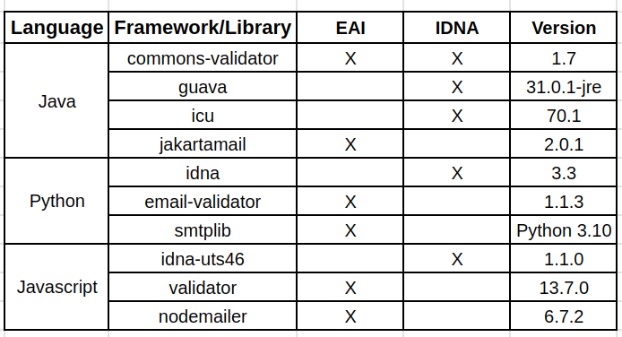
Target Languages and Libraries
10 libraries

Slide 3
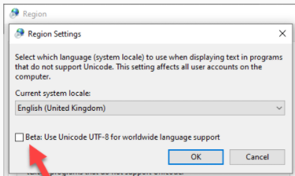
General Recommendations
Centralize processing of emails and domain names to avoid using different versions of the protocols.
Refer to the general guidelines in UASG 026 UA-Readiness Framework.
Ensure staying up to date with new versions: JavaMail -> JakartaMail (compliance with EAI only since 1.6.4 in 2019).
Avoid validations based on a static list of TLDs (during a 10-day period in November 2019, 7 TLDs were removed from the root).
Check “UTF-8 support beta feature” if developing/deploying on Windows.

Slide 4
Java
IDNs:
Avoid using java.net.IDN since it is based on IDNA2003.
Prefer com.ibm.icu.text.IDNA when the choice is available.
EAI:
Use the latest JakartaMail, the re-brand (maintained) version of JavaMail by Eclipse.
The following slides discuss possible and correct usage of the following libraries:
Commons Validator
Guava
ICU
JakartaMail

Slide 5
Java: Common Validators
IDNA:
Uses a static list of TLDs
However, one can provide his or her own static list as input to the library.
By fetching the latest updated list of TLDs from IANA and caching it for a short period of time, one can validate domains the following way:
It’s also possible to provide the TLD of the domain to be tested in A-label form directly to the validator being instantiated to avoid the process of validating the TLD against the IANA list.
Once the domain validator is properly instantiated, one can provide it to the UrlValidator

Slide 6
Java: Common Validators
EAI:
Like UrlValidator, EmailValidator accepts a DomainValidator instance:
“lastIndexOf” is important here, because emails can contain ‘@’ in the local part if it is wrapped in double quotes.
Bug report:
Domain validator converts the domain to A-label with java.net.IDN that is only IDNA 2003 compliant

Slide 7
Java: Guava
IDNA
Only performs some basic checks (label length, no ending dash, etc.) on domain names.
IDNs are accepted by default without further validation so another validation should be performed.
Can only be used to check whether the domain is in the public suffix list, which is not a reliable method to consider a domain as invalid.
Bug report:
Pull request to clarify the documentation about IDN

Slide 8
Java: ICU
IDNA
Convert domain to A-label prior to using it on wire. This mitigates the risk induced by other libraries which may have a poor UA compliance level.
Combination of flags to be fully compliant with IDNA2008:
Bug report:
ICU performs some normalization on domain and therefore, some invalid characters as per IDNA 2008 but valid as per UTS46 are considered valid

Slide 9
Java: Jakarta Mail
EAI
Some valid Unicode characters as per IDNA 2008 are rejected, in such cases, convert domain to A-label.
convertDomainToAlabel use ICU discussed earlier.
Session transport must be initialized with allowutf8:

Slide 10
Java: Jakarta Mail
EAI
In case the remote server does not support SMTPUTF8 extension and only the domain is a U-label (local part is ASCII), conversion to an A-label becomes an appropriate way to send the email:

Slide 11
Java: Jakarta Mail
EAI
Finally, when everything is validated and ready to send, add the proper headers to the message:
Bug reports
Some valid domains are considered invalid

Slide 12
Python
IDNs:
Avoid using Python native module encodings.idna which implements IDNA2003.
Prefer idna lib.
The following slides discuss possible and correct usage of the following libraries:
idna
email validator
smtplib

Slide 13
Python: IDNA
IDNA
Fully IDNA 2008 compliant.
Does not perform any normalization before converting the domain. Make sure to normalize before using the library:
Ongoing discussion to make it a replacement to the Python idn module that implements IDNA 2003.

Slide 14
Python: Email Validator
EAI
Common email addresses validation (means that some valid email addresses per RFCs may be rejected, but only for edge cases).
EAI, however, is correctly supported and IDN validation is performed with the IDNA library.
check_deliverability option make a DNS query in order to ensure that the email address domain exists. Depending on the volume of email addresses to validate, it can be interesting to enable it (here we disabled it).

Slide 15
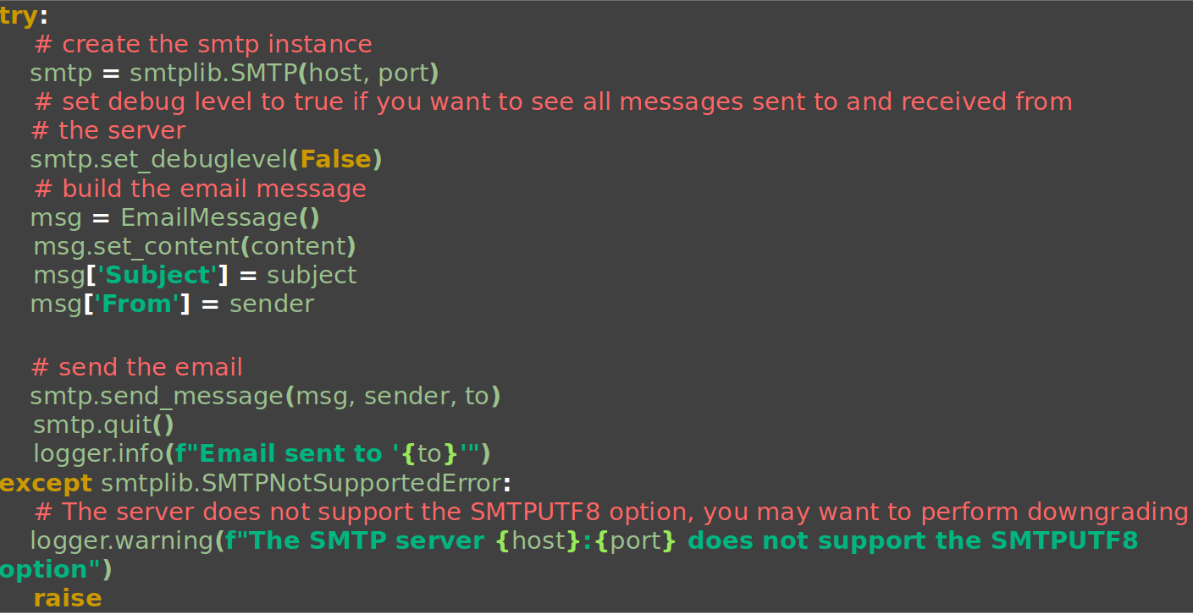
Python: smtplib
EAI
Used to send EAI compliant emails.
Supports EAI since Python 3.5.
Partial validation of the email address (please use email-validator beforehand).

Slide 16
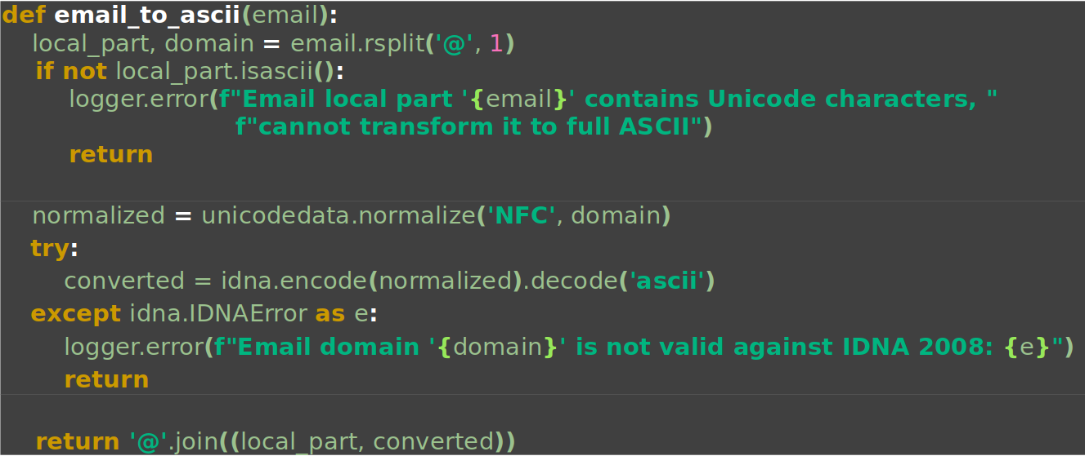
Python: smtplib
EAI
If the remote server does not support SMTPUTF8 option and local-part is ASCII only, email address can be downgraded by transforming domain into A-label.

Slide 17
Javascript
IDNs:
URL WHATWG native javascript object automatically converts to ASCII. This conversion is sometimes using IDNA2003 or IDNA2008 depending on the browser and the installation of NodeJS if server-side.
Please use an RFC compliant library like uri-js instead of the URL object, especially when running code client-side.
Bug reports
Illegal characters in URL do not raise an exception (LDH rule)
IDNA2008 DISALLOWED characters are permitted in URL
The following slides discuss possible and correct usage of the following libraries:
Idna-uts46
validator
nodemailer

Slide 18
Javascript: idna-uts46
IDNA
Known issues: doesn’t support BIDI and contextual rules.
Project no longer maintained. CentralNic fork (called idna-uts46-hx) took over the maintenance and ensure new Unicode versions are supported.
Transitional=false ensures we are on the IDNA2008 protocol.
useStd3ASCII=true ensures we allow only LDH domains.
verifyDnsLength=true ensures we do not allow a domain label to exceed 63 characters.

Slide 19
Javascript: validator
EAI
Validation EAI compliant.
Can use client-side and server-side as-is.

Slide 20
Javascript: nodemailer
EAI
Automatically transform the domain part into a A-label when possible.
Checking compliance of remote with SMTPUTF8 is on the shoulder of the developer:
Bug report:
No error for internationalized emails when the SMTP server doesn't support SMTPUTF8

Slide 21
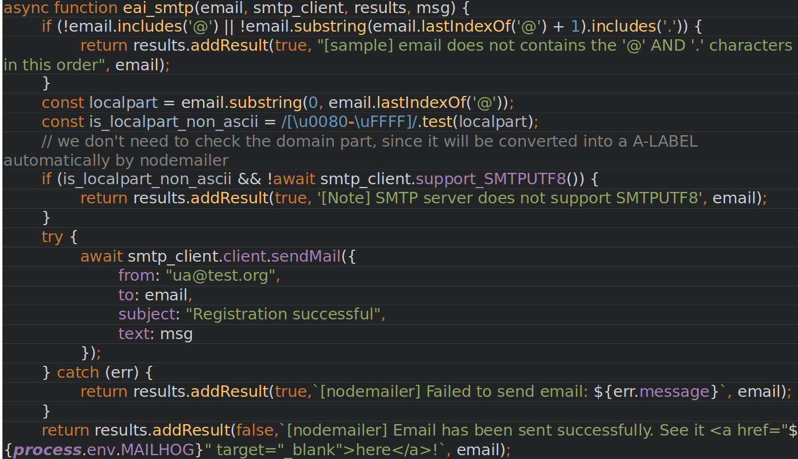
Javascript: nodemailer
EAI (complete example):

Slide 22
Resources
All resources, bug reports, and detailed results are available at:
https://github.com/icann/ua-code-samples

