Slide 1
UA Remediation for Top Global Websites
EVARIS Systems LLP / UA Technology Working Group / May 2023
UASG046A

Slide 2
Objectives
  This report focuses on the outcomes as well as the UA remediation process undertaken to make websites UA-ready. It includes:
  Understanding the platform and technology stack used while developing the websites.
  Possible changes for making the website UA-ready.
  Suggesting changes along with suitable pseudo code, and use of requisite library.

Slide 3
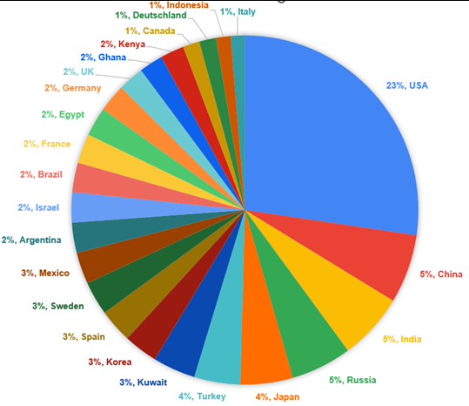
Country-Wide Distribution of Websites Used in UASG039 Testing
SN | Country | Website count | Percentage out of 1796
1 | USA | 420 | 23%
2 | China | 98 | 5%
3 | India | 95 | 5%
4 | Russia | 87 | 5%
5 | Japan | 75 | 4%
6 | Turkey | 66 | 4%
7 | Kuwait | 61 | 3%
8 | Korea | 49 | 3%
9 | Spain | 48 | 3%
10 | Sweden | 48 | 3%
11 | Mexico | 45 | 3%
12 | Argentina | 43 | 2%
13 | Israel | 43 | 2%
14 | Brazil | 42 | 2%
15 | France | 42 | 2%
16 | Egypt | 41 | 2%
17 | Germany | 40 | 2%
18 | UK | 37 | 2%
19 | Ghana | 34 | 2%
20 | Kenya | 34 | 2%
21 | Canada | 24 | 1%
22 | Deutschland | 24 | 1%
23 | Indonesia | 21 | 1%
24 | Italy | 20 | 1%
The chart shows total count of 1796 websites from 24 countries.
Notes:
Able to find out country details for 1796 out of 2010 websites which were undertaken for testing.
The chart shows total count of 1796 websites from 24 countries.

Slide 4
Campaign – Overall status
Delivery Rate | 85 %
Open Rate | 60 %
Link Click Rate | 35 %
Automated Response | 25 %
Manual Response | 0.4 %

Slide 5
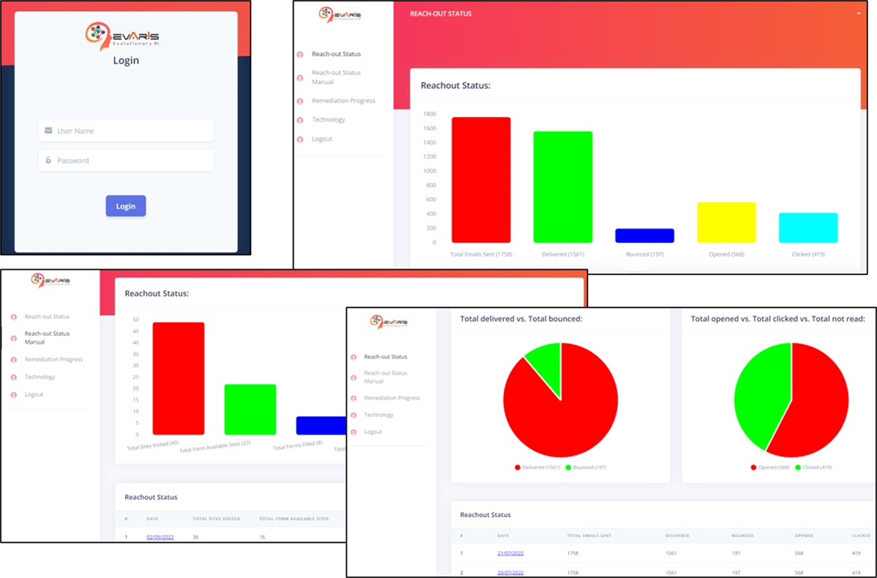
Dashboard
  Different APIs provided by MailChimp for status of the email (i.e. delivered, read, bounced, clicked, and others) were used and the final status was prepared in.csv files, which are being used for dashboard updating on a regular basis.

Slide 6
UA-Readiness of Websites
 | Number | Status
Unable to proceed further | 19 | − Website developers backed out from implementation without citing any reason
Unable to evaluate | 7 | − Problem while sending the form. − Email field not found. − Email field not available, however only Google form was available. − Provided Facebook URL instead of website.
Unable to implement fully | 8 | Contact form 7 plugin related issues
UA-ready | 22 | Result of remediation efforts undertaken by project team
TOTAL | 56

Slide 7
UA Implementation of 22 Websites
  20 websites were provided with the solutions to become UA-ready.
  Out of 22 UA-ready websites, 10 websites were developed in PHP and Laravel and 2 websites were developed in PHP. As such, the PHP-based solution was recommended and implemented.
  A further 5 websites were designed in HTML Bootstrap and 4 websites were in WordPress. For these HTML Bootstrap and WordPress sites, we recommended to use a JS-based solution.
  Although the TDIL website was making use of PHP, both the solutions were explained. The JS-based solution was implemented.
Implementor feedback

Slide 8
Contact Form 7 Plugin-Related Issues
  An additional 8-10 websites would have become UA-ready, but these websites made use of third-party WordPress plugins, namely “Contact Form -7”. We tried to have a workaround but it did not yield the desired results.
  It is difficult to achieve UA-readiness by either overriding and or writing wrapper on the existing contact form 7 plugin.
  Issue with implementing IDNA library in contact form 7 or other contact forms in WordPress.
    Plugin provider implements the server-side validation. In case we override the client-side validation using our UI API and validate, then also, after validation contact form plugin sends data to the server.
    After receiving the data at server side, WordPress plugin again validates the data at server side as per server-side implementation.
    Developer is not permitted to change the server-side code because of copyright issues or security issues where source code is not allowed to change.
  In such cases, we need to approach the plugin owner/developer to educate them about need of a UA compliant plugin.

Slide 9
Overall Challenges in Implementation
  Takes time to get permissions from the client or website owner for the changes to be made on their website.
  Since certain tasks are allocated to specific developer(s), availability of these developers is a challenge. Takes time to get developers the time to implement.
  Since developers do not have much knowledge about Universal Acceptance and EAI, it took several calls and meetings to explain and also walk through the implementation details, including pseudo code and procedure.
  It was time consuming to take necessary permissions and get developer availability (window period for implementation) since UA implementation was not a priority.
  Daily follow ups were required with respective parties through WhatsApp messages, email, and voice calls.

Slide 10
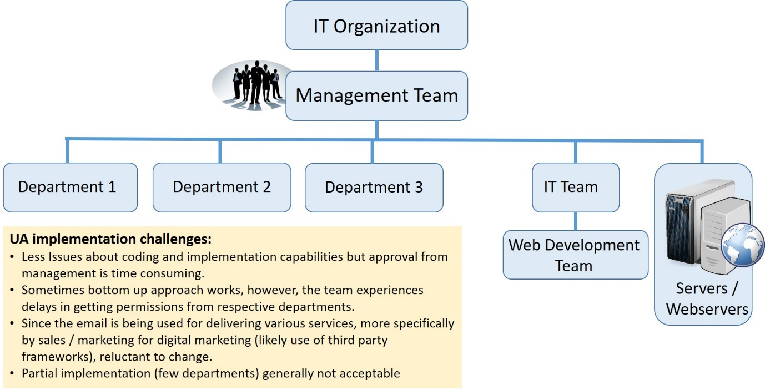
A Typical IT Organization Setup

Slide 11
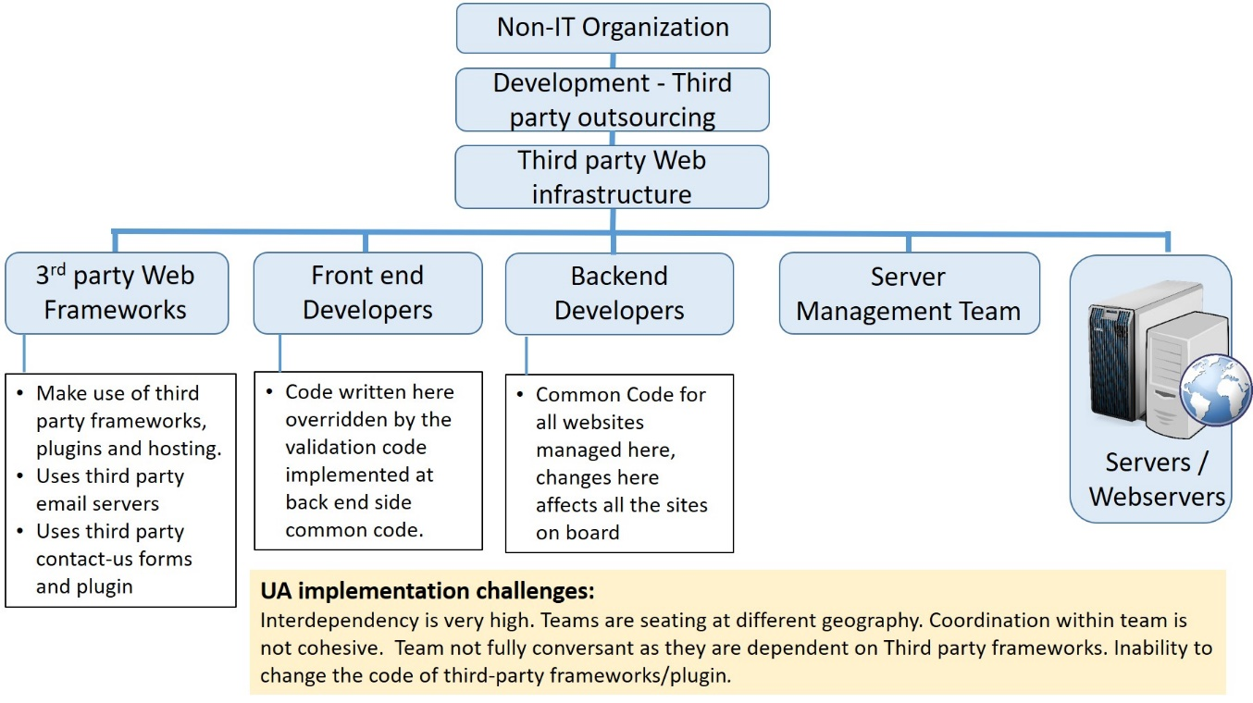
A Typical Non-IT Organization Setup

Slide 12
Challenges Faced: IT and Non-IT Organizations
  At first instance, website owners, though they understood the importance of UA compliance, have not shown interest in implementing it immediately. Rather they were reluctant to make the changes in existing working sites because of various reasons.
  Since website development and maintenance is outsourced (more specifically in non-IT organizations) they were unable to allocate the task and make developers available. Issues were also related to financial involvement for changes and priority of activity.

Slide 13
Challenges Faced: IT and Non-IT Organizations
  In the case of certain sites, the implementations were required to be done at the frontend and backend. In certain cases the frontend working teams and backend working teams were different and only have respective permissions (i.e., frontend developer cannot make changes in the backend application.)
  In some cases, the teams are in different cities or countries, and getting permissions were tough and time consuming.
    It was also observed that there is a need to involve both the frontend and backend (server-side) developers, since these were handled by different development teams.
    Needed permissions from server team for backend implementation.
    After getting the permissions and requisite access, then only we were able to start implementation.

Slide 14
Challenges Faced: IT and Non-IT Organizations
  Some of the websites use third-party plugins/frameworks like 'WordPress Contact us form 7 plugins' and rely on existing implementation and are reluctant to make any changes or they are not well versed in the third-party plugin’s functionality.
  Although the owner finds it is good to have, they do not find it a priority and they are unable to deploy a developer to complete it in one go. Per this exercise, they are making developers available when they find a time. It was time consuming to follow up with them.
  Although UA implementation looks simple technically, and the pseudo code, IDN libraries, and requisite knowledge is readily available, they find it is time consuming as implementation is required in many places (frontend, backend, database, corn job services, email service configuration, and compliance testing).

Slide 15
Challenges Faced: IT and Non-IT Organizations
  Most of the non-technical website's development is done by outsourcing and are mainly based on the plugins or third-party frameworks. As such, there was reluctance to make any changes.
  Another Issue faced was that there was a common validation method on the server side that was applicable to their multiple websites. In such cases, we were not allowed to make the changes for particular websites. The validations done on the frontend site were overruled by the backend validations.

Slide 16
Observations
  Overall, implementing IDNA can require a significant amount of technical expertise and effort, particularly for large-scale websites or those with complex infrastructure. However, with careful planning and execution, it’s possible to successfully implement IDNA for all sites.
  Regex to accept EAI
  Most of the best libraries are server-based.
  Implementing IDNA complexities depends upon technology stacks used, where it is hosted, common code in use by hosting provider, and technical expertise.
  Implementing IDNA requires ensuring that the web server, DNS, and other relevant systems are configured to handle IDNs correctly.
  Looking at the limitation of 'email' tag which doesn't allow mailboxes in non-ASCII characters and the skill set requirement to roll out a minimum level of compatibility, developers looked for simple solutions like replacing ASCII email validation regex pattern with equivalent regex, which will at least permit acceptance of Unicode characters but not the validation of EAI.

Slide 17
Observations
  Various libraries and overall UA implementation flow:
  There are many libraries available for IDN to ASCII converters.
  IDNA libraries are available for various languages/frameworks. Developers face challenges in using the one suitable to them.
  The conversion and API implementation of each library varies. Certain libraries convert the complete string, which may include subdomain, domain, and TLD, while others only convert a single label. Some libraries require the use of specific flags, such as UTS46 and Transit, for which developers must invest considerable effort to comprehend their importance and purpose.
  Additionally, these libraries anticipate that the input Unicode string is in an IDN-compatible format. Each library will either convert the Unicode input string to a Punycode (ASCII) string or produce an error message regarding the incompatible IDN input.
  The actual implementation of UA is not limited to using the IDNA library, but to follow the entire process from taking input from the text box, splitting into subdomains and TLDs.

Slide 18
UA Compliance Sample Code for PHP
  The UASG046 report includes information on how to make PHP-based websites UA compliant.
The code provided is compatible for PHP Version: 5 >= 5.3.0, PHP 7, PHP 8.
  In summary, the following steps are need to be implemented at the frontend and backend. Service also needs to be implemented for validation of TLDs against the official database (https://data.iana.org/TLD/tlds-alpha-by-domain.txt) from iana.org.
Frontend allowing Unicode characters in the email field.
Code for converting domain part Unicode to Punycode (PHP)
Top-level domain (TLD) validation
Note: To use regex-free code, visit https://github.com/icann/ua-code-samples.
For PHP Universal Compliance code samples, visit https://github.com/icann/ua-code-samples/tree/master/readiness-sample-code/php.

Slide 19
Conclusions and Next Steps
  Possible reasons for lukewarm response in implementation:
  As indicated above, most of the IT and non-IT organizations outsource tasks of web development, digital marketing, customer engagement, etc., to third-party organizations.
  The choice of stack/tools/frameworks used in such development rests with the third-party and the organizations have little to no say in this. However, their mere focus is on increased customer engagement and in turn business. So organizations are not that concerned with technologies used, but rather outcomes.
  It was also observed that organizations that have internal web development teams also rely on third-party frameworks/plugins and do not have direct control over changes or modifications.

Slide 20
Conclusions and Next Steps
  Because of this it is likely that organizations lose their interest.
  In addition, multistakeholder involvement in development delays the process of implementation and in turn lose their enthusiasm.
  It was also observed that most of the developers rely on a browser’s built-in functionality even for ASCII email acceptance and validation. Very few organizations use regex pattern to further validate the email as per domain name policies.

Slide 21
Conclusions and Next Steps
  Looking forward:
  Our main focus is to have multilingual support and UA compliance in popular web development, digital marketing, customer relationship, ticketing, project management and other frameworks, apart from targeting individual website organizations and developers.
  A major step in IDN email is acceptance followed by validation. Hence, developers and organizations that are reluctant to use libraries or make modifications, may use a more simple pattern that can allow Unicode characters in the email field. This will ensure that email with Unicode characters will not be rejected outrightly.
  Further, if, the organization expects valid emails in their database, then they can apply validations according to the IDNA protocols and make use of libraries to become UA compliant.

Slide 22
Questions / Feedback

Slide 23
Thank You

