Slide 1
Programming to Support Universal Acceptance of Domain Names and Email Addresses
UA Day Program
DD Month 2024

Slide 2
Agenda
Introduction
Overview of Universal Acceptance
Quiz
Fundamentals of Unicode
Fundamentals for IDNs and EAI
Programming for UA
Processing Domain Names
Processing Email Address
Conclusion

Slide 3
Overview of Universal Acceptance (UA)

Slide 4
Universal Acceptance of Domain Names and Email
Goal
All domain names and email addresses work in all software applications.
Impact
Promote consumer choice, improve competition, and provide broader access to end users.

Slide 5
Categories of Domain Names and Email Addresses
It’s now possible to have domain names and email addresses in local languages using UTF8
Internationalized Domain Names (IDNs)
Email Address Internationalization (EAI)
Domain names
Newer top-level domain names: example.sky
Longer top-level domain names: example.abudhabi
Internationalized Domain Names: 普遍接受-测试.世界
Internationalized email addresses (EAI)
ASCII@IDN marc@société.org
UTF8@ASCII ईमेल@example.com
UTF8@IDN 测试@普遍接受-测试.世界
UTF8@IDN; right-to-left scripts موقع.مثال@میل-ای

Slide 6
Acceptance of Email Addresses by Websites Globally
For details, see UASG027

Slide 7
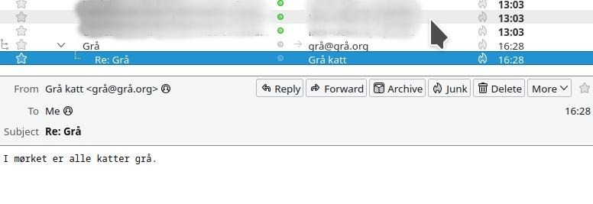
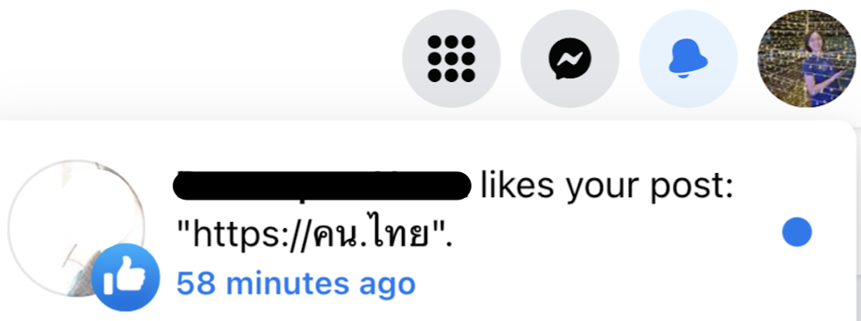
Example Screenshots
Thunderbird showing Norwegian address
Gmail showing Hindi address
Facebook showing link to Thai domain

Slide 8
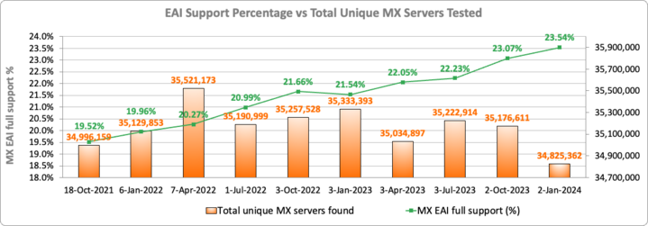
EAI Support Across Email Servers
Notes:
Switching to a point per MX server - Multiple MX servers may resolve to the same IP addresses.
Full: All resolved IPs passed the tests
Partial: Some IP passed the tests, and some failed
None: All of the MX server IPs failed the tests
No IPs: No IPs could be resolved for the MX server (e.g. NXdomain)
Not tested: IPs could not be tested (e.g. timeout, refused connections, special use IPs, etc.)

Slide 9
Scope of UA Readiness for Programmers
Support all Domain Names including Internationalized Domain Names (IDNs) and all Email Addresses, including Internationalized Email Addresses (EAI):
Accept: The user can input characters from their local script into a text field
Validate: The software accepts the characters and recognizes them as valid
Process: The system performs operations with the characters
Store: The database can store the text without breaking or corrupting
Display: When fetched from the database, the information is correctly shown
Accept
Validate
Process
Store
Display

Slide 10
Technology Stack for UA Consideration
Applications and Websites
- Wikipedia.org, ICANN.org, Amazon.com, custom websites globally
- PowerPoint, Google-Docs, Safari, Acrobat, custom apps
Programming Languages and Frameworks
- JavaScript, Java, Swift, C#, PHP, Python
- Angular, Spring, .NET core, J2EE, WordPress, SAP, Oracle
Standards and Best Practices
- IETF RFCs, W3C HTML, Unicode CLDR, WHATWG
- Industry-based standards (health, aviation, ...)
Platforms, Operating Systems and Sytem Tools
- iOS, Windows, Linux, Android, App Stores
- Active Directory, OpenLDAP, OpenSSL, Ping, Telnet
Social Media and Search Engines
- Chrome, Bing, Safari, Firefox, local (e.g., Chinese) browsers
- Facebook, Instagram, Twitter, Skype, WeChat, WhatsApp, Viber
Accept, validate, process, store and display
all domain names and email addresses.

Slide 11
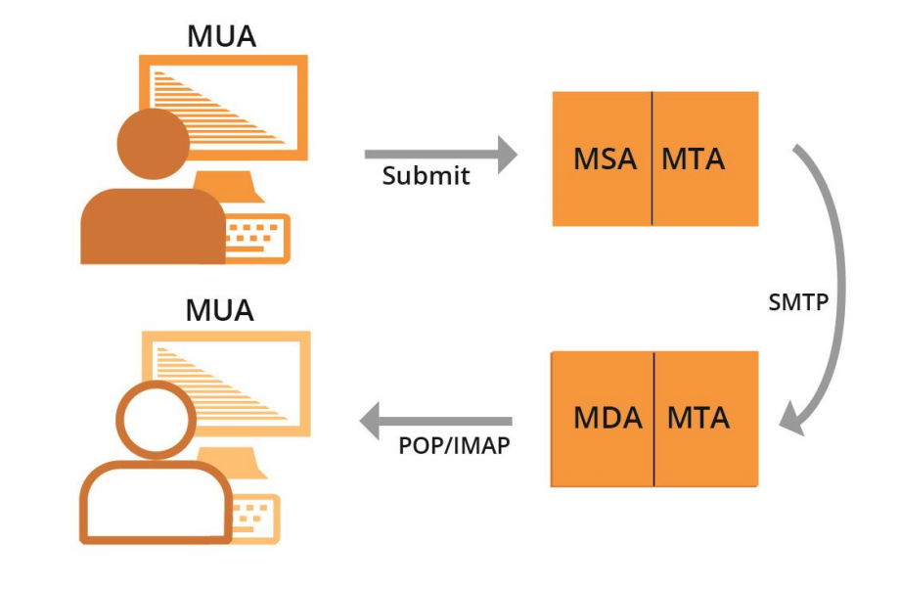
Email Systems and EAI Support
All email agents must be configured to send and receive internationalized email addresses. See EAI: A Technical Overview for details.
MUA – Mail User Agent: A client program that a person uses to send, receive, and manage mail
MSA – Mail Submission Agent: A server program that receives mail from a MUA and prepares it for transmission and delivery
MTA – Mail Transfer Agent: A server program that sends and receives mail to and from other Internet hosts. An MTA may receive mail from an MSA and/or deliver mail to an MDA.
MDA – Mail Delivery Agent: A server program that handles incoming mail and typically stores it in a mailbox or folder

Slide 12
Examples of Email Components
MUA – Mail User Agent – Outlook, Thunderbird, Amazon’s shipping backend, Gmail’s webmail subsystem, a web server’s contact form
MSA – Mail Submission Agent – Exchange, Postfix, Sendgrid, AWS Workmail
MTA – Mail Transfer Agent – Postfix, Exim, Halon, Sendgrid, AWS Workmail
MDA – Mail Delivery Agent – part of Gmail and Exchange, parts of Zendesk
Smartphone MUA app
MTA for recipient
MTA for sender
MSA for sender
MTA: Spam filter
Mail storage
MUA: Webmail

Slide 13
Examples of Email Components
MUA – Mail User Agent – Outlook, Thunderbird, Amazon’s shipping backend, Gmail’s webmail subsystem, a web server’s contact form
MSA – Mail Submission Agent – Exchange, Postfix, Sendgrid, AWS Workmail
MTA – Mail Transfer Agent – Postfix, Exim, Halon, Sendgrid, AWS Workmail
MDA – Mail Delivery Agent – part of Gmail and Exchange, parts of Zendesk
Web browser
Web server
MUA: Contact form software
MTA for recipient
MTA for sender
MSA for sender
MTA: Spam filter
Mail storage
Smartphone MUA app

Slide 14
Quiz

Slide 15
Quiz 1 Question
To enhance systems to be Universal Acceptance (UA) ready, which of the following categories of domain names and email addresses are relevant?
ASCII domain names
Internationalized Domain Names (IDNs)
Internationalized email addresses (EAI)
All the above
Only 2 and 3

Slide 16
Quiz 1 Question
To enhance systems to be Universal Acceptance (UA) ready, which of the following categories of domain names and email addresses are relevant?
ASCII domain names
Internationalized Domain Names (IDNs)
Internationalized email addresses (EAI)
All the above
Only 2 and 3

Slide 17
Fundamentals of Unicode

Slide 18
Character and Character Set
A label or string such as أهلا, नमस्ते, Hello is formed of characters
Hello → H e l l o
A character is unit of information used for the organization, control, or representation of textual data
Examples of character:
Letters
Digits
Special characters, i.e. mathematical symbols, punctuation marks
Control characters - typically not visible
American Standard Code for Information Interchange (ASCII) assigns encodes characters used in computing including letters a-z, digits 0-9 and others

Slide 19
Code Point
Code point is a value, or a position, for a character, in any coded character set
Code point is a number assigned to represent an abstract character in a system for representing text
Notes:
https://bournetocode.com/projects/GCSE_Computing_Fundamentals/pages/3-3-5-ascii.html

Slide 20
Code Point
Code point is a value, or a position, for a character, in any coded character set
Code point is a number assigned to represent an abstract character in a system for representing text
Notes:
https://bournetocode.com/projects/GCSE_Computing_Fundamentals/pages/3-3-5-ascii.html

Slide 21
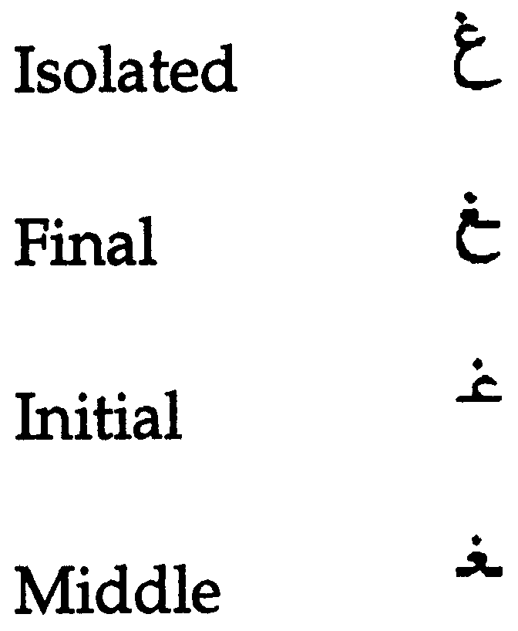
Glyph
A typographic representation of a character is called a glyph
English: a, a
Each Arabic letters often have four glyphs based on where they occur in a string. For example, for the ARABIC LETTER GHAIN the four glyphs are:
Languages may be written/displayed in right-to-left and left-to-right order but reading of data is on the basis of key press order in a file and not dependent on writing direction

Slide 22
Character Encoding
Character encoding is mapping from a character set definition to the actual code units used to represent the data
An encoding describes how to encode code points to bytes and how to decode bytes to code points

Slide 23
A Brief History
Basic ASCII single 7-bit character, limited to a maximum of 128 characters
Extended ASCII single 8-bit character, limited to a maximum limit of 256 characters
ASCII encoding could contain enough characters to cover all the languages
So, different encoding systems were developed for assigning numbers to characters for different languages and scripts, which created interoperability problems

Slide 24
Unicode Standard
The standard for digital representation of the characters used in writing all of the world's languages
Organized characters at script level
Unicode provides a uniform means for storing, searching, and interchanging text in any language
It is used by all modern computers and is the foundation for processing text on the Internet
Number of slots to represent world languages is 0000 – 10FFFF. See https://unicode.org/charts/ to see script coverage and encoding ranges.

Slide 25
Unicode Encoding
Unicode can be implemented by different character encodings:
UTF-8
UTF-16
UTF-32
UTF-8 encoding is generally used by the Domain Name System (DNS)
UTF-8 is variable length character encoding
UTF-8 encodes code points in one to four bytes, read one byte at a time:
For ASCII characters 1 byte is used
For Arabic characters 2 bytes are used
For Devanagari characters 3 bytes are used
For Chinese characters 4 bytes are used
So, for byte-level reading, we need to specify encoding before file reading

Slide 26
Hello World: Python
print("Enter your input: ")
inputstr = input() #default character encoding is UTF-8
print("Input data is: ")
print(inputstr)
All of the code in this presentation is available on github: https://github.com/icann/ua-code-samples

Slide 27
Hello World: Java
import java.util.Scanner;
public class ReadWriteUnicode {
public static void main(String[]args) {
Scanner scr = new Scanner(System.in);
System.out.println("Enter your input");
String Input = scr.nextLine(); //default character encoding is UTF-8
System.out.println("Receieved input is: "+Input);
}
}

Slide 28
Unicode Encoding – File Reading/Writing in Python
Read UTF-8 file
Write UTF-8 file
file = open("filepath",'r',encoding='UTF-8') for line in file: print(line) file.close()
file2 = open(“filepath",'w',encoding='UTF-8') data_to_write='اُن کے وکلا کی کوشش ہو گی' file2.writelines(data_to_write) file2.close()

Slide 29
Unicode Encoding – File Reading in Java
public void ReadFile(final String filename){ try { FileInputStream fis = new FileInputStream(filename); InputStreamReader isr = new InputStreamReader(fis, StandardCharsets.UTF_8); BufferedReader br = new BufferedReader(isr); String line = ""; while((line = br.readLine())!=null) { System.out.println(line); } fis.close(); } catch(IOException ex) { System.err.println(ex.toString()); } }

Slide 30
Unicode Encoding – File Writing in Java
public void WriteFile(final String filename, String text){ try{ FileOutputStream fis = new FileOutputStream(filename); OutputStreamWriter osw = new OutputStreamWriter(fis, StandardCharsets.UTF_8); BufferedWriter bw = new BufferedWriter(osw); bw.write(text); bw.flush(); fis.close(); }catch(IOException ex) { System.err.println(ex.toString()); } }

Slide 31
Normalization
There are multiple ways to encode certain glyphs in Unicode:
è = U+00E8
e + ` = è = U+0065 + U+0300
آ = U+0622
ٓ + ا = آ =U+0627 U+0653
The following string can exist in corpus in the form of first string below, whereas input string is in the form of second string, below. So, search result will be empty.
آدم (U+0622 U+062F U+0645)
آدم (U+0627 U+0653 U+062F U+0645)
For searching, sorting and any string operations we need normalization
Normalization ensures that the end representation is the same, even if users type differently

Slide 32
Normalization
Different normalization forms defined by Unicode are listed below:
Normalization Form D (NFD)
Normalization Form C (NFC)
Normalization Form KD (NFKD)
Normalization Form KC (NFKC)
In domain names NFC is used
C is composed (å is one character), while D is decomposed (å is a + ring-above)
K includes additional bug compatibility, and seldom used now

Slide 33
Normalization Code - Python
import unicodedata
input_str = input() # take input from user
normalized_input = unicodedata.normalize('NFC',input_str) #normalize user input
print(normalized_input)

Slide 34
Normalization Code - Java
import com.ibm.icu.text.Normalizer2;
Scanner sc = new Scanner(System.in);
Normalizer2 norm = Normalizer2.getNFCInstance(); //get NFC object
String input;
input = sc.nextline();
String normalized_input = norm.normalize(input);

Slide 35
Internationalized Domain Names

Slide 36
Domain Names
A domain name is an ordered set of labels or strings: www.example.co.uk
The top-level domain (TLD) is the rightmost label: ”uk”
Second-level domain: “co”
Third-level domain: “example”
Initially, TLDs were only two or three characters long (e.g., .ca, .com)
Now TLDs can be longer strings (e.g., .info, .google, .engineering)
TLDs delegated in the root zone can change over time, so a fixed list can get outdated
Each label is 63 octets
Total domain name length can not be more than 255 (including separators)

Slide 37
Internationalized Domain Names (IDNs)
Domain names can also be internationalized when one of the labels contains at least one non-ASCII character
For example: www.exâmple.ca, 普遍接受-测试.世界., صحة.مصر, ทัวร์เที่ยวไทย.ไทย
There are two equivalent forms of IDN domain labels: U-label and A-label
Human users use the IDN version called U-label (using UTF-8 format): exâmple
DNS uses an ASCII equivalent called A-label:
Take user input and normalize and check against IDNA2008 to form IDN U-label
Convert U-label to punycode (using RFC3492)
Add the “xn--” prefix to identify the ASCII string as an IDN A-label
exâmple => exmple-xta => xn--exmple-xta
普遍接受-测试 => --f38am99bqvcd5liy1cxsg => xn----f38am99bqvcd5liy1cxsg
Most systems should use U-labels, particularly databases

Slide 38
Convert U-Label ←→ A-Label: Python
import unicodedata #library for normalization import idna #library for conversion domainName = 'صحة.مصر' try: domainName_normalized = unicodedata.normalize('NFC', domainName) #normalize to NFC print(domainName_normalized) domainName_alabel = idna.encode(domainName_normalized).decode("ascii") #U-label to A-label print(domainName_alabel) domainName_ulabel = idna.decode(domainName_alabel) print(domainName_ulabel) except idna.IDNAError as e: print("Domain '{domainName}' is invalid: {e}") #invalid domain as per IDNA 2008 except Exception as e: print("ERROR: {e}")

Slide 39
Convert U-Label ←→ A-Label: Java
International Components for Unicode (ICU)
The gold standard library for Unicode, it was developed by IBM and is now managed by Unicode in sync with Unicode standards.
IDNA Conversion is based on Unicode UTS46, which supports transition from IDNA2003 to IDNA2008. However, it is possible to configure not to support transition (recommended).
IDNA Conversion includes normalization as per IDNA (good!)
Check if there are errors in the conversion by calling info.hasErrors()
For IDNs, set the options to restrict the validation and use to IDNA2008
The static methods implement IDNA2003, and non-static methods implement IDNA2008

Slide 40
Convert U-Label ←→ A-Label: Java
import com.ibm.icu.text.IDNA;
public static String convertULabeltoALabel(final String uLabel) {
final IDNA idnaInstance = IDNA.getUTS46Instance(IDNA.NONTRANSITIONAL_TO_ASCII
| IDNA.CHECK_BIDI
| IDNA.CHECK_CONTEXTJ
| IDNA.CHECK_CONTEXTO
| IDNA.USE_STD3_RULES); StringBuilder output = new StringBuilder();
IDNA.Info info = new IDNA.Info();
idnaInstance.nameToASCII(uLabel, output, info);
String aLabel = output.toString();
if (!info.hasErrors()) {
return Alabel;
} else {
return info.getErrors().stream().toString();
} }

Slide 41
Convert U-Label ←→ A-Label: Java
import com.ibm.icu.text.IDNA;
public static String convertALabeltoULabel(final String aLabel) {
final IDNA idnaInstance = IDNA.getUTS46Instance(IDNA.NONTRANSITIONAL_TO_ASCII
| IDNA.CHECK_BIDI
| IDNA.CHECK_CONTEXTJ
| IDNA.CHECK_CONTEXTO
| IDNA.NONTRANSITIONAL_TO_UNICODE
| IDNA.USE_STD3_RULES);
StringBuilder output = new StringBuilder();
IDNA.Info info = new IDNA.Info();
idnaInstance.nameToUnicode(Alabel, output, info);
final String uLabel = output.toString();
if (!info.hasErrors()) {
return uLabel;
} else {
return info.getErrors().stream().toString();
}
}

Slide 42
Domain Name Validation

Slide 43
Validating a Domain Name
Validating syntax:
ASCII: RFC1035
Composed of letters, digits, and hyphen
Max length is 255 octets with each label up to 63 octets
IDN: IDNA2008 (RFCs 5890-5894)
Valid A-labels
Valid U-labels
Three ways to validate a domain name:
Validate only syntax
Check that the TLD is valid and check syntax for the rest
Checking TLD validity is surprisingly tricky
Check existence using a DNS lookup

Slide 44
Validating a Top-Level Domain Name
Validating the top-level domain names effectively needs a list.
Using a static list is a bad idea.
A large mobile phone company forgot to update its list for several years.
Downloading from IANA on server startup provides up-to-date lists, but makes server startup depend on connectivity to IANA.
Automatic weekly updates is an alternative, but perhaps complex.
Using third-party libraries that update often is also an alternative.
There are libraries called ‘publicsuffix’ or similar in many languages.
In Java/Kotlin, Google’s Guava toolkit has useful functionality.

Slide 45
TLD Validation - Java
/**
* Download the list of TLDs on ICANN website
*/
public static String[] retrieveTlds() {
String IANA_TLD_LIST_URL = "https://data.iana.org/TLD/tlds-alpha-by-domain.txt";
StringBuilder out = new StringBuilder();
try (BufferedInputStream in = new BufferedInputStream(
new URL(IANA_TLD_LIST_URL).openStream())) {
byte[] dataBuffer = new byte[1024];
int bytesRead;
while ((bytesRead = in.read(dataBuffer, 0, 1024)) != -1) {
out.append(new String(dataBuffer, 0, bytesRead));
}
} catch (IOException e) {
// handle exception
}
return Arrays.stream(out.toString().split("\n"))
.filter(s -> !s.startsWith("#"))
.map(String::toLowerCase).distinct().toArray(String[]::new);
}

Slide 46
Domain Validation - Java
public static DomainValidator createDomainValidatorInstance(String domain,
boolean use_actual_domains) {
List<Item> domains = new ArrayList<>();
if (use_actual_domains) {
domains.add(new Item(GENERIC_PLUS, retrieveTlds()));
} else {
String tld = domain;
if (domain.contains(".")) {
tld = domain.substring(domain.lastIndexOf(".") + 1);
}
// Convert TLD to A-Label
String domainConverted = convertULabeltoALabel(tld);
// if there is an error, do nothing, validator will fail
if (domainConverted!="") {
domains.add(new Item(GENERIC_PLUS, new String[]{domainConverted}));
}
}
return DomainValidator.getInstance(false, domains);
}

Slide 47
Validate Domain Name: Python
import unicodedata #library for normalization import idna #library for conversion domainName = 'صحة.مصر' try: domainName_normalized = unicodedata.normalize('NFC', domainName) #normalize to NFC print(domainName_normalized)
#U-label to A-label domainName_alabel = idna.encode(domainName_normalized).decode("ascii") print(domainName_alabel) except idna.IDNAError as e: #invalid domain as per IDNA 2008
print("Domain '{domainName}' is invalid: {e}") except Exception as e: print("ERROR: {e}")

Slide 48
Validate Domain Name: Java
import com.ibm.icu.text.IDNA;
public static boolean isValidDomain(final String domainName) {
final IDNA idnaInstance = IDNA.getUTS46Instance(IDNA.NONTRANSITIONAL_TO_ASCII
| IDNA.CHECK_BIDI
| IDNA.CHECK_CONTEXTJ
| IDNA.CHECK_CONTEXTO
| IDNA.USE_STD3_RULES);
StringBuilder output = new StringBuilder();
IDNA.Info info = new IDNA.Info();
idnaInstance.nameToASCII(domainName, output, info);
return !info.hasErrors(); }

Slide 49
Domain Name Resolution

Slide 50
Domain Name Resolution
After validation, a software would then use the domain name identifier as:
A domain name to be resolved in the DNS
Traditional way of doing hostname resolution and sockets resolution cannot be used for IDNs
Programming languages vary; some have been updated
Java generally allows using U-labels freely
C++ does not
We may need to do following:
Take user input and normalize
Convert U-label to A-label (IDNA2008)
Use A-label for hostname resolution

Slide 51
Domain Name Resolution – Python
import socket import unicodedata import idna domainName='' try: #normalize domain Name domainName_normalized = unicodedata.normalize('NFC', domainName) #Convert U-label to A-label form domainName_alabelForm = idna.encode(domainName_normalized).decode("ascii") #get IP address of the domain ip = socket.gethostbyname(domainName_alabelForm) print(ip) except Exception as ex: print(ex)

Slide 52
Domain Name Resolution – Java
Normalization and U-label to A-label conversion is same as discussed before
import java.net.InetAddress;
try { InetAddress ad = InetAddress.getByName(domainNameAlabelForm); String ip = ad.getHostAddress(); // returns ip for domain System.out.println(ip); } catch (Exception ex) { System.out.println(ex); //Unknown host exception }

Slide 53
Domain Name Storage
We need to ensure that database supports and configure for UTF-8
SQL, e.g., MySQL, Oracle, Microsoft SQL Server
Set domain names to max: 255 octets, 63 octets per label
In UTF-8 native, variable length
Recommendation to use variable length String columns
Consider/verify the object-relational mapping (ORM) driver/tool if you are using one
noSQL, e.g., MongoDB, CouchDB, Cassandra, HBase, Redis, Riak, Neo4J
Already UTF-8 variable length
Store and retrieve either U-label or A-label in a field consistently
You can also store both U-label and A-label in separate fields

Slide 54
Email Address Internationalization (EAI)

Slide 55
Email Address
Email address syntax: mailboxName@domainName
Email has a mailboxName
Email has a domainName
The domainName can be ASCII or IDN
For example:
myname@example.org
myname@xn--exmple-xta.ca
myname@exâmple.ca
If you receive email from others, then you will see both …@exâmple... and …@xn--example-xta… in use
The former is more commonly used
exâmple@xn--example--xte... is valid and used, but xn--…@xn--… is not valid

Slide 56
EAI
EAI has the mailboxName in Unicode (in UTF-8 format)
The domainName can be ASCII or IDN
For example:
kévin@example.org
すし@ xn--exmple-xta.ca
すし@快手.游戏.

Slide 57
Email Addresses Form
name@exâmple.ca and name@xn--exmple-xta.ca represent equivalent email addresses
Application should be able to treat both forms as equivalent
Internally consistently use A-label or U-label, but don’t mix A-label and U-label
Technical recommendation: Backend processing should use:
A-label for software that uses the DNS or SMTP byte-level protocol
U-label for most software (e.g. normal django/flask/rails/symfony applications)
Check that input works using both formats (or even mixed format)

Slide 58
Email Validation: Email Regular Expressions (Regex)
Basic: something@something
^(.+)@(.+)$
From owasp.org (security):
[^[a-zA-Z0-9_+&*-]+(?:\.[a-zA-Z0-9_+&*-]+)*@(?:[a-zA-Z0-9-]+\.)+[a-zA-Z]{2,7}$].
Does not support EAI, i.e., mailbox name in UTF8 not allowed: [a-zA-Z0-9_+&*-]
Does not support ASCII TLD longer than 7 characters: [a-zA-Z]{2,7}
Does not support U-labels in IDN TLD: [a-zA-Z]
But OWASP is THE reference for security
Therefore, you may end up fighting with your security team to use a UA-compatible Regex instead of the “standard” one from OWASP

Slide 59
Email Regular Expressions (Regex)
Example of Regex suggested in various forums: ex: List of proposals
^[A-Za-z0-9+_.-]+@(.+)$ does not support UTF8 in mailbox name
^[a-zA-Z0-9_!#$%&’*+/=?`{|}~^.-]+@[a-zA-Z0-9.-]+$ does not support U-labels
^[a-zA-Z0-9_!#$%&’*+/=?`{|}~^-]+(?:\\.[a-zA-Z0-9_!#$%&’*+/=?`{|}~^-]+)*@[a-zA-Z0-9-]+(?:\\.[a-zA-Z0-9-]+)*$ does not support U-labels
^[\\w!#$%&’*+/=?`{|}~^-]+(?:\\.[\\w!#$%&’*+/=?`{|}~^-]+)*@(?:[a-zA-Z0-9-]+\\.)+[a-zA-Z]{2,6}$ have length restrictions for the TLD between 2-6 characters
One can come up with an EAI-IDN compatible regex using various Unicode codepoints characteristics
For IDN it would be like a reimplementation of the IDNA protocol tables in regex!
Given that both sides of an EAI may have UTF8, then one regex for an EAI could be .*@.* which is only verifying the presence of the ‘@’ character

Slide 60
Validate Email

Slide 61
Email Addresses Validation
Email has a mailboxName
Email has a domainName
DomainName validation is the same as before
mailboxName validation require a valid UTF8 string
Local administrator defines policy for mailboxName
Gmail policy: firstname.lastname@gmail.com is equivalent to firstnamelastname@gmail.com
Guidelines for mailboxName are available by UASG

Slide 62
EAI Validation - Python
from email_validator import validate_email,EmailNotValidError logger = logging.getLogger(__name__)
try: # As part of process it performs DNS resolution # Normalizes email addresses automatically # Supports internationalized domain names validated = validate_email(email_address, check_deliverability=True) print(validated) logger.info("'{address}' is a valid email address") print("'{address}' is a valid email address") except EmailNotValidError as e: print("'{address}' is not a valid email address: {e}") except Exception as ex: print("Unexpected Exception")

Slide 63
EAI Validation - Java
Apache Common Validator:
Has domain and email validators
Do not use as it relies on a static list of TLDs! OUTDATED!

Slide 64
EAI Validation - Java
public static boolean isValidEmail(String emailaddress){
emailaddress = Normalizer2.getNFCInstance().normalize(emailaddress);
String[]emailparts = emailaddress.split("@");
if(emailparts.length==2){
String mailboxname = emailparts[0];
String domainName = emailparts[1];
String domainNameAlabelForm = convertULabeltoALabel(domainName);
try {
EmailValidator em = new EmailValidator(false, false,
createDomainValidatorInstance(domainName,true));
return em.isValid(mailboxname+"@"+domainNameAlabelForm);
} catch (Exception ex) {
System.out.println(ex.toString());
return false;
}
} else{
return false;
}
}

Slide 65
Sending and Receiving Email

Slide 66
Sending and Receiving
We need to be able to send to either form:
mailboxName-UTF-8@A-labelform
mailboxName-UTF-8@U-labelform
We need to be able to receive from either form:
mailboxName-UTF-8@A-labelform
mailboxName-UTF-8@U-labelform
Storage of email should be consistent with domain name in either A-label or U-label form
Backend send/receive should be managed by mail server
Handover process (Front end application → email server)
Libraries used in handover process should be EAI compliant
Mail server should also be EAI compatible
How to make mail server EAI compatible is out of scope of this training

Slide 67
Sending and Receiving – Python
Smtplib can be used to send EAI-compliant emails
It does not validate the domain compliance with IDNA 2008, therefore another validation method should be used before trying to send an email
For instance, using the email-validator library
If you do not validate addresses before sending, you will get DSN messages for any invalid addresses and may harm your spam rating

Slide 68
Sending and Receiving – Python
try: to = 'kévin@example.com' local_part, domain = to.rsplit('@', 1) domain_normalized= unicodedata.normalize('NFC',domain)#normalize domain name to = '@'.join((local_part,idna.encode(domain_normalized).decode('ascii’)))#convert U-label to A-label validated = validate_email(to, check_deliverability=True) #validate email address if validated: host='' port='' smtp = smtplib.SMTP(host, port) smtp.set_debuglevel(False) smtp.login(‘useremail’,’password') sender=‘ua@test.org' subject='hi' content='content here' msg = EmailMessage() msg.set_content(content) msg['Subject'] = subject msg['From'] = sender msg['to']=to smtp.send_message(msg, sender, to) smtp.quit() logger.info("Email sent to '{to}'") except smtplib.SMTPNotSupportedError: # The server does not support the SMTPUTF8 option, you may want to perform downgrading logger.warning("The SMTP server {host}:{port} does not support the SMTPUTF8 option") raise

Slide 69
Sending and Receiving – Java
Jakarta Mail can be used for sending email
import com.sun.mail.smtp.SMTPTransport;
import jakarta.mail.Message;
import jakarta.mail.MessagingException;
import jakarta.mail.PasswordAuthentication;
import jakarta.mail.Session;
import jakarta.mail.Transport;
import jakarta.mail.internet.InternetAddress;
import jakarta.mail.internet.MimeMessage;
import java.util.Date;
import java.util.Properties;

Slide 70
Sending and Receiving – Java
public static boolean sendEmail(String to, String host, String sender,
String subject, String content,String username,String password){
if(isValidEmail(to)) {
Properties props = new Properties();
props.put("mail.smtp.host", host);
props.put("mail.smtp.port", "587");
props.put("mail.smtp.auth", "true");
props.put("mail.smtp.starttls.enable", "true");
// enable UTF-8 support, mandatory for EAI support
props.put("mail.mime.allowutf8", true);
Session session = Session.getInstance(props,
new jakarta.mail.Authenticator() {
protected PasswordAuthentication getPasswordAuthentication() {
return new PasswordAuthentication(username, password);
}
});

Slide 71
Sending and Receiving – Java(2)
/*
* Jakarta mail is EAI compliant with 2 issues:
* - it rejects domains that are not NFC normalized
* - it rejects some unicode domains
* In such case, first try to normalize, then convert domain to A-label. We do normalization
* first to get an email address the closest possible to the user input because once
* converted in A-label it may be displayed as is to the user.
*/
String[] add_parts = to.split("@");
String mailboxName = add_parts[0];
String domainName = add_parts[1];
String domainNameNormalized = Normalizer2.getNFCInstance().normalize(domainName);
String domainNameAlabelForm = convertULabeltoALabel(domainNameNormalized);
String compliantTo = mailboxName+"@"+domainNameAlabelForm;

Slide 72
Sending and Receiving – Java(3)
try (Transport transport = session.getTransport()) {
if (transport instanceof SMTPTransport && !((SMTPTransport) transport).supportsExtension("SMTPUTF8")) {
try {
MimeMessage message = new MimeMessage(session);
//set message headers for internationalized content
message.addHeader("Content-type", "text/HTML; charset=UTF-8");
message.addHeader("Content-Transfer-Encoding", "8bit");
message.addHeader("format", "flowed");
message.setFrom(new InternetAddress(sender));
message.setSubject(subject, "UTF-8");
message.setText(content, "UTF-8");
message.setSentDate(new Date());
message.setRecipient(Message.RecipientType.TO, new InternetAddress(compliantTo));
Transport.send(message);
return true;
} catch (Exception e) {
System.out.println(String.format("Failed to send email to %s: %s", to, e));
}
}
} catch (MessagingException e) {
}
return false; }

Slide 73
Conclusion

Slide 74
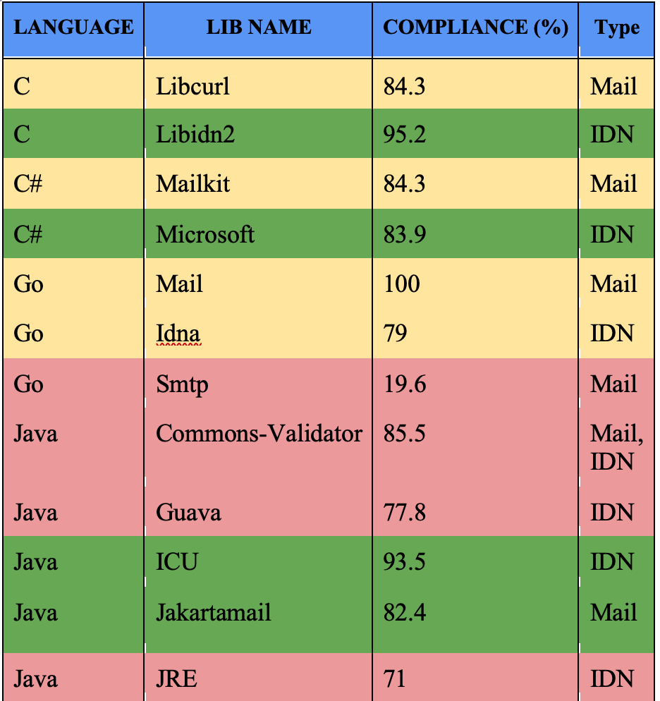
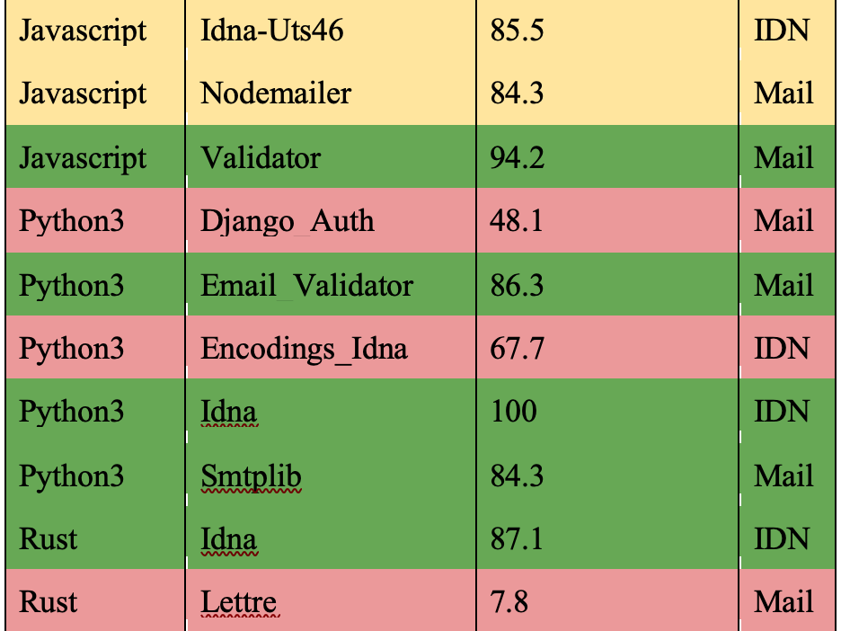
Prog. Languages Support
UASG018A

Slide 75
Conclusion
Be aware that UA identifiers may not be fully supported in software and libraries
Use the right libraries and frameworks
Adapt your code to properly support UA
Do unit and system testing using UA test cases to ensure that your software is UA-ready

Slide 76
Get Involved!

Slide 77
Get Involved!
For more information on UA, email info@uasg.tech or UAProgram@icann.org
Access all UASG documents and presentations at https://uasg.tech
Access details of ongoing work from wiki pages: https://community.icann.org/display/TUA
Register to participate or listen in the UA discussion list at https://uasg.tech/subscribe
Register to participate in UA working groups here

Slide 78
Some Relevant Materials
See https://uasg.tech for a complete list of reports
Universal Acceptance Quick Guide: UASG005
Introduction to Universal Acceptance: UASG007
Quick Guide to EAI: UASG014
EAI – A Technical Overview: UASG012
UA Compliance of Some Programming Language Libraries and Frameworks – UASG018A
EAI – Evaluation of Major Email Software and Services: UASG021B
Universal Acceptance Readiness Framework: UASG026
Considerations for Naming Internationalized Email Mailboxes: UASG028
Evaluation of EAI Support in Email Software and Services Report: UASG030
UA of Content Management Systems (CMS) Phase 1 – WordPress: UASG032
The code samples used: https://github.com/icann/ua-code-samples

Slide 79
Engage with ICANN – Thank You and Questions
Email: sarmad.hussain@icann.org

