Slide 1
Universal Acceptance (UA) of Domain Names and Email Addresses
[Presenter Name] / UA Day Awareness Session / [Day, month] 2025

Slide 2
Digital Inclusion, A Long Standing Commitment
Building the Information Society: A Global Challenge in the New Millennium
Declaration of Principles at the Geneva Summit 2003
We, the representatives of the peoples of the world, assembled for the first phase of the World Summit on the Information Society (WSIS), declare our common desire and commitment to
build a people-centred, inclusive and development-oriented Information Society,
where everyone can create, access, utilize and share information and knowledge,
enabling individuals, communities and peoples to achieve their full potential in promoting their sustainable development and improving their quality of life.

Slide 3
We Live in a Multilingual World!
Globally, language usage is diverse. English comes third in terms of native speakers around the world, after Chinese and Spanish. English represents 52% of the total content online but the percentage is decreasing.
Language | Speakers
Chinese | 1,346,000,000
Spanish | 485,063,960
English | 379,682,200
Arabic | 373,000,000
Hindi | 344,650,870
Portuguese | 236,266,650
Bengali | 233,808,880
Russian | 146,954,150
Source: https://www.statista.com/statistics/262946/most-common-languages-on-the-internet/
Source
https://www.britannica.com/topic/languages-by-number-of-native-speakers-2228882

Slide 4
Multilingualism, A Key To Digital Inclusion
A linguistically diverse Internet significantly contributes toward a knowledge-based society by bridging the digital divide
A key principle in WSIS Geneva Declaration in 2003, leading to a commitment “towards multilingualization of the Internet” in the WSIS Tunis Agenda in 2005.
Advance the introduction of multilingualism in domain names, and e-mail addresses, by implementing programmes and strengthening cooperation for their global deployment.
UNESCO, in its recommendations on multilingualism and universal access to cyberspace 2003 asked to alleviate language barriers on the Internet by access to content, capacity-building, national policies, and collaborative research and development on, and local adaptation of technology with extensive multilingual capabilities.
More recently, Global Digital Compact asks to make digital technologies more accessible and affordable to everyone, including in diverse languages and formats/

Slide 5
The Domain Name System and ICANN
A domain name is a unique name that forms the basis of the uniform resource locators (URLs) that people use to find resources on the Internet (e.g., web pages, email servers, images, and videos).
The domain name itself identifies a specific address on the Internet that belongs to an entity such as a company, organization, institution, or individual.
Every Internet-connected device has a unique IP address. For example, the domain name: icann.org has the IP address: 192.0.43.7.
Collectively, the domain names and the Internet Protocol (IP) addresses help us navigate the Internet.
The Internet Corporation for Assigned Names and Numbers (ICANN) helps coordinate and support these unique identifiers across the world. ICANN's mission is to help ensure a stable, secure, and unified global Internet.

Slide 6
Evolution of Top-Level Domains (TLDs) and the DNS
In the past, top-level domains (TLDs) have mostly been two or three letters long formed with Latin characters a-z (e.g., .com, .org).
The evolution of the DNS has allowed for newer and longer TLDs. There are now around 1,200 new generic gTLDs that represent brands, communities, and geographies (e.g., .photography, .london).
These new TLDs also include Internationalized Domain Names (IDNs), which allow for domain names in local languages and scripts such as “.例子” and “مثال.“ (“example” written in Chinese and Arabic).
Other labels within a domain name can also be internationalized, allowing for a domain name to be in a local language and script completely. IDNs are separate from online content, which can also be multilingual.
The next round of gTLDs will continue to expand the DNS and give new opportunities to the next billion people waiting for access to a more multilingual and inclusive Internet in their language or script.

Slide 7
Expansion of the DNS and the Next Round
The introduction of new gTLDs, including long TLDs and IDNs, into the Internet ecosystem through the New gTLD Program enabled the largest expansion of the DNS.
Pre-2009
2016
2012-onward
2009-onward
Generic TLDs (gTLDs)
(22 total)
IDN ccTLDs
(in non-Latin scripts)
New gTLD Program
New and Long gTLDs
(Over 1,200 total)
.com
.edu
.рф
.台灣
.org
.net
.한국
.ଭାରତ
.bank
.bar
.technology
.aero
.asia
.car
.global
.london
.mobi
.travel
.rio
.vote
.photography
.info
IDN gTLDs
(in various scripts)
Country Code TLDs (ccTLDs)
(two-character ASCII ccTLDs)
.संगठन
.在线
.uk
.jp
.닷넷
.ストア
.de
.fr
.ابوظبي
. дети

Slide 8
IDN Country Code Top-Level Domains
There are a total of 61 IDN ccTLDs delegated for 42 countries and territories.
Հայ البحرين বাংলা бел бг 中国 中國 مصر გე ελ ישראל भारत ભારત இந்தியா ഭാരതം 한국 ລາວ мкд
See complete list at https://www.icann.org/resources/pages/fast-track-2012-02-25-en.

Slide 9
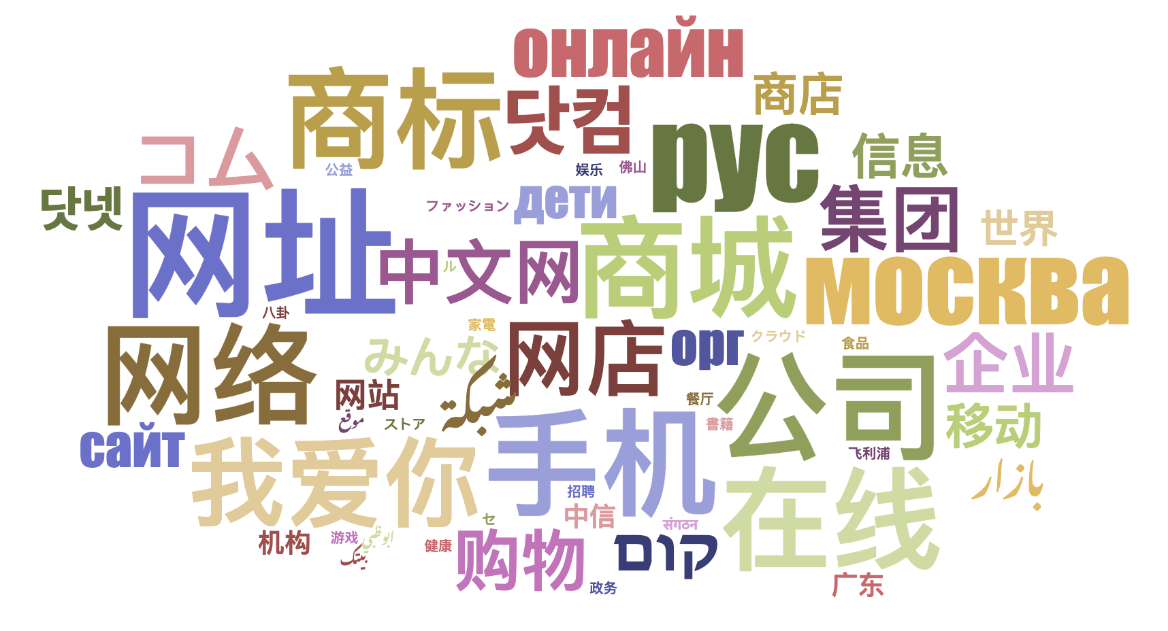
IDN Generic TLDs (gTLDs)
90 IDN gTLDs are delegated.

Slide 10
Evolution of Email Addresses
Initially, email addresses were also not available in local languages and scripts.
Email Address Internationalization (EAI) addresses this limitation and allows for having email addresses in local languages and scripts.
Internationalized email addresses are not related to the text in the body of the email.

Slide 11
Examples of IDNs
համընդհանուր-ընկալում-թեստ.հայ
ଯୁନିଭରସାଲ-ଏକସେପ୍ଟନ୍ସ-ଟେଷ୍ଟ.ଭାରତ
უნივერსალური-თავსობადობის-ტესტი.გე
다국어도메인이용환경테스트.한국
സാർവത്രിക-സ്വീകാര്യതാ-പരിശോധന.ഭാരതം
تجربة-القبول-الشامل.موريتانيا
Armenian
Oriya
Georgian
Korean
Malayalam
Arabic

Slide 12
Examples of Internationalized Email
Էլփոստ-թեստ@համընդհանուր-ընկալում-թեստ.հայ
电子邮件测试@普遍适用测试.我爱你
ईमेल-परीक्षण@सार्वभौमिक-स्वीकृति-परीक्षण.संगठन
تجربة-بريد-الكتروني@تجربة-القبول-الشامل.موريتانيا
ηλεκτρονικό-μήνυμα-δοκιμή@καθολική-αποδοχή-δοκιμή.ευ
மின்னஞ்சல்-சோதனை@பொது-ஏற்பு-சோதனை.சிங்கப்பூர்
Armenian
Chinese
Devanagari
Arabic
Greek
Tamil

Slide 13
The Challenge
IDN TLDs allow for multilingual domain names and email addresses for communities to register and use, allowing for more digital inclusion.
But, there are issues in their universal acceptance, e.g., a valid email is rejected by a form on a website and is incorrectly displayed from left-to-right instead of right-to-left:

Slide 14
Examples of Categories Affected by UA
Domain Names that may not work in applications:
ASCII: example.sky
ASCII: example.engineering
Unicode: คน.ไทย
Internationalized email addresses (EAI) that may not work in applications:
Unicode: marc@société.org
Unicode: 测试@example.com
Unicode: ईमेल@उदाहरण.भारत
Unicode: ای-میل@ مثال.موقع (written right-to-left, RTL)
ASCII is based on letters A-Z, a-z, digits 0-9 and hyphen.
Unicode supports characters of languages and scripts used worldwide.

Slide 15
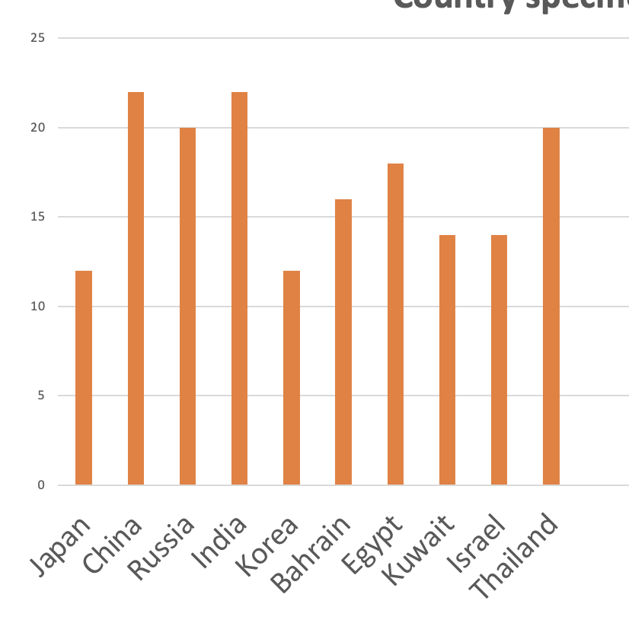
The Challenge: Internationalized Email Address Acceptance by Websites
Email Address (in local language) Acceptance Rates (%) in Form Fields on 1000 Local Websites
(data from 2025 study to be published at UASG.tech)

Slide 16
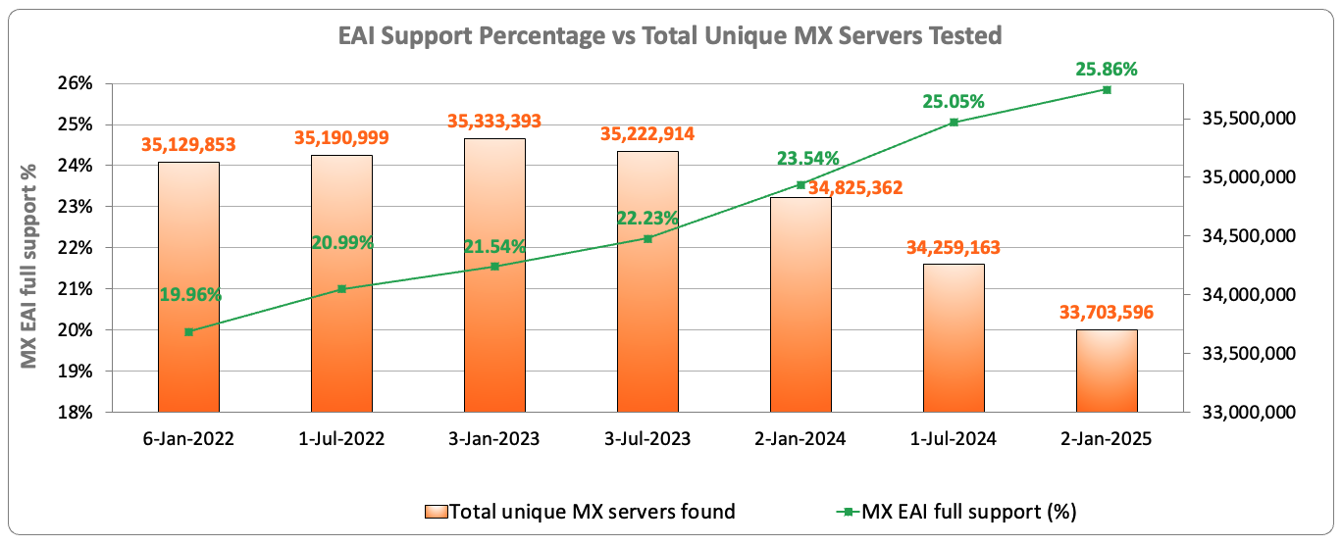
The Challenge: Internationalized Email Address Support Across Email Servers
Out of the 33.7 million email servers tested in January of 2025, only 25.86% show support for internationalized email addresses.
Source: https://ithi.research.icann.org/graph-eai.html

Slide 17
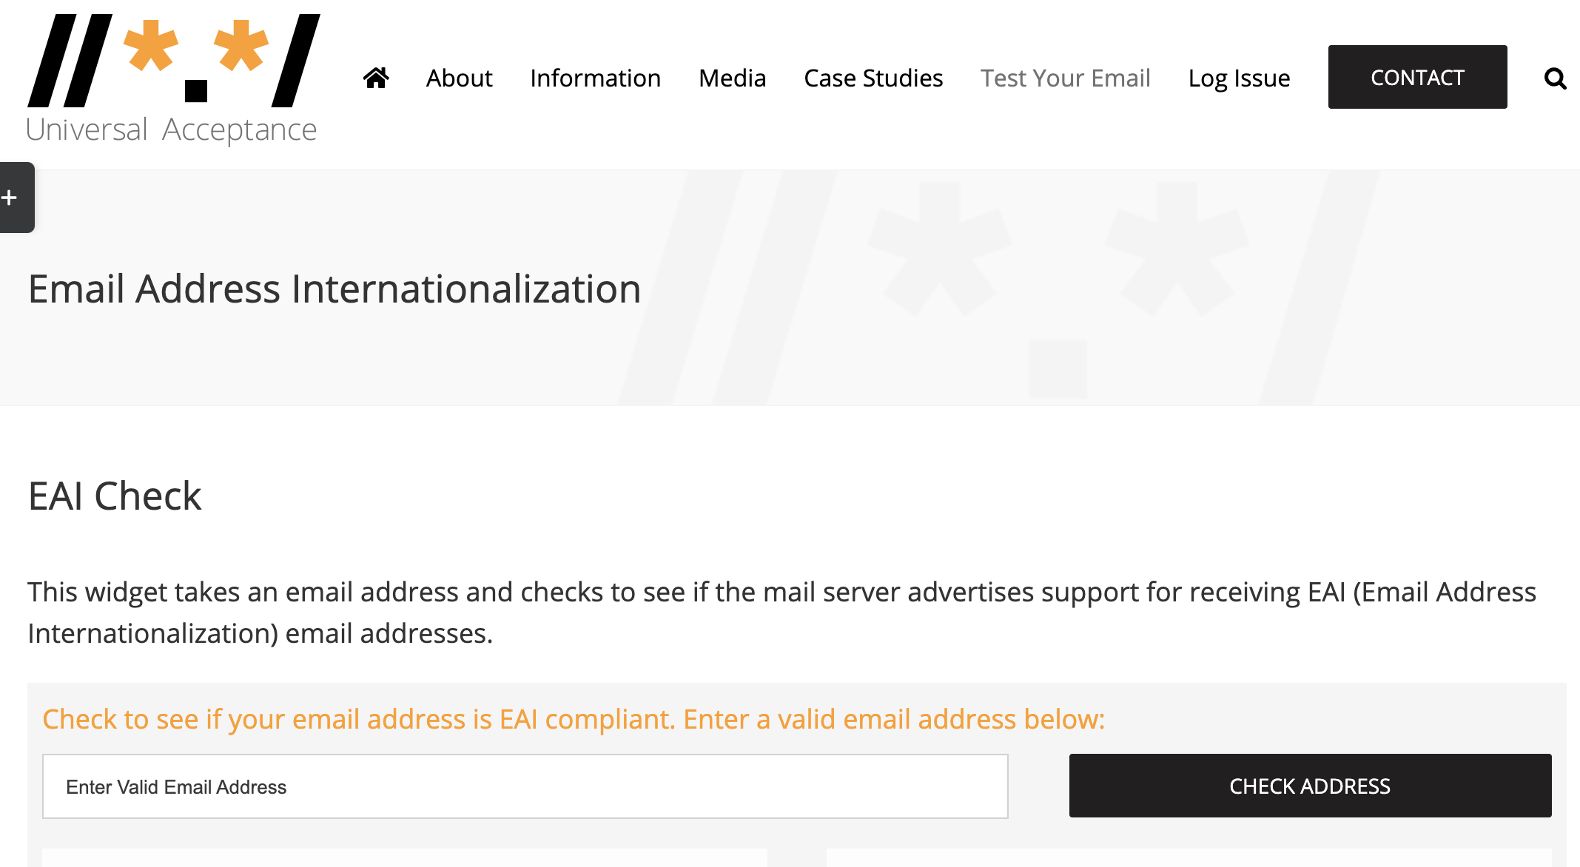
Does Your Email Server Support EAI?
Enter your email and check now at: https://uasg.tech/eai-check/

Slide 18
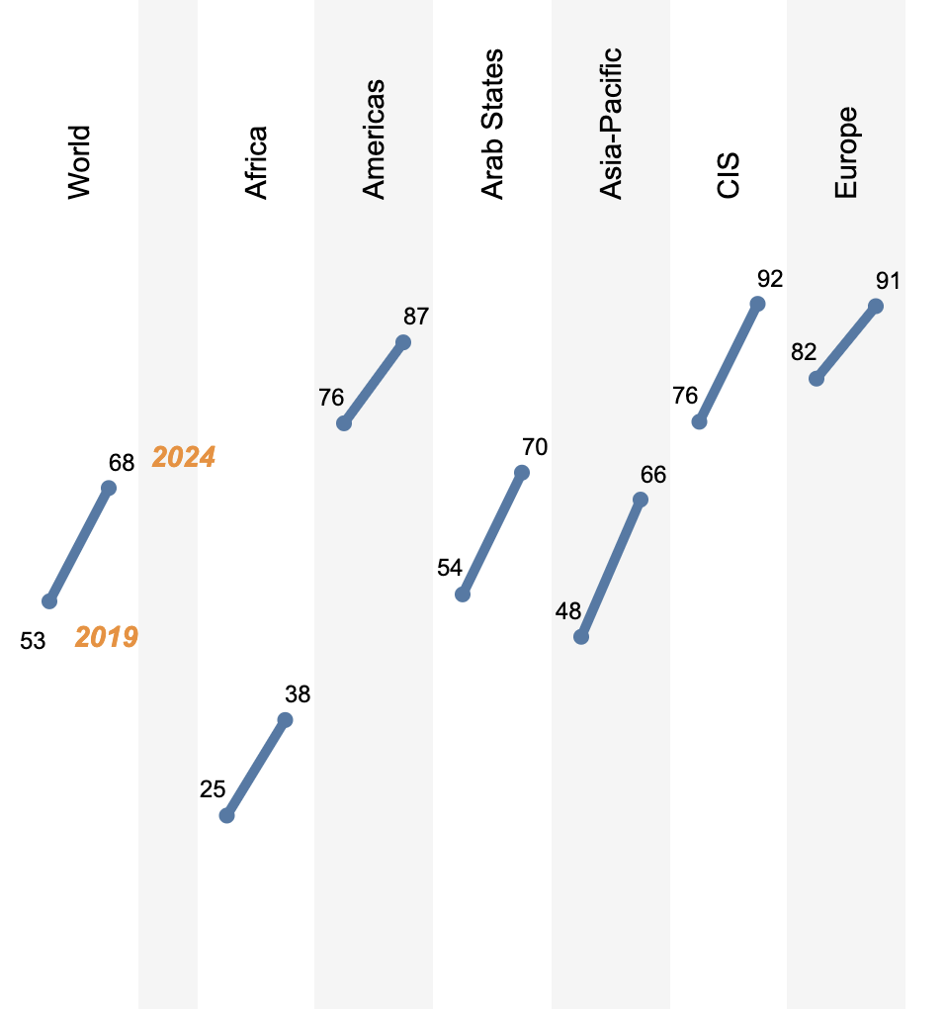
Digital Inclusion, an Opportunity
5.5 billion
Internet users worldwide
68%
Internet Users
Remaining 32% of the world population, ~2.6 billion people, still aren’t online; primarily from Asia and Africa (see percent increase).
Many of those already online, and most of those who will be coming online, communicate in their native languages.
Source: https://www.itu.int/itu-d/reports/statistics/2024/11/10/ff24-internet-use/

Slide 19
What is Universal Acceptance (UA)?
While the DNS has evolved, the checks used by many software applications to validate domain names and email addresses remain outdated.
In addition, not all online portals are primed for the opening of a user account with a related email address, leaving many people unable to navigate the Internet using their language and online identity of choice.
Considered a technical compliance best practice, UA solves these issues by ensuring all valid domain names and email addresses, regardless of script, language or character length, can be used equally by all Internet-enabled applications, devices, and systems.
Achieving UA ensures every person has the ability to navigate and communicate on the Internet using their chosen domain name and email address that best aligns with their interests, business, culture, language, and script.

Slide 20
UA Goal and Impact
Goal
All valid domain names and email addresses work in all software applications.
Impact
Promote consumer choice, improve competition, and provide broader access to end users.

Slide 21
Why Does UA Matter?
UA can also help:
Supports a diverse, multicultural and multilingual Internet.
Allows more trust and freedom of expression.
Enables greater competition, innovation, and consumer choice.
Creates social and business opportunities.
Offers career advantages for developers and system administrators.
Assists governments and policymakers in communicating with their citizens.

Slide 22
Supporting a Multilingual and Inclusive Internet
Today, the Internet population is made up of 5.5 billion active users, with billions more expected to come online. Through UA, they will experience the full benefits of the Internet.
The majority of the world does not speak English as a first language. In fact, only more than a third of the world population uses the Latin alphabet in English, while there are billions of people who prefer to read and write in Arabic, Ethiopic, Chinese, Cyrillic, or other scripts.
By being UA-ready, there are important economic and social benefits of supporting multilingual Internet users:
Increasing their ability to access and connect to ecommerce, local communities, and governments.
Embracing and proliferating cultural traditions through language promoting Internet diversity and openness.

Slide 23
Making Applications UA-Ready
Support all valid domain names and email addresses:
Accept: The user can input characters from their local script into a text field.
Validate: The software accepts the characters and recognizes them as valid.
Process: The system performs operations with the characters.
Store: The database can store the text without breaking or corrupting.
Display: When fetched from the database, the information is correctly shown.
Accept
Validate
Process
Store
Display

Slide 24
Working Towards UA-Readiness
The ICANN community created the Universal Acceptance Steering Group (UASG) to promote UA-readiness globally.
ICANN actively promotes UA and financially supports the UASG.
The UASG and ICANN work to achieve UA-readiness by:
Organizing outreach to raise awareness on UA issues.
Conducting detailed studies to identify technical gaps.
Determining solutions to address the technical gaps.
Submitting bug reports in the relevant tools, systems, and applications.
Developing and conducting technical training on the solutions for supporting UA-readiness.
More info at https://uasg.tech and https://icann.org/ua.

Slide 25
Who Can Help Achieve UA?
Technology Enablers - Organizations producing relevant standards and best current practices and providers of software programming languages, tools, and frameworks.
Technology Developers - Organizations and individuals developing and deploying online applications and services using the programming languages, tools, and frameworks.
Email Software and Service Providers
Email Software Providers - Organizations and individuals providing different applications, tools, and utilities for the email ecosystem.
Email Service Providers - Organizations and individuals providing services for the email ecosystem.
Email (and System) Administrators - Organizations and individuals deploying and administering email-related software and services.
Government Policy Makers - Government officials generating demand for UA-ready products and services by updating accessibility standards and procurement processes.
Academia – University programs offering IT-related degree programs.

Slide 26
What Is Your Role: Business
Many businesses are leaving money on the table by not updating their systems to be UA-ready, which has the potential to unlock billions in revenue from untapped customers.
A UASG study, conducted in 2017, found that the Universal Acceptance of Internet domain names is a $9.8+ billion opportunity, which is a conservative estimate.
Businesses that are UA-ready will be best positioned to reach growing global audiences and maximize revenue potential from the current Internet population, as well as the next billion.
Organize internally and assess if your business’ systems are compliant with UA standards.
Update your own IT systems to be UA-ready.
Encourage your collaborators to participate and promote local UA-related discussions.
Create UA awareness with partner organizations and companies, aiming to update their systems to current globally-inclusive standards.

Slide 27
What Is Your Role: Government
Being UA-ready can assist governments and policymakers in reaching their citizens.
Evaluate the possibility of including UA requirements in government procurements.
Reach out to government departments involved in e-government services for citizens and ask them to incorporate UA practices to provide digital inclusivity.
Coordinate with your national ccTLD managers and ICANN Governmental Advisory Committee (GAC) delegates to participate in and strengthen UA-related actions.

Slide 28
What Is Your Role: Civil Society
Encourage your community to attend local and regional UA-related events; help coordinate and promote them.
Make your own systems UA-ready for broader digital inclusion.
Promote research on inclusion and access that reinforces the principles of UA.
Create UA awareness with partner organizations and companies to update their systems to current globally-inclusive standards.

Slide 29
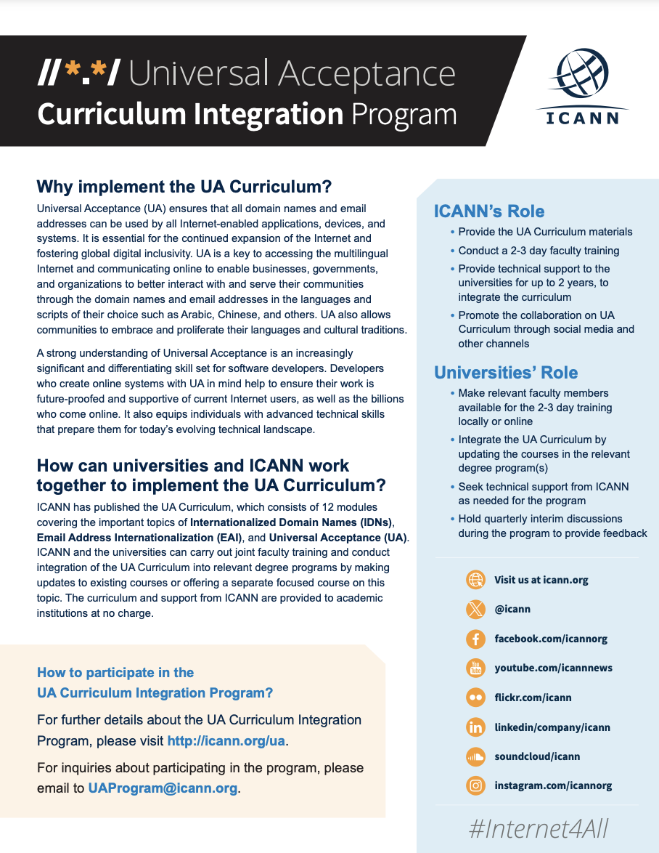
What Is Your Role: Academia
Upgrade email systems to support EAI.
Update IT curricula to include teaching and learning of IDNs and UA and software based on internationalization concepts.
See ICANN’s UA Curriculum Integration Program
Train faculty and students to adopt UA practices in software development.
Create awareness of UA issues and solutions in the local technical community.

Slide 30
What Is Your Role: Technical Community
Carry out training and educational activities that allow software developers and project managers to address UA-related issues.
Test and address UA-related issues in your own products and services.
Test domain names and email addresses in UASG 004.
Report bugs related to UA in other products and services.
Accept
Validate
Process
Store
Display

Slide 31
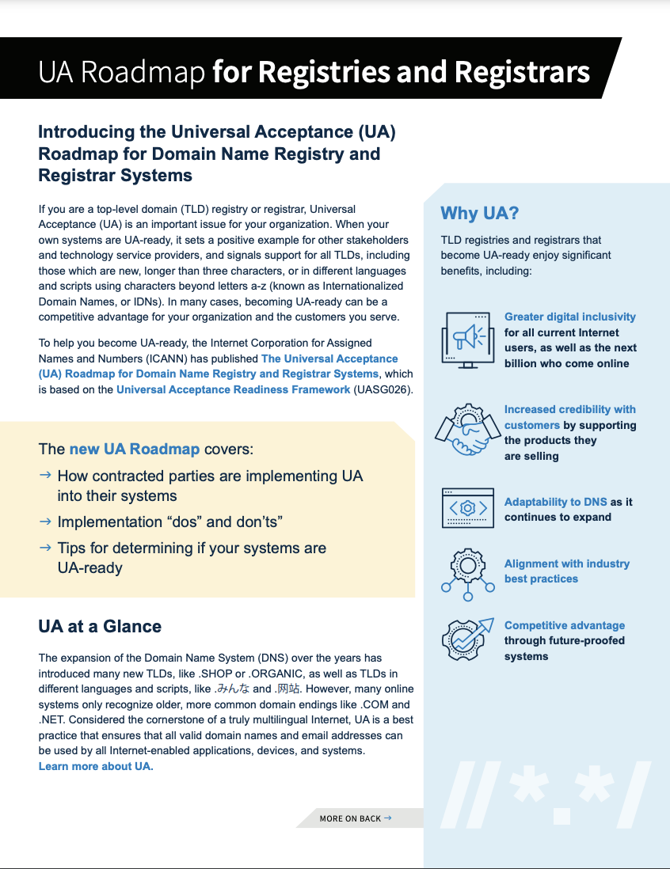
What Is Your Role: Domain Registries and Registrars
Assess UA-related gaps in customer facing systems.
Upgrade customer facing systems to support UA; UA Roadmap for Domain Name Registry and Registrar Systems is available as a guidance.
Create awareness of UA with your business stakeholders and encourage them to upgrade their systems as well.

Slide 32
What is Your Role: Domain Holder/Registrant
Check with your Internet Service Provider (ISP) hosting your website and email to see if their services are UA-ready.
Check with your website and email admin if your website and email is UA ready. If it is not, consider taking the initiative to update it and make it UA-ready.
Create UA awareness with your ISP, web developers and email admin, and ask them to update their systems to be UA-ready.
Refer them to FY23 UA Readiness report for further information. You may consider using the template letter or alternatively log the issue.

Slide 33
Additional Efforts by UNESCO and ICANN for Promoting Digital Inclusion
UNESCO is conducting multiple programs to promote multilingualism online.
ICANN is launching the Next Round of new gTLDs to promote digital inclusion.
The following sections highlights this work by UNESCO and ICANN.

Slide 34
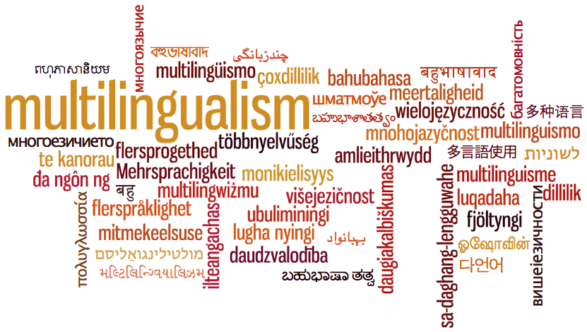
UNESCO's Commitment to Promoting Multilingualism
Setting standards through normative instruments
The 2003 Recommendation concerning the Promotion and Use of Multilingualism and Universal Access to Cyberspace
Advocating for a more diverse linguistic internet
WSIS Action Line C8: Cultural diversity and identity, linguistic diversity, and local content
Partnership with the Internet Governance Forum (IGF) under the theme, “Language and Inclusion – Multilingual Names”
Building capacities to empower communities to produce linguistic diverse content
Toolkit Digital Initiatives for Indigenous Peoples
The 3rd key approach "Normalizing" aims to promote the Universal Acceptance of the use of Indigenous languages
Work with partners to support grassroot initiatives
Collaborate with tech companies to develop keyboards for Indigenous languages

Slide 35
Multilingualism and Universal Access to Cyberspace (2003)
Recommendation concerning the Promotion and Use of Multilingualism and Universal Access to Cyberspace (2003)
The recommendation focuses on four areas:
Development of multilingual content and systems
Facilitating access to networks and services
Development of public domain content
Reaffirming equitable balance between interests of right-holders and public interest

Slide 36
The International Decade of Indigenous Languages
IDIL 2022-2032
Draw attention to the critical loss of indigenous languages and the urgent need to preserve, revitalize and promote indigenous languages
Take urgent steps at the national and international levels.
IDIL Global Action Plan specified in the Digital empowerment thematic area to:
Empower Indigenous youth and professionals in digital skills, media literacy, and online activism.
Promote better representation and multilingual access for Indigenous languages in media and technology.
Foster public-private partnerships and develop standards for language digitization and Indigenous involvement in content creation
UNESCO serves as the lead agency for the International Decade, in collaboration with UNDESA and other relevant agencies , within existing resources
Establish dedicated Ad-Hoc Group working on digital equality and domains

Slide 37
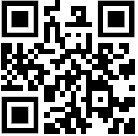
The UNESCO World Atlas of Languages
The World Atlas of Languages is an interactive online tool that documents language status worldwide, aiming to provide detailed records of languages as communicative tools and knowledge resources in their sociocultural and sociopolitical contexts.
The Atlas covers 8,324 languages documented by governments, institutions, and academics, with about 7,000 still in use.
UNESCO collaborates with the Focal Points nominated by Member States to collect and document linguistic diversity, while providing training to enhance their capacity for digital transformation.
The Atlas is exploring the use of Application Programming Interface (API) to enhance access to digital tools with a focus on Indigenous and low-resources languages:
online translation tool that leverages open data for high-quality translations
speech-to-text AI models
online Indigenous language dictionaries
https://en.wal.unesco.org/

Slide 38
ICANN’s New gTLD Program: Next Round and Applicant Support Program
New opportunities to obtain a new generic top-level domain (gTLD), including Internationalized Domain Names (IDNs), are on the horizon.
The application window for the next round is expected to open in Q2 2026.
The next expansion of the Domain Name System (DNS) will enable people and organizations to manage their presence and identity on the Internet.
Domain names in various languages and scripts will help build online digital inclusivity.
An Applicant Support Program (ASP) will benefit applicants in underserved regions and emerging markets.
Includes financial and non-financial support for qualified applicants.
Further details about these programs included below.

Slide 39
A More Inclusive Internet: The New gTLD Applicant Support Program
Bringing Opportunity to Communities, Organizations, and Regions Around the World

Slide 40
Overview of the New gTLD Program: Next Round
01
Notes:
Let’s start with the reason we’re here today, to tell you about some interesting and exciting new opportunities that are about to happen with the launch of something called the New gTLD Program: Next Round.

Slide 41
The New gTLD Program
The New Generic Top-Level Domains (gTLD) Program is a community-driven initiative to enable the continued expansion of the Domain Name System.
Beginning in 2026, businesses, communities, governments, and other organizations can apply for new gTLDs tailored to fit their needs.
.онлайн
.dance
.charity
.futbol
.paris
.baby
.host
.公益
The number of gTLDs has grown to over 1,200.
.fast
.alibaba
.chase
.みんな
.com
.org
Notes:
The Internet started with just a handful of gTLDs. You’re probably most familiar with .com, .org, or .net.
As the Internet evolved, the number of gTLDs has increased. ICANN launched the New gTLD Program in 2012 to encourage innovation, competition, and consumer choice in the domain name industry. By the end of March 2021, there were more than 1,200 gTLDs.

Slide 42
Harnessing the Power of the Internet with a gTLD
02
Notes:
ICANN is preparing to open another round of applications for new gTLDs. But - what exactly do we mean by “applying for a new gTLD”? And why would an organization want to apply, let alone operate a gTLD?

Slide 43
New Domain Names, New Uses
EXAMPLES:
Serve diverse
cultural, geographic,
language, and professional communities.
Provide communities and organizations opportunity to create their own space online.
.photography
Industry-specific:
.rugby
.bank
playlist.new
Creative tools:
doc.new
Build trust in and awareness of a brand.
Manage and secure your online presence.
Location-based:
.durban
.nyc
Script-based:
.网址
شبكة.
Brands:
.google
.apple
Online identity:
.blog
Notes:
New gTLDs are intended to provide greater consumer choice and can be used in many innovative ways. For example, several brands are using a TLD for internal use to enable their employees and technical teams to set up secure spaces online.
.bank enhances trust in the online banking system by serving financial industries only and offering a secured, verified, easily identifiable location online.
.nyc was created to show the diversity of perspectives, people, and businesses that make New York the vibrant city that it is.
.new on the other hand can only be used to create a new task, like opening a new Google doc or a new Spotify playlist.
gTLDs can represent cultures, brands, geographies, communities, special interests, and more (e.g., .community, .london, .sport).

Slide 44
gTLD Opportunities
Connect and serve new groups:
Businesses and brands
Communities and cultures
Geographies
(e.g., cities and regions)
Governments – local and national - and IGOs
Targeted customers or members
Users of diverse scripts
Notes:
For businesses, a gTLD is a branding opportunity. And the opportunities are almost limitless, allowing individual businesses, commercial organizations, or entire sectors, to develop a unique label for themselves on the Internet.
New gTLDs will benefit people, businesses, and communities – from indigenous, religious, or linguistic communities, to companies and governments that want to address customers and constituents in local scripts, to communities that share a passion or commonality that are scattered throughout the world. These groups and entities have the opportunity to reflect their community, values, and geographic or cultural niches, via a new gTLD.

Slide 45
Benefits of Operating a gTLD
Brand management
Increased credibility
Control over policies
gTLDs provide organizations with the ability to make an impact on a global scale.
Monetization opportunities
Flexibility and creativity
Enhanced security
Localization
Notes:
In addition to having a unique “label” or name, a gTLD can offer many potential benefits:
Enhanced Security: An RO has the ability to implement security measures tailored to that domain, reducing the risk of cyber threats like phishing attacks.
Monetization Opportunities: An RO can sell domain names under the gTLD, potentially generating revenue.
Increased Credibility: A gTLD can enhance the credibility and trustworthiness of a brand in the eyes of users.
Brand Control: A gTLD gives you much more control over your brand online.
Flexibility and Creativity: As an RO, you can create domain names that are more relevant and creative for your specific niche or industry.
Control Over Policies: While some rules are set by ICANN Consensus Policies, an RO generally has the autonomy to set registration policies for the gTLD, including who can register domain names under your gTLD and for what purposes.
Localization: having your own gTLD can allow for localized domain names that cater to specific regions or languages, improving your global reach and relevance.

Slide 46
Becoming a Registry Operator
03
Notes:
The process of applying to operate a registry business is much more complex than registering a domain name, which any individual or organization can do, and should not be entered into lightly. Applying for a new gTLD essentially means applying to operate an Internet registry. Let’s talk a little bit about what that entails.

Slide 47
Becoming a Registry Operator
Applying for a gTLD means you are applying to operate a piece of the Internet (a registry).
A registry supports all the domains registered under a particular gTLD.
A Registry Operator:
Sets the requirements for the gTLD.
Determines which second-level domains (the characters to the left of the dot) can be registered, and by whom.
Notes:
As an applicant, your organization is requesting to operate a registry that represents a part of the Internet infrastructure.
A registry is a database of all the domains registered under a specific TLD. Registry operators (ROs) maintain the master list or registry of all those domains. ROs have contracts with registrars that enable them to sell a gTLD. ROs also add, delete, or modify domain names and make other changes as requested by registrars.
The RO determines what organizations are allowed to register to use your domain and what organizations are not?
They also decide: What is the gTLD being used for? Is it a closed community like .bank or .edu or is it open?
Is it to be used only in a specific way, like .new? Or within a specific geography?

Slide 48
Financial and Technical Considerations
!
Applying for a new gTLD requires significant financial and technical resources.
New gTLD Program: Next Round expected evaluation fee: US $227,000
Standard operational fees included in the Registry Agreement signed with ICANN
Ongoing financial and technical obligations
!
All new gTLD applicants must be able to demonstrate the operational, technical, and financial capacities necessary to operate a registry and comply with contractual requirements.
*Fees subject to change
**Exceptions may apply for eligible applicants
Notes:
All new gTLD applicants must be able to demonstrate the operational, technical, and financial capacities necessary to operate a registry. Some of these operational and technical capacities, like back-end services, can be outsourced to third parties called Registry Service Providers.
But applying for a new gTLD requires financial and technical resources, including staff and equipment, that are out of reach for many.
The evaluation fee is expected to be 227,000 US dollars. More information is available in our fee FAQs available on the next round website.

Slide 49
Assistance for New gTLD Applicants
04
Notes:
The Applicant Support Program, or ASP, makes applying for a new gTLD more attainable to entities that are interested in running a gTLD but that need financial or training resources to do so.

Slide 50
Criteria for Applicant Support
To be eligible for assistance through the Applicant Support Program, applicants must demonstrate:
General business due diligence
Public responsibility due diligence
Financial need
Financial viability
Eligible entity status
Notes:
The evaluation criteria for qualifying include:
Business Due Diligence
Public Responsibility Due Diligence
Financial Need
Financial Viability
Eligible Entity Status
A complete guide to the ASP application process is available in the ASP Handbook - and we will talk more about this in a few minutes.

Slide 51
Applicant Support Program
Applying for a gTLD is expensive and may be out of reach for many. The Applicant Support Program makes applying for a new gTLD more accessible to entities that are unable to because of financial and other resource constraints.
Candidates must be one of these types of entities:
Nonprofit,
nongovernmental,and charitable organizations
Intergovernmental organizations
Indigenous/tribalpeoples’ organizations
Micro and small businesses that are social enterprises or that operate in a less-developed economy
Notes:
To apply to the Applicant Support Program, applicants must be one of these entities:
a nonprofit, nongovernmental, or charitable organization;
an intergovernmental organization;
an indigenous or tribal peoples’ organization;
or a small businesses that operates as a social enterprise or that is located in a developing economy.
Applicants need to certify to being one of the types of entities on this list and provide corresponding documentation.

Slide 52
Applicant Support Portfolio
The Applicant Support Program provides a range of financial and nonfinancial assistance to qualified, eligible entities.
Financial Support
A 75-85% reduction in applicable gTLD evaluation fees
Bid credit
Reduced/waived base registry operator fees
Nonfinancial Support
Training materials: applying for a gTLD, becoming a Registry Operator
Capacity Development/ Mentorship Program
Access to an Applicant Counselor
List of volunteer professional service providers
Notes:
For applicants that qualify for support, the program offers a range of financial and nonfinancial assistance to help applicants apply for a gTLD.
Financial assistance includes fee reductions (between 75-85% reduction) based upon available funds and the number of applicants that qualify for support.
75% is the minimum fee reduction for supported applicants; 85% is the maximum reduction for supported applicants.
It’s important to note there that fee reductions will apply to only one gTLD application per supported applicant.
Qualified ASP applicants that participate in contention resolution procedures in the new gTLD program will also be eligible to receive a bid credit.
Non-financial assistance includes access to training materials and resources, applicant counselors who can help support your application, and volunteer professional services.

Slide 53
What Happens Next?
1
All new gTLD applicants – supported or not – are required to submit a completed application for a new gTLD.
2
Requires demonstration of technical, operational, and financial capabilities needed to operate a gTLD.
3
There are also measures in place to deter abuse of the program, outlined in the Applicant Support Program Handbook..
Notes:
It’s important to note that all applicants interested in applying for a new gTLDs must submit an application to the new gTLD Program. The New gTLD Program application submission will begin in early 2026. Applicants that apply for but do not qualify for support are still able to submit a gTLD application and pay the full fees. Applicants will need to meet the requirements for the gTLD program evaluation in order to be successful in their gTLD application. More information about the New gTLD Program is available on the website: https://newgtldprogram.icann.org/en

Slide 54
Key Dates
NOV 2024
DEC 2025
APRIL 2026
Q3 2026
Applicant Support Program Application Submission
Applicant Guidebook
gTLD Application Submission
Application submission period for ASP (19 Nov 2024 - 19 Nov 2025)
The Applicant Guidebook is a critical resource for the program and is estimated to be available in December 2025
Application submission period for new gTLDs expected to open in April 2026
Dates subject to change
Notes:
Here are some of the important dates you may want to make note of. The Applicant Support Program will open to receive applications on 19 November this year. The final version of the new gTLD Program Applicant Guidebook is estimated to be ready in December 2025. The new gTLD program is expected to open to receive applications in April 2026.

Slide 55
Stay Informed.
Join the Mailing List by sending email to: nextroundinfo@icann.org
General inquiries: globalsupport@icann.org
Updates and news: https://newgtldprogram.icann.org

Slide 56
Helpful Resources for Support Applicants
OUTREACH AND ENGAGEMENT
Applicant Support Program Website
Applicant Support Program Handbook
Applicant Support Program IRT Sub-Track Wiki Page
Background information on the Applicant Support Program
Use Cases of gTLDs
ICANN Learn Courses

Slide 57
Engage with ICANN – Fellowship and NextGen Programs
The goal of the ICANN Fellowship Program is to strengthen the diversity of the multistakeholder model by fostering opportunities for individuals from underserved and underrepresented communities to become active participants in the ICANN community.
Apply to the ICANN Fellowship to get involved.
The ICANN organization is looking for the next generation of individuals who are interested in becoming actively engaged in their regional communities and in shaping the future of global Internet policy. Important work is happening every day at ICANN.
Apply to the ICANN NextGen Program to get involved.

Slide 58
Get Involved with UA!
For more information on UA, email info@uasg.tech or UAProgram@icann.org
Access all UA documents and materials at: https://uasg.tech and https://icann.org/ua.
Follow the UASG on social media and use the hashtag #Internet4All
Universal Acceptance Steering Group info & recent developments: www.uasg.tech
Twitter: @UASGTech
LinkedIn: https://www.linkedin.com/company/uasgtech/
Facebook: https://www.facebook.com/uasgtech/

