Slide 1
Supporting Internationalized Email Addresses (EAI) in Email Servers
UA Day Program
Name
Event
Date

Slide 2
Introduction to Email Address Internationalization

Slide 3
Universal Acceptance of Domain Names and Emails
Goal
All domain names and email addresses work in all software applications
Impact
Promote consumer choice, improve competition, and provide broader access to end users
Accept
Validate
Process
Store
Display

Slide 4
Categories of Domain Names and Email Addresses
Now possible to have domain names and email addresses in local languages:
Internationalized domain names (IDNs).
Email Address Internationalization (EAI).
UTF8 format by Unicode used for IDNs and EAI.
Domain Names
Newer top-level domain names: example.sky
Longer top-level domain names: example.abudhabi
Internationalized domain names 普遍接受-测试.世界
Internationalized email addresses (EAI)
ASCII@IDN marc@société.org
UTF8@ASCII ईमेल@example.com
UTF8@IDN 测试@普遍接受-测试.世界
UTF@IDN; right to left scripts موقع.مثال@میل-ای

Slide 5
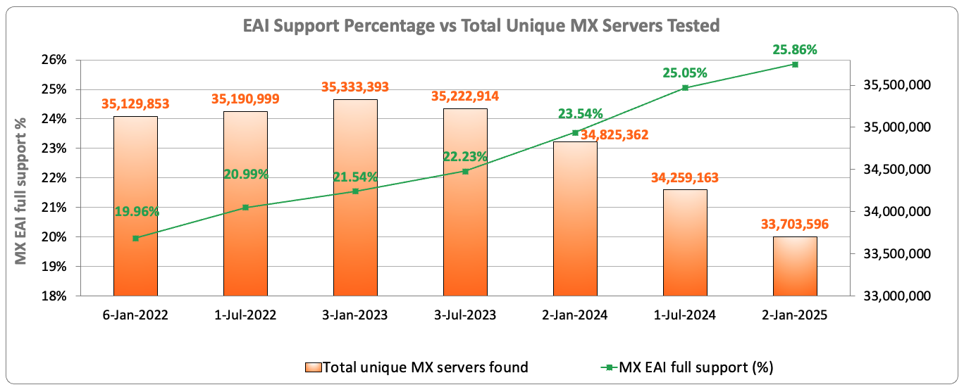
EAI Support Across Email Servers Under gTLDs
Out of the 33.7 million email servers tested in January 2025, only 25.86% show support for internationalized email addresses.
Source: https://ithi.research.icann.org/graph-eai.html
Notes:
Switching to a point per MX server - Multiple MX servers may resolve to the same IP addresses.
Full: All resolved IPs passed the tests
Partial: Some IP passed the tests, and some failed
None: All of the MX server IPs failed the tests
No IPs: No IPs could be resolved for the MX server (e.g. NXdomain)
Not tested: IPs could not be tested (e.g. timeout, refused connections, special use IPs, etc.)

Slide 6
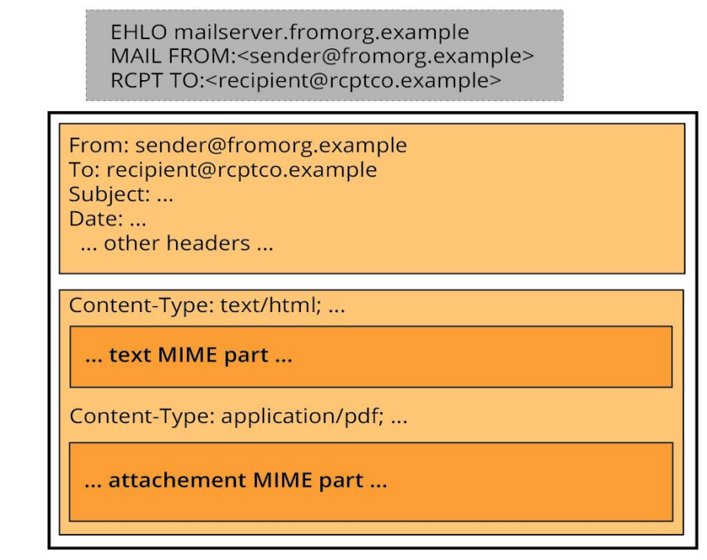
Structure of Email Messages
Envelope – Information that accompanies a message in transit, including the address(es) it is being sent to, and the return address to which error or failure reports can be sent
Message Header – A series of structured fields with a header name such as From: To: or Subject: followed by the contents of the header
free-format, such as the Subject:
fixed-format, such as the Date: and Message-ID:
A combination of fixed- and free-format, such as the To:, From: and Cc: with fixed-format addresses with free-format comment text
Message Body – The contents of a message, which may be unformatted text, or it may be one or more formatted or encoded MIME parts
See EAI: A Technical Overview for details

Slide 7
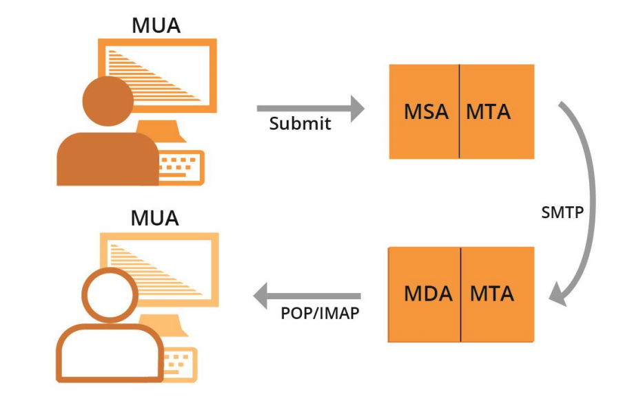
Email Systems
MUA – Mail User Agent - A client program that a person uses to send, receive, and manage mail
MSA – Mail Submission Agent - A server program that receives mail from a MUA and prepares it for transmission and delivery
MTA – Mail Transfer Agent - A server program that sends and receives mail to and from other Internet hosts. An MTA may receive mail from an MSA and/or deliver mail to an MDA
MDA – Mail Delivery Agent - A server program that handles incoming mail and typically stores it in a mailbox or folder
These agents create and process the email envelope, message header and message body and need to be enhanced to handle Unicode text in UTF8 format to support EAI. See EAI: A Technical Overview for details

Slide 8
Email Address Internationalization
What is EAI?
Having UTF8 support for:
mailbox name (before the @ sign).
domain name (after the @ sign).
What is not EAI?
Having UTF8 support in:
Subject line.
Address comments.
Message body
MIME provides all these in conventional mail.
Use of any character set other than UTF-8.

Slide 9
Levels of EAI Implementation
No EAI support - only ASCII email addresses supported by the tools and services.
Level 1/Silver - can exchange email with EAI addresses.
Receive email from an EAI address.
Send email to an EAI address.
Cannot create mailbox and domain name in UTF8.
Level 2/Gold - can create EAI addresses.
Receive email from an EAI address.
Send email to an EAI address.
Create mailbox and domain name in UTF8.

Slide 10
EAI Self-Certification
UASG has developed detailed requirements for EAI support.
Detailed checklist.
Easy to use for verifying that a product/service supports EAI, including peripheral functions like an address book.
Has been used by service providers’ QA teams to check service.
Available at uasg.tech/eai-certification.

Slide 11
Free Servers With EAI Support
For a ready made server including popular software, please email UAProgram@icann.org:
Popular, stable software packages.
All configured to support EAI.
Another example of all-in-one mail server: xmox.nl
Version 0.x, not yet 1.0.
Strong emphasis on working out of the box, with EAI, DKIM, DMARC, DANE etc.
Both need a linux server and a global IP address.
Very low resource usage.
Low-cost virtual server is adequate.

Slide 12
Quiz

Slide 13
Quiz 1
Applications present Internationalized Domain Names (IDNs) and Email Address Internationalization (EAI) to users in the following encoding format(s):
ASCII
UTF-8
UTF-16
UTF-32
Some of the above

Slide 14
Quiz 2
Is .london a valid Top Level Domain?

Slide 15
Configuring for EAI

Slide 16
Pre-Requisites for Setting up EAI
Normalize Unicode (UTF-8) string before processing, storing, etc. For IDNs use NFC form: e + ` (è: U+0065 U+0300) 🡪 è (U+00E8).
Support both representations of IDN labels: U-label and A-label. U-Label is used for displaying and comparing; A-label for processing:
exâmple => exmple-xta => xn--exmple-xta.
Always use IDNA2008, not the older IDNA2003 version.
Do not use code/libraries that have a static list of top-level domains (TLDs) as these change often. See IANA list for TLDs, with regular updates.
Do not use regex for user input validation of internationalized identifiers. Use IDNA2008 libraries for IDN; EAI local part may be difficult to validate.

Slide 17
Email: How To Find the Destination Server
When sending email to user@example.com, the method to find the destination email server is by querying the DNS for the MX records of the domain.
For example, the MX records for example.com could be:
MX 10 server1.example.com
MX 10 server2.example.com
MX 20 server3.example.com
The sender email server would then try connecting to either server1 or server2 since they have same priority (10). If neither server responds, it would then try server3 since it has a lower priority (20).
The higher number means lower priority.

Slide 18
Email Protocol Changes for EAI
SMTP:
Is augmented to support EAI.
Has a signaling flag (SMTPUTF8) to specify support of EAI.
All SMTP servers in the path must support EAI to successfully deliver the email.
POP/IMAP:
Are augmented to properly support EAI.
Have a signaling flag to specify support of EAI.

Slide 19
SMTPUTF8 Example
SMTP
S
R
Server S forwarding an email to server R
S: <connect> R: 220 receive.net ESMTP S: EHLO sender.org R: 250-8BITMIME R: 250-SMTPUTF8 R: 250 PIPELINING S: MAIL FROM:<猫王@普遍接受-测试.世界> SMTPUTF8 R: 250 Sender accepted S:RCPT TO:<ray@receive.net> R:250 Recipient accepted
Specific SMTPUTF8 Signaling (EAI support)

Slide 20
SMTPUTF8 Example
S:DATA R:354 Send your message S:From: 猫王 <猫王@普遍接受-测试.世界> S:To: ray@receive.net S:Subject: 我们要吃午饭吗? S: S:How about lunch at 12:30? S:. R:250 Message accepted 389dck343fg34 S:QUIT R:221 Sayonara
Email message

Slide 21
Email Delivery Path
Using email software for both users.
Using web email for both users.
Mix is also very common: Email software for one user, web email for other user.
Mail server is the MTA; the source and destination servers are MSA and MDA, respectively.
Mail User Client can be on desktop, laptop, or mobile.

Slide 22
Email Delivery Path Considerations
Each user of an email communication chooses his own email environment/software/setup independently.
The sender does not know the receiver email environment, meaning:
The sender does not know which protocols are used to deliver email.
The sender does not know if the receiver email supports some features.
The delivery goes through a chain of email servers.
The number of email servers is unknown.
The actual chain of servers:
Is unknown at the beginning.
May change for any subsequent email sent.
The features supported by each email server is unknown to the path or from the sender.
Features are only discovered one hop at a time (i.e. the next hop).

Slide 23
Protocol Changes, Delivery Path Considerations
To send and receive an email with EAI:
All email parties involved in the delivery path have to be updated for EAI support.
If a single SMTP server in the path does not support EAI, then the email is not delivered.

Slide 24
Protocol Changes, Delivery Path Considerations
What happens when one email (SMTP) server in the path does not support EAI?
The last server trying to send to the next hop:
Sends back to the sender user a report of unable to deliver.
Drops the email.
Similar to reports that a sender receives when an email address does not exist.

Slide 25
Additional Considerations
Case folding:
In ASCII, email users expect the equivalence of lowercase and uppercase. For example, PETER@example.com and peter@example.com will be delivered to the same mailbox.
Typically for EAI, such case folding functionality is not automatically implemented in most EAI-ready software.
SPAM:
EAI emails may be considered as spam by spam filtering software even when proper SPF/DKIM records are enabled.
Software/Services:
Not every server/client software and services support EAI.

Slide 26
EAI Support by Email Tools and Services

Slide 27
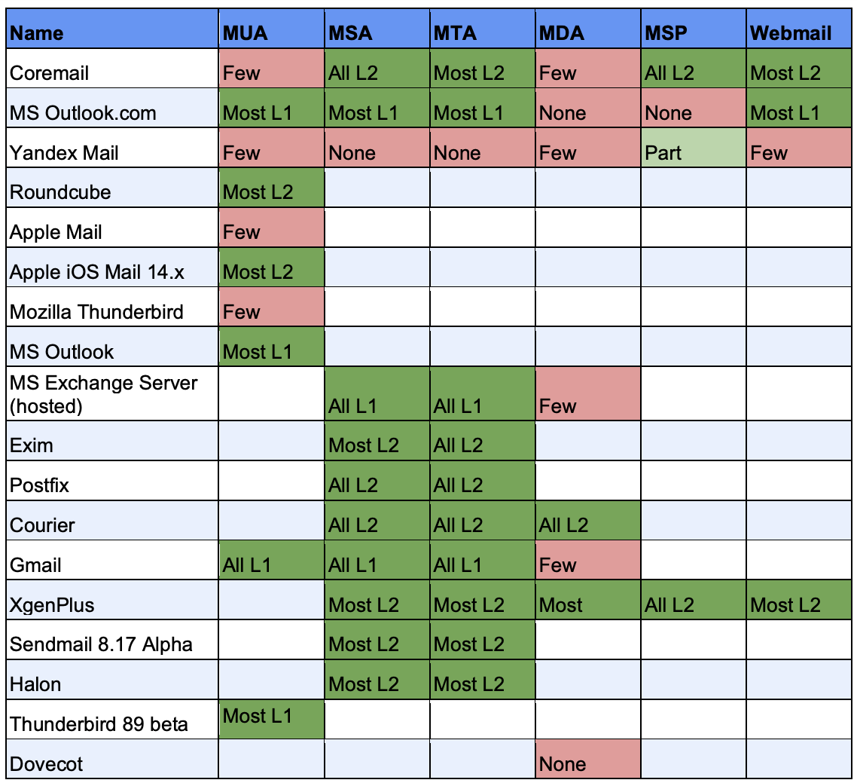
EAI Support by Email Tools and Services (2020)
ICANN carried out detailed testing in 2020, see UASG030A: EAI Software Test Results

Slide 28
Quiz

Slide 29
Quiz 3
For Email Address Internationalization (EAI) to work MTAs should support SMTPUTF8 signaling flag?
- True or False?
.

Slide 30
Quiz 4
Which of the following statement(s) are True when sending and receiving an email with EAI:
All email parties/nodes involved in the delivery path have to be updated for EAI support.
If a single SMTP server in the path does not support EAI, then the email will not be delivered.
POP/IMAP servers could provide downgraded emails to non-EAI conforming email clients but this is not recommended.
None of the above.

Slide 31
Considerations for Mailbox Names Using EAI

Slide 32
Considerations for Mailbox Names Using EAI
UASG028 - Considerations for Naming Internationalized Email Mailboxes
Supported Scripts:
Know user expectations for writing systems for mailbox name and domain name portion.
Understand complexities involved for additional scripts (e.g. security, confusion, etc.).
Length of a Mailbox Name String:
Know constraints of your system and user expectations.
Consider same or a similar policy as for ASCII mailbox names.
Script Mixing:
Allow limited script mixing only when clear user need based on local practice.
Consider security and confusion due to script mixing for mailbox and domain name.

Slide 33
Considerations for Mailbox Names Using EAI
Preventing Invalid and Unstably-Rendered Strings:
Check if Reference IDN tables meet desired mailbox string and update as needed.
Use a string validation tool (e.g. LGR Tool) to validate the mailbox strings.
Right-to-Left (RTL) Script Consideration:
Avoid script mixing with right-to-left scripts to avoid confusability and security issues.
Aliases and Display Names Consideration:
Consider alias-creation option for the user interface during the mailbox name selection. process. ASCII alias can be allowed with an EAI mailbox name.
Optionally allow the user to add additional aliases at a later time.

Slide 34
Considerations for Mailbox Names Using EAI
Signs and Symbols:
Avoid using signs and symbols, especially that do not exist on keyboard/input devices
If required for your market, the dot (.), underscore (_), hyphen (-) and plus sign (+) are commonly used.
Review any additional signs (if needed) and ensure it does not cause a security issue.
Unicode Character Normalization:
Understand the normalization type of your email system.
Ensure that your email program does normalized-form-independent name comparisons.
If it’s possible to select normalization, prefer to use NFC form.

Slide 35
Considerations for Mailbox Names Using EAI
Equivalence Considerations:
Define a policy for determining the “same” or equivalent mailbox names based on the writing system, user expectations, and technical capabilities of your implementation.
Examine the IDN tables, case-folding, separators, numerals, and symbols for policy.
Avoid creating different mailboxes using names which are equivalent to each other.
Share your policy to let end users understand which characters and combinations will be considered valid and which ones might have equivalence.
Other considerations:
Spell domain names with their internationalized non-ASCII names. Avoid displaying the “xn--” alternative name.
Some email clients might not automatically link the U-label and A-label forms of email address mailbox names, so ensure that both labels are mapped to each other.

Slide 36
Quiz

Slide 37
Quiz 5
Which of the following statement(s) are False:
Universal Acceptance (UA) is the state in which all valid domain names and email addresses are accepted, validated, stored, processed, and displayed correctly and consistently.
To achieve Universal Acceptance, Internet applications and systems must treat all Top Level Domains (TLDs) in a consistent manner, including new generic TLDs and all internationalized TLDs.
All domain names should be validated against the Internationalized Domain Names in Applications IDNA2003 Standard.
The A-label represents a domain label in Unicode UTF8 format.
The A-label format is used to represent mailbox names in EAI.

Slide 38
Quiz 6
What is the A-label of 测试 ?
Hint: You can use the tool: https://lgrtool.icann.org/

Slide 39
Are Your Software Applications UA Ready?

Slide 40
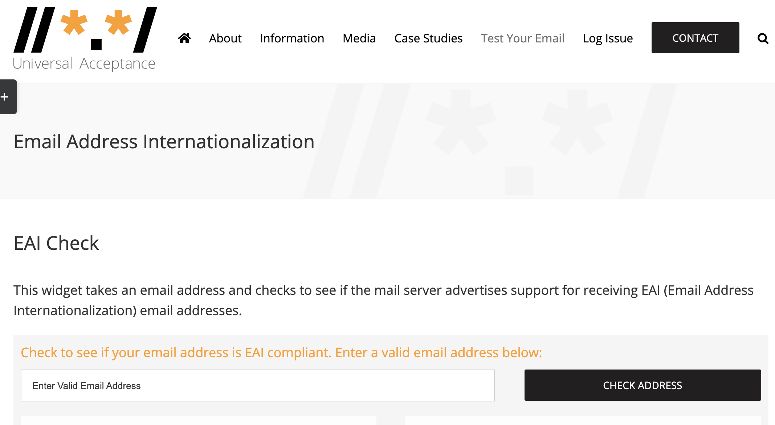
EAI Check
Check if your email server supports Email Address Internationalization (EA):
https://uasg.tech/eai-check/

Slide 41
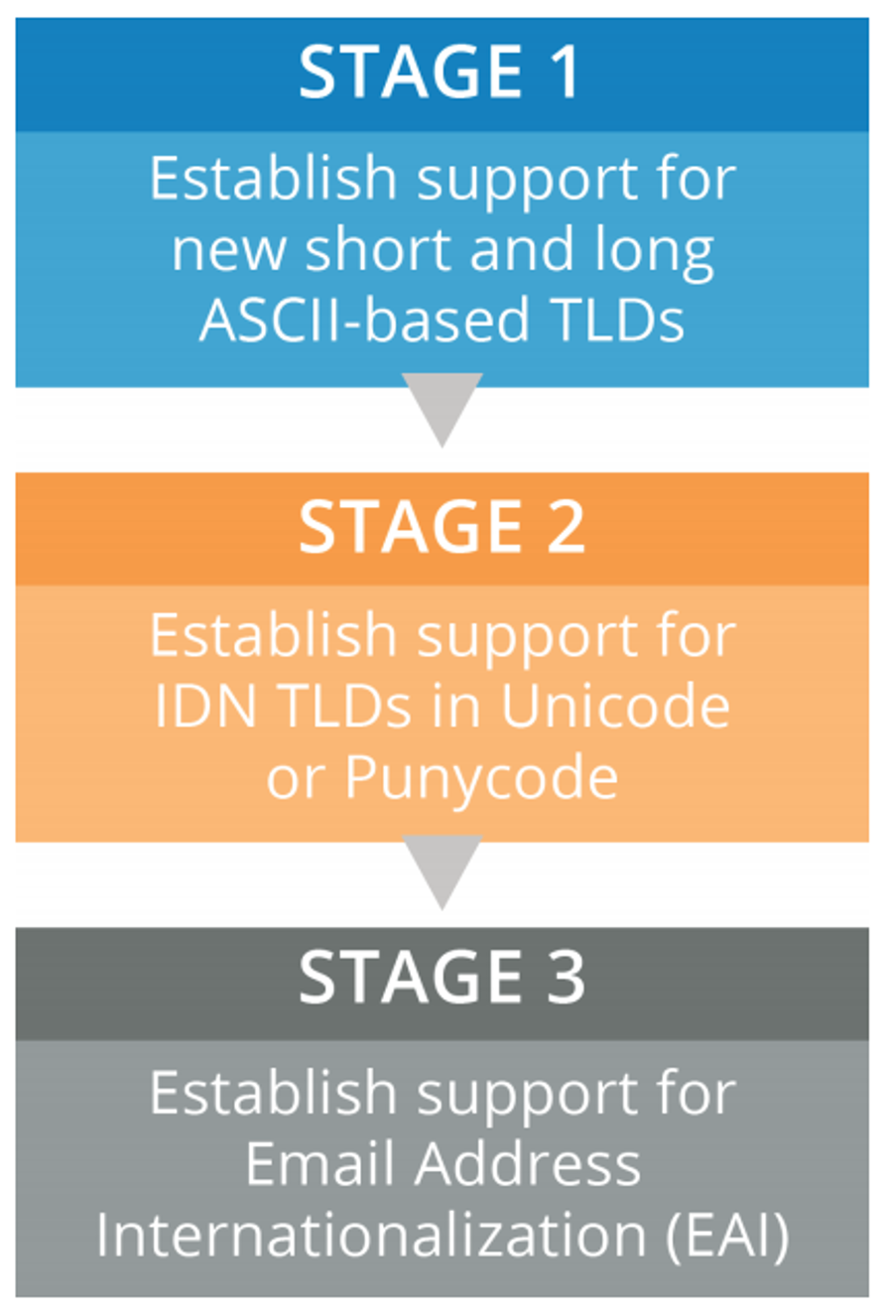
ICANN’s Journey to UA Readiness - Model
Stage 1: Update services to support both new short and long ASCII TLDs.
Stage 2: Update services to support non-ASCII Internationalized Domain Names (IDNs) in Unicode (U-label), and ASCII-based IDN representations in Punycode (A-label).
Stage 3: Update infrastructure and services to support non-ASCII email addresses.
Note: all components must support Email Address Internationalization (EAI) before infrastructure is compliant.
See details in ICANN’s Case Study

Slide 42
Next Steps and Community Support
UASG and ICANN continue to undertake gap analysis, remediation, training and outreach:
Gap analysis – Social Media, Browsers, Programming Languages, EAI Tools, etc.
Remediation – engaging technology forums (e.g. Github) and bug reporting.
Training and outreach – through local initiatives and ambassadors.
We request the community to help address UA readiness and lead by example:
Raise awareness of the technical problems within the community.
Upgrade and use UA ready systems as a community to create the necessary demand, e.g. upgrade email servers, use email in local language.
Advocate more broadly to support UA in their systems (e.g. in e-govt. services; the private sector organizations, etc.).
Such activities may be undertaken in collaboration with UA Local Initiative and UA Ambassadors.

Slide 43
Get Involved!

Slide 44
Get Involved!
For more information, email info@uasg.tech or UAProgram@icann.org.
Access all UA documents and presentations at website: https://uasg.tech and https://icann.org/ua.

Slide 45
Some Relevant Materials
See https://uasg.tech for a complete list of reports.
Universal Acceptance Quick Guide: UASG005
Introduction to Universal Acceptance: UASG007
Quick Guide to EAI: UASG014
EAI – A Technical Overview: UASG012
EAI – Evaluation of Major Email Software and Services: UASG021B
Guide to EAI self-certification
Universal Acceptance Readiness Framework: UASG026
Considerations for Naming Internationalized Email Mailboxes: UASG028
Evaluation of EAI Support in Email Software and Services Report: UASG030
UA-Ready Code Samples in Java, Python, and JavaScript - UASG043

Slide 46
Engage with ICANN – Thank You and Questions

