Slide 1
Programming to Support Universal Acceptance of Domain Names and Email Addresses
UA Day Program
DD Month 2025

Slide 2
Agenda
Introduction
Overview of Universal Acceptance
Quiz
Fundamentals of Unicode
Fundamentals for IDNs and EAI
Programming for UA
Processing Domain Names
Processing Email Address
Conclusion

Slide 3
Overview of Universal Acceptance

Slide 4
Universal Acceptance of Domain Names and Email
Goal
All domain names and email addresses work in all software applications.
Impact
Promote consumer choice, improve competition, and provide broader access to end users.

Slide 5
Categories of Domain Names and Email Addresses
It’s now possible to have domain names and email addresses in local languages using UTF8.
Internationalized Domain Names (IDNs)
Email Address Internationalization (EAI)
Domain names
Newer top-level domain names: example.sky
Longer top-level domain names: example.abudhabi
Internationalized Domain Names: 普遍接受-测试.世界
Internationalized email addresses (EAI)
ASCII@IDN marc@société.org
UTF8@ASCII ईमेल@example.com
UTF8@IDN 测试@普遍接受-测试.世界
UTF8@IDN; right-to-left scripts ای-میل@ مثال.موقع

Slide 6
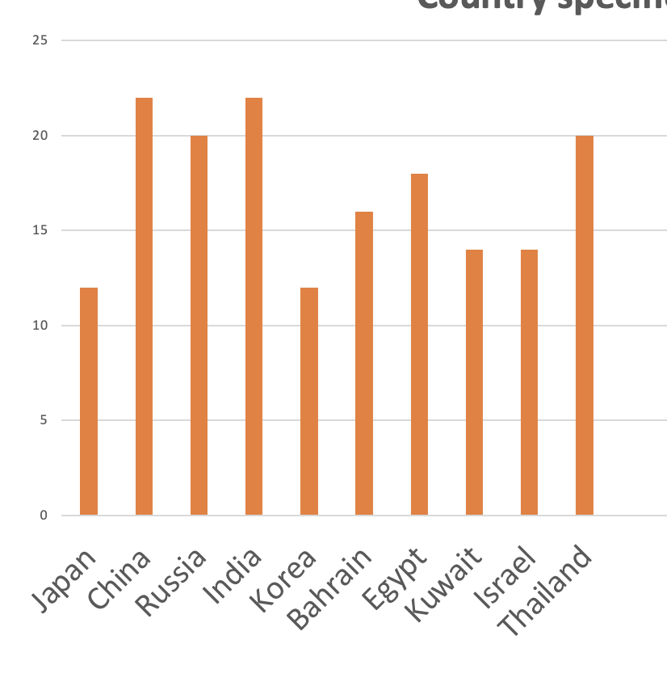
Acceptance of Email Addresses by Websites
EAI (in local language) Acceptance Rates in Form Fields on 1000 Local Websites
(data from 2025 study to be published at UASG.tech)

Slide 7
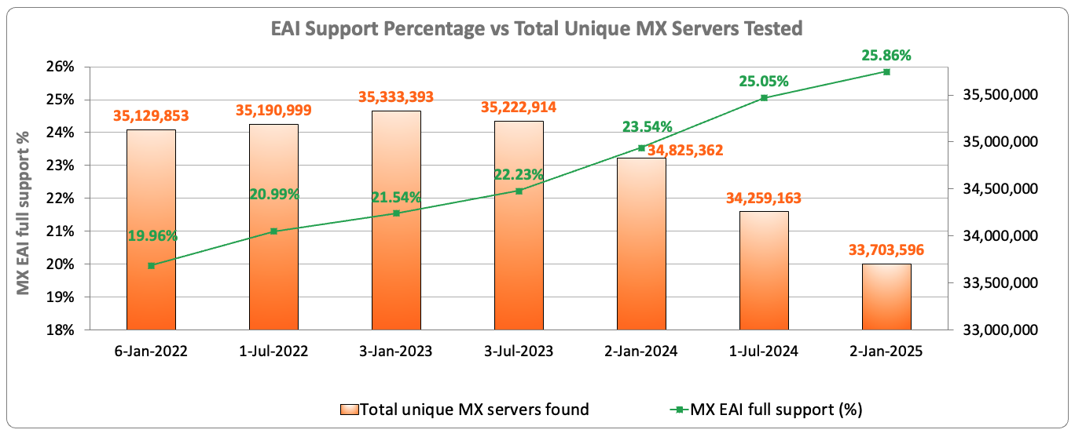
EAI Support Across Email Servers Under gTLDs
Out of the 33.7 million email servers tested in January 2025, only 25.86% show support for internationalized email addresses.
Source: https://ithi.research.icann.org/graph-eai.html
Notes:
Switching to a point per MX server - Multiple MX servers may resolve to the same IP addresses.
Full: All resolved IPs passed the tests
Partial: Some IP passed the tests, and some failed
None: All of the MX server IPs failed the tests
No IPs: No IPs could be resolved for the MX server (e.g. NXdomain)
Not tested: IPs could not be tested (e.g. timeout, refused connections, special use IPs, etc.)

Slide 8
Scope of UA Readiness for Programmers
Support all Domain Names including Internationalized Domain Names (IDNs) and all Email Addresses, including Internationalized Email Addresses (EAI):
Accept: The user can input characters from their local script into a text field.
Validate: The software accepts the characters and recognizes them as valid.
Process: The system performs operations with the characters.
Store: The database can store the text without breaking or corrupting.
Display: When fetched from the database, the information is correctly shown.
Accept
Validate
Process
Store
Display

Slide 9
Technology Stack for UA Consideration
Applications and Websites
- Wikipedia.org, ICANN.org, Amazon.com, custom websites globally
- PowerPoint, Google-Docs, Safari, Acrobat, custom apps
Social Media and Search Engines
- Chrome, Bing, Safari, Firefox, local (e.g., Chinese) browsers
- Facebook, Instagram, Twitter, Skype, WeChat, WhatsApp, Viber
Programming Languages and Frameworks
- JavaScript, Java, Swift, C#, PHP, Python
- Angular, Spring, .NET core, J2EE, WordPress, SAP, Oracle
Accept, validate, process, store and display
all domain names and email addresses.
Platforms, Operating Systems and Sytem Tools
- iOS, Windows, Linux, Android, App Stores
- Active Directory, OpenLDAP, OpenSSL, Ping, Telnet
Standards and Best Practices
- IETF RFCs, W3C HTML, Unicode CLDR, WHATWG
- Industry-based standards (health, aviation, ...)

Slide 10
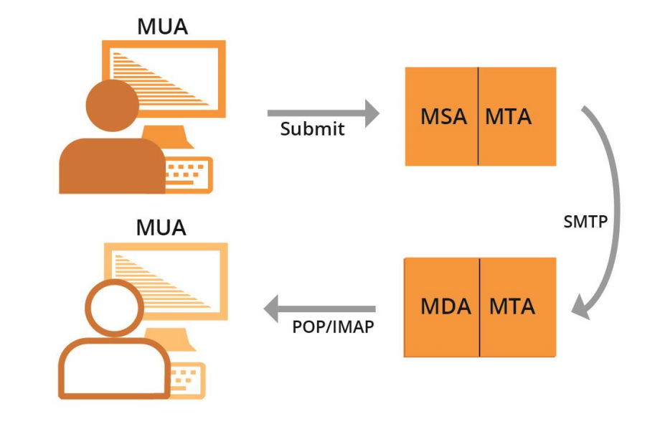
Email Systems and EAI Support
All email agents must be configured to send and receive internationalized email addresses. See EAI: A Technical Overview for details.
MUA – Mail User Agent: A client program that a person uses to send, receive, and manage mail.
MSA – Mail Submission Agent: A server program that receives mail from a MUA and prepares it for transmission and delivery.
MTA – Mail Transfer Agent: A server program that sends and receives mail to and from other Internet hosts. An MTA may receive mail from an MSA and/or deliver mail to an MDA.
MDA – Mail Delivery Agent: A server program that handles incoming mail and typically stores it in a mailbox or folder.

Slide 11
Quiz

Slide 12
Quiz 1 Question
To enhance systems to be Universal Acceptance (UA) ready, which of the following categories of domain names and email addresses are relevant?
ASCII domain names.
Internationalized Domain Names (IDNs).
Internationalized email addresses (EAI).
All the above.
Only 2 and 3.

Slide 13
Quiz 1 Question
To enhance systems to be Universal Acceptance (UA) ready, which of the following categories of domain names and email addresses are relevant?
ASCII domain names.
Internationalized Domain Names (IDNs).
Internationalized email addresses (EAI).
All the above.
Only 2 and 3.

Slide 14
Fundamentals of Unicode

Slide 15
Character and Character Set
A label or string such as أهلا, नमस्ते, Hello is formed of characters.
Hello --> H e l l o
A character is unit of information used for the organization, control, or representation of textual data.
Examples of character:
Letters
Digits
Special characters i.e. Mathematical symbols , punctuation marks
Control Characters - typically not visible
American Standard Code for Information Interchange (ASCII) encodes characters used in computing including letters a-z, digits 0-9 and others.

Slide 16
Code Point
Code point is a value, or a position, for a character, in any coded character set.
Code point is a number assigned to represent an abstract character in a system for representing text.
Notes:
https://bournetocode.com/projects/GCSE_Computing_Fundamentals/pages/3-3-5-ascii.html

Slide 17
Code Point
Code point is a value, or a position, for a character, in any coded character set.
Code point is a number assigned to represent an abstract character in a system for representing text.
Notes:
https://bournetocode.com/projects/GCSE_Computing_Fundamentals/pages/3-3-5-ascii.html

Slide 18
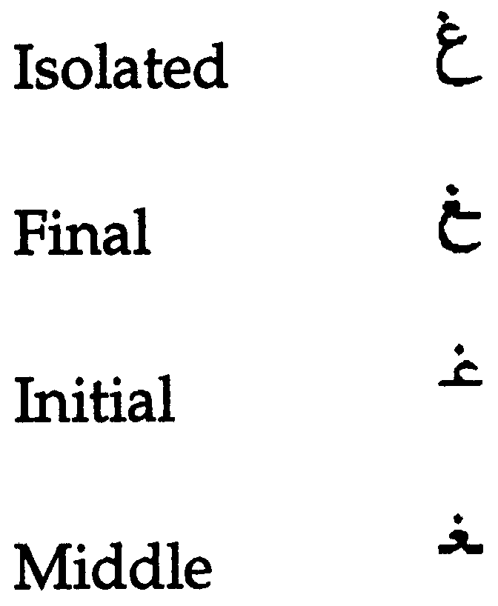
Glyph
A typographic representation of a character is called a glyph.
English: a, a
Each Arabic letters often have four glyphs based on where they occur in a string. For example, for the ARABIC LETTER GHAIN the four glyphs are:
Languages may be written/displayed in right-to-left and left-to-right order but reading of data is on the basis of key press order in a file and not dependent on writing direction.

Slide 19
Character Encoding
Character encoding is mapping from a character set definition to the actual code units used to represent the data.
An encoding describes how to encode code points to bytes and how to decode bytes to code points.

Slide 20
A Brief History
Basic ASCII single 7-bit character, limited to a maximum of 128 characters.
Extended ASCII single 8-bit character, limited to a maximum limit of 256 characters.
ASCII encoding could contain enough characters to cover all the languages.
So, different encoding systems were developed for assigning numbers to characters for different languages and scripts, which created interoperability problems.

Slide 21
Unicode Standard
The standard for digital representation of the characters used in writing all of the world's languages.
Organized characters at script level.
Unicode provides a uniform means for storing, searching, and interchanging text in any language.
It is used by all modern computers and is the foundation for processing text on the Internet.
Number of slots to represent world languages is 0000 – 10FFFF. See https://unicode.org/charts/ to see script coverage and encoding ranges.

Slide 22
Unicode Encoding
Unicode can be implemented by different character encodings.
UTF-8
UTF-16
UTF-32
UTF-8 encoding is generally used in domain name system.
UTF-8 is variable length character encoding.
UTF-8 encodes code points in one to four bytes, read one byte at a time:
For ASCII characters 1 byte is used.
For Arabic characters 2 bytes are used.
For Devanagari characters 3 bytes are used.
For Chinese characters 4 bytes are used.
So, for byte level reading, we need to specify encoding before file reading.

Slide 23
Hello World: Python
print("Enter your input: ")
inputstr = input() #default character encoding is UTF-8
print("Input data is: ")
print(inputstr)

Slide 24
Hello World: Java
import java.util.Scanner;
public class ReadWriteUnicode {
public static void main(String[]args) {
Scanner scr = new Scanner(System.in);
System.out.println("Enter your input");
String Input = scr.nextLine(); //default character encoding is UTF-8
System.out.println("Receieved input is: "+Input);
}
}

Slide 25
Unicode Encoding – File Reading/Writing in Python
Read UTF-8 file
Write UTF-8 file
file = open("filepath",'r',encoding='UTF-8') for line in file: print(line) file.close()
file2 = open(“filepath",'w',encoding='UTF-8') data_to_write='اُن کے وکلا کی کوشش ہو گی' file2.writelines(data_to_write) file2.close()

Slide 26
Unicode Encoding – File Reading in Java
public void ReadFile(String filename){
try {
FileInputStream fis = new FileInputStream(filename);
InputStreamReader isr = new InputStreamReader(fis, StandardCharsets.UTF_8)
BufferedReader br = new BufferedReader(isr);
String line ="";
while((line = br.readLine())!=null) {
System.out.println(line);
}
fis.close();
}catch(IOException ex) {
System.err.println(ex.toString());
}
}

Slide 27
Unicode Encoding – File Writing in Java
public void WriteFile(String filename, String text){
try{
FileOutputStream fis = new FileOutputStream(filename);
OutputStreamWriter osw = new OutputStreamWriter(fis,StandardCharsets.UTF_8);
BufferedWriter bw = new BufferedWriter(osw);
bw.write(text);
bw.flush();
fis.close();
}catch(IOException ex) {
System.err.println(ex.toString()); }
}

Slide 28
Normalization
There are multiple ways to encode certain glyphs in Unicode:
è = U+00E8
e + ` = è = U+0065 + U+0300
آ = U+0622
ٓ + ا = آ =U+0627 U+0653
The following string can exist in corpus in the form of first string below, whereas input string is in the form of second string, below. So, search result will be empty.
آدم (U+0622 U+062F U+0645)
آدم (U+0627 U+0653 U+062F U+0645)
For searching , sorting and any string operations we need normalization.
Normalization ensures that the end representation is the same, even if users type differently

Slide 29
Normalization
Different normalization forms defined by Unicode are listed below:
Normalization Form D (NFD)
Normalization Form C (NFC)
Normalization Form KD (NFKD)
Normalization Form KC (NFKC)
In domain names NFC is used.

Slide 30
Normalization Code - Python
import unicodedata
input_str = input() # take input from user
normalized_input = unicodedata.normalize('NFC',input_str) #normalize user input
print(normalized_input)

Slide 31
Normalization Code - Java
import com.ibm.icu.text.Normalizer2
Scanner sc = new Scanner(System.in);
Normalizer2 norm = Normalizer2.getNFCInstance(); //get NFC object
String input;
input = sc.nextline();
String normalized_input = norm.normalize(input);

Slide 32
Internationalized Domain Names

Slide 33
Domain Names
A domain name is an ordered set of labels or strings: www.example.co.uk.
The top-level domain (TLD) is the rightmost label: ”uk”.
Second-level domain: “co”.
Third-level domain: “example”.
Initially, TLDs were only two or three characters long (e.g., .ca, .com).
Now TLDs can be longer strings (e.g., .info, .google, .engineering).
TLDs delegated in the root zone can change over time, so a fixed list can get outdated.
Each label is 63 Octet.
Total domain name length cannot be more than 255 (including separators).

Slide 34
Internationalized Domain Names (IDNs)
Domain names can also be internationalized when one of the labels contains at least one non-ASCII character.
For example: www.exâmple.ca , 普遍接受-测试.世界. , صحة.مصر, ทัวร์เที่ยวไทย.ไทย
There are two equivalent forms of IDN domain labels: U-label and A-label.
Human users use the IDN version called U-label (using UTF-8 format): exâmple
Applications or systems internally use an ASCII equivalent called A-label:
Take user input and normalize and check against IDNA2008 to form IDN U-label.
Convert U-label to punycode (using RFC3492).
Add the “xn--” prefix to identify the ASCII string as an IDN A-label.
exâmple => exmple-xta => xn--exmple-xta
普遍接受-测试 => --f38am99bqvcd5liy1cxsg => xn----f38am99bqvcd5liy1cxsg
Use the latest IDN standard called IDNA2008 for IDNs.
Do not use libraries for the outdated IDNA2003 version.

Slide 35
Convert U-Label => A-Label: Python
import unicodedata #library for normalization import idna #library for conversion domainName = 'صحة.مصر' try: domainName_normalized = unicodedata.normalize('NFC', domainName) #normalize to NFC print(domainName_normalized) domainName_alabel = idna.encode(domainName_normalized).decode("ascii") #U-label to A-label print(domainName_alabel) domainName_ulabel = idna.decode(domainName_alabel) print(domainName_ulabel) except idna.IDNAError as e: print("Domain '{domainName}' is invalid: {e}") #invalid domain as per IDNA 2008 except Exception as e: print("ERROR: {e}")

Slide 36
Convert U-Label => A-Label: Java
International Components for Unicode (ICU).
The gold standard library for Unicode. It was developed by IBM and is now managed by Unicode. In sync with Unicode standards.
IDNA Conversion is based on Unicode UTS46, which supports transition from IDNA2003 to IDNA2008. However, it is possible to configure not to support transition (recommended).
IDNA Conversion includes normalization as per IDNA (good!).
Check if there are errors in the conversion by calling info.hasErrors().
For IDNs, set the options to restrict the validation and use to IDNA2008.
The static methods implement IDNA2003, and non-static methods implement IDNA2008.

Slide 37
Convert U-Label => A-Label: Java
import com.ibm.icu.text.IDNA;
public static String convertULabeltoALabel(String Ulabel) {
String Alabel = "";
final IDNA idnaInstance = IDNA.getUTS46Instance(IDNA.NONTRANSITIONAL_TO_ASCII
| IDNA.CHECK_BIDI
| IDNA.CHECK_CONTEXTJ
| IDNA.CHECK_CONTEXTO
| IDNA.USE_STD3_RULES);
StringBuilder output = new StringBuilder();
IDNA.Info info = new IDNA.Info();
idnaInstance.nameToASCII(Ulabel, output, info);
Alabel = output.toString();
if (!info.hasErrors()) {
return Alabel;
} else {
//Conversion fails
return info.getErrors().stream().toString();
}
}

Slide 38
Convert U-Label => A-Label: Java
import com.ibm.icu.text.IDNA;
public static String convertALabeltoULabel(String Alabel) {
String Ulabel = "";
final IDNA idnaInstance = IDNA.getUTS46Instance(IDNA.NONTRANSITIONAL_TO_ASCII
| IDNA.CHECK_BIDI
| IDNA.CHECK_CONTEXTJ
| IDNA.CHECK_CONTEXTO
| IDNA.NONTRANSITIONAL_TO_UNICODE
| IDNA.USE_STD3_RULES);
StringBuilder output = new StringBuilder();
IDNA.Info info = new IDNA.Info();
idnaInstance.nameToUnicode(Alabel, output, info);
Ulabel = output.toString();
if (!info.hasErrors()) {
return Ulabel;
} else {
return info.getErrors().stream().toString();
}
}

Slide 39
Domain Name Validation

Slide 40
Validating Domain Name
Validating syntax:
ASCII: RFC1035
Composed of letters, digits, and hyphen.
Max length is 255 octets with each label up to 63 octets.
IDN: IDNA2008 (RFCs 5890-5894)
Valid A-labels
Valid U-labels

Slide 41
Validate Domain Name: Python
import unicodedata #library for normalization import idna #library for conversion domainName = 'صحة.مصر' try: domainName_normalized = unicodedata.normalize('NFC', domainName) #normalize to NFC print(domainName_normalized)
#U-label to A-label domainName_alabel = idna.encode(domainName_normalized).decode("ascii") print(domainName_alabel) except idna.IDNAError as e: #invalid domain as per IDNA 2008
print("Domain '{domainName}' is invalid: {e}") except Exception as e: print("ERROR: {e}")

Slide 42
Validate Domain Name: Java
import com.ibm.icu.text.IDNA;
public static boolean isValidDomain(String DomainName) {
String Alabel = "";
final IDNA idnaInstance = IDNA.getUTS46Instance(IDNA.NONTRANSITIONAL_TO_ASCII
| IDNA.CHECK_BIDI
| IDNA.CHECK_CONTEXTJ
| IDNA.CHECK_CONTEXTO
| IDNA.USE_STD3_RULES);
StringBuilder output = new StringBuilder();
IDNA.Info info = new IDNA.Info();
idnaInstance.nameToASCII(DomainName, output, info);
Alabel = output.toString();
if (!info.hasErrors()) {
return true;
} else {
//Conversion fails
return false;
}
}

Slide 43
Domain Name Resolution

Slide 44
Domain Name Resolution
After validation, a software would then use the domain name identifier as:
A domain name to be resolved in the DNS.
Traditional way of doing hostname resolution and sockets resolution cannot be used for IDNs.
We need to do following:
Take user input and normalize
Convert U-label to A-label (IDNA2008)
Use A-label for hostname resolution

Slide 45
Domain Name Resolution – Python
import socket import unicodedata import idna domainName='' try: #normalize domain Name domainName_normalized = unicodedata.normalize('NFC', domainName) #Convert U-label to A-label form domainName_alabelForm = idna.encode(domainName_normalized).decode("ascii") #get IP address of the domain ip = socket.gethostbyname(domainName_alabelForm) print(ip) except Exception as ex: print(ex)

Slide 46
Domain Name Resolution – Java
Normalization and U-label to A-label conversion is same as discussed before.
import java.net.InetAddress;
try {
InetAddress ad = InetAddress.getByName(domainNameAlabelForm);
String ip = ad.getHostAddress(); // returns ip for domain
System.out.println(ip);
} catch (Exception ex) {
System.out.println(ex.toString()); //Unknown host exception
}

Slide 47
Domain Name Storage
We need to ensure that database supports and configure for UTF-8.
SQL, e.g., MySQL, Oracle, Microsoft SQL Server.
Set domain names to max: 255 octets, 63 octets per label.
In UTF-8 native, variable length.
Recommendation to use variable length String columns.
Consider/verify the object-relational mapping (ORM) driver/tool if you are using one.
noSQL, e.g., MongoDB, CouchDB, Cassandra, HBase, Redis, Riak, Neo4J.
Already UTF-8 variable length.
Store and retrieve either U-label or A-label in a field consistently.
You can also store both U-label and A-label in separate fields.

Slide 48
Email Address Internationalization (EAI)

Slide 49
Email Address
Email address syntax: mailboxName@domainName.
Email has a mailboxName.
Email has a domainName.
The domainName can be ASCII or IDN.
For example:
myname@example.org
myname@xn--exmple-xta.ca

Slide 50
EAI
EAI has the mailboxName in Unicode (in UTF-8 format).
The domainName can be ASCII or IDN.
For example:
kévin@example.org
すし@ xn--exmple-xta.ca
すし@快手.游戏.

Slide 51
Email Addresses Form
name@exâmple.ca and name@xn--exmple-xta.ca represent equivalent email address.
Application should be able to treat both forms as equivalent.
Internally consistently use A-label or U-label, but don’t mix A-label and U-label.
Technical Recommendation: Backend processing should be in A-label, and U-label for visual inspection.
For example, new user registration in application with equivalent A-label.

Slide 52
Email Validation: Email Regular Expressions (Regex)
Basic: something@something.
^(.+)@(.+)$
From owasp.org (security):
[^[a-zA-Z0-9_+&*-]+(?:\.[a-zA-Z0-9_+&*-]+)*@(?:[a-zA-Z0-9-]+\.)+[a-zA-Z]{2,7}$].
Does not support EAI, i.e., mailbox name in UTF8 not allowed: [a-zA-Z0-9_+&*-].
Does not support ASCII TLD longer than 7 characters: [a-zA-Z]{2,7}.
Does not support U-labels in IDN TLD: [a-zA-Z].
But OWASP is THE reference for security.
Therefore, you may end up fighting with your security team to use a UA-compatible Regex instead of the “standard” one from OWASP.

Slide 53
Email Regular Expressions (Regex)
Example of Regex suggested in various forums: ex: List of proposals
^[A-Za-z0-9+_.-]+@(.+)$ does not support UTF8 in mailbox name.
^[a-zA-Z0-9_!#$%&’*+/=?`{|}~^.-]+@[a-zA-Z0-9.-]+$ does not support U-labels.
^[a-zA-Z0-9_!#$%&’*+/=?`{|}~^-]+(?:\\.[a-zA-Z0-9_!#$%&’*+/=?`{|}~^-]+)*@[a-zA-Z0-9-]+(?:\\.[a-zA-Z0-9-]+)*$ does not support U-labels.
^[\\w!#$%&’*+/=?`{|}~^-]+(?:\\.[\\w!#$%&’*+/=?`{|}~^-]+)*@(?:[a-zA-Z0-9-]+\\.)+[a-zA-Z]{2,6}$ have length restrictions for the TLD between 2 – 6 characters.
One can come up with an EAI-IDN compatible regex using various Unicode codepoints characteristics.
For IDN it would be like a reimplementation of the IDNA protocol tables in regex!
Given that both sides of an EAI may have UTF8, then one regex for an EAI could be .*@.* which is only verifying the presence of the ‘@’ character.

Slide 54
Validate Email

Slide 55
Email Addresses Validation
Email has a mailboxName.
Email has a domainName.
DomainName validation same as before.
mailboxName validation require a valid UTF8 String.
Local administrator defines policy for mailboxName.
Gmail policy: firstname.lastname@gmail.com is equivalent to firstnamelastname@gmail.com.
Guidelines for mailboxName are available by UASG.

Slide 56
EAI Validation - Python
from email_validator import validate_email,EmailNotValidError logger = logging.getLogger(__name__)
try: # As part of process it performs DNS resolution # Normalizes email addresses automatically # Supports internationalized domain names validated = validate_email(email_address, check_deliverability=True) print(validated) logger.info("'{address}' is a valid email address") print("'{address}' is a valid email address") except EmailNotValidError as e: print("'{address}' is not a valid email address: {e}") except Exception as ex: print("Unexpected Exception")

Slide 57
EAI Validation - Java
Apache Common Validator:
Has domain and email validators.
Do not use as it relies on a static list of TLDs! OUTDATED!

Slide 58
EAI Validation - Java
/**
* Download the list of TLDs on ICANN website
*/
public static String[] retrieveTlds() {
String IANA_TLD_LIST_URL = "https://data.iana.org/TLD/tlds-alpha-by-domain.txt";
StringBuilder out = new StringBuilder();
try (BufferedInputStream in = new BufferedInputStream(
new URL(IANA_TLD_LIST_URL).openStream())) {
byte[] dataBuffer = new byte[1024];
int bytesRead;
while ((bytesRead = in.read(dataBuffer, 0, 1024)) != -1) {
out.append(new String(dataBuffer, 0, bytesRead));
}
} catch (IOException e) {
// handle exception
}
return Arrays.stream(out.toString().split("\n"))
.filter(s -> !s.startsWith("#"))
.map(String::toLowerCase).distinct().toArray(String[]::new);
}

Slide 59
EAI Validation - Java
public static DomainValidator createDomainValidatorInstance(String domain,
boolean use_actual_domains) {
List<Item> domains = new ArrayList<>();
if (use_actual_domains) {
domains.add(new Item(GENERIC_PLUS, retrieveTlds()));
} else {
String tld = domain;
if (domain.contains(".")) {
tld = domain.substring(domain.lastIndexOf(".") + 1);
}
// Convert TLD to A-Label
String domainConverted = convertULabeltoALabel(tld);
// if there is an error, do nothing, validator will fail
if (domainConverted!="") {
domains.add(new Item(GENERIC_PLUS, new String[]{domainConverted}));
}
}
return DomainValidator.getInstance(false, domains);
}

Slide 60
EAI Validation - Java
public static boolean isValidEmail(String emailaddress){
emailaddress = Normalizer2.getNFCInstance().normalize(emailaddress);
String[]emailparts = emailaddress.split("@");
if(emailparts.length==2){
String mailboxname = emailparts[0];
String domainName = emailparts[1];
String domainNameAlabelForm =convertULabeltoALabel(domainName);
try {
EmailValidator em = new EmailValidator(false, false,
createDomainValidatorInstance(domainName,true));
if(em.isValid(mailboxname+"@"+domainNameAlabelForm)){
return true;
}
return false;
} catch (Exception ex) {
System.out.println(ex.toString());
return false;
}
}
else{
return false;
}
}

Slide 61
Sending and Receiving Email

Slide 62
Sending and Receiving
We need to be able to send to either form:
mailboxName-UTF-8@A-labelform.
mailboxName-UTF-8@U-labelform.
We need to be able to receive to either form:
mailboxName-UTF-8@A-labelform.
mailboxName-UTF-8@U-labelform.
Storage of email should be consistent with domain name in either A-label or U-label form.
Backend send/receive should be managed by mail server.
Handover process (Front end application 🡪 email server).
Libraries used in handover process should be EAI Compliant.
Mail server should also be EAI compatible.
How to make mail server EAI compatible is out of scope of this training?

Slide 63
Sending and Receiving – Python
Smtplib can be used to send EAI-compliant emails.
It does not validate the domain compliance with IDNA 2008, therefore another validation method should be used before trying to send an email.
For instance, using the email-validator library.

Slide 64
Sending and Receiving – Python
try: to = 'kévin@example.com' local_part, domain = to.rsplit('@', 1) domain_normalized= unicodedata.normalize('NFC',domain)#normalize domain name to = '@'.join((local_part,idna.encode(domain_normalized).decode('ascii’)))#convert U-label to A-label validated = validate_email(to, check_deliverability=True) #validate email address if validated: host='' port='' smtp = smtplib.SMTP(host, port) smtp.set_debuglevel(False) smtp.login(‘useremail’,’password') sender=‘ua@test.org' subject='hi' content='content here' msg = EmailMessage() msg.set_content(content) msg['Subject'] = subject msg['From'] = sender msg['to']=to smtp.send_message(msg, sender, to) smtp.quit() logger.info("Email sent to '{to}'") except smtplib.SMTPNotSupportedError: # The server does not support the SMTPUTF8 option, you may want to perform downgrading logger.warning("The SMTP server {host}:{port} does not support the SMTPUTF8 option") raise

Slide 65
Sending and Receiving – Java
Jakarta Mail can be used for sending email.
import com.sun.mail.smtp.SMTPTransport;
import jakarta.mail.Message;
import jakarta.mail.MessagingException;
import jakarta.mail.PasswordAuthentication;
import jakarta.mail.Session;
import jakarta.mail.Transport;
import jakarta.mail.internet.InternetAddress;
import jakarta.mail.internet.MimeMessage;
import java.util.Date;
import java.util.Properties;

Slide 66
Sending and Receiving – Java
public static boolean sendEmail(String to, String host, String sender,
String subject, String content,String username,String password){
if(isValidEmail(to))
{
Properties props = new Properties();
props.put("mail.smtp.host", host);
props.put("mail.smtp.port", "587");
props.put("mail.smtp.auth", "true");
props.put("mail.smtp.starttls.enable", "true");
// enable UTF-8 support, mandatory for EAI support
props.put("mail.mime.allowutf8", true);
Session session = Session.getInstance(props,
new jakarta.mail.Authenticator() {
protected PasswordAuthentication getPasswordAuthentication() {
return new PasswordAuthentication(username, password);
}
});

Slide 67
Sending and Receiving – Java(2)
/*
* Jakarta mail is EAI compliant with 2 issues:
* - it rejects domains that are not NFC normalized
* - it rejects some unicode domains
* In such case, first try to normalize, then convert domain to A-label. We do normalization
* first to get an email address the closest possible to the user input because once
* converted in A-label it may be displayed as is to the user.
*/
String[] add_parts = to.split("@");
String mailboxName = add_parts[0];
String domainName = add_parts[1];
String domainNameNormalized =Normalizer2.getNFCInstance().normalize(domainName);
String domainNameAlabelForm = convertULabeltoALabel(domainNameNormalized);
String compliantTo = mailboxName+"@"+domainNameAlabelForm;

Slide 68
Sending and Receiving – Java(3)
try (Transport transport = session.getTransport())
{
if (transport instanceof SMTPTransport && !((SMTPTransport) transport).supportsExtension("SMTPUTF8")) {
try {
MimeMessage message = new MimeMessage(session);
//set message headers for internationalized content
message.addHeader("Content-type", "text/HTML; charset=UTF-8");
message.addHeader("Content-Transfer-Encoding", "8bit");
message.addHeader("format", "flowed");
message.setFrom(new InternetAddress(sender));
message.setSubject(subject, "UTF-8");
message.setText(content, "UTF-8");
message.setSentDate(new Date());
message.setRecipient(Message.RecipientType.TO, new InternetAddress(compliantTo));
Transport.send(message);
return true;
} catch (Exception e) {
System.out.println(String.format("Failed to send email to %s: %s", to, e));
}
}
else
{ return false;}
} catch (MessagingException e) {
// ignore
}
}
return false;}

Slide 69
Conclusion

Slide 70
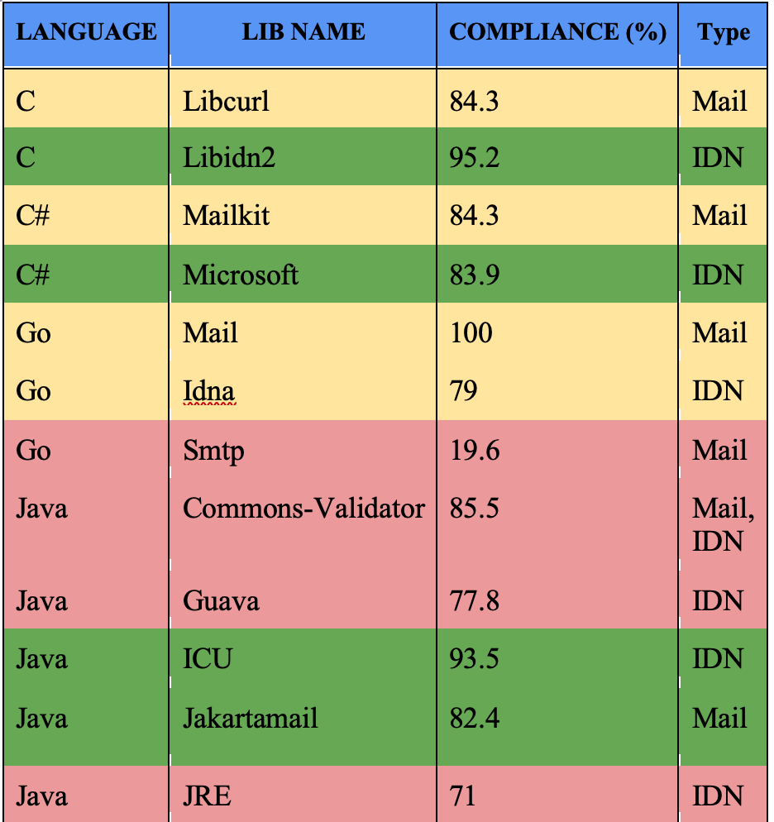
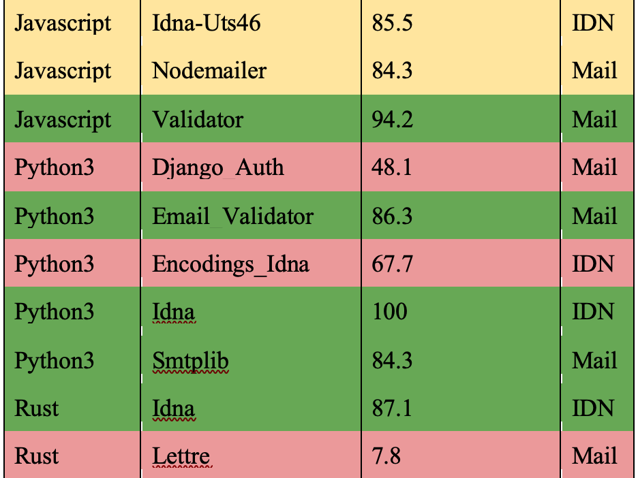
Prog. Languages Support
UASG018A – note that some have improved since.

Slide 71
Free Servers With EAI Support
For a ready made server including popular software, please email UAProgram@icann.org :
Popular, stable software packages
All configured to support EAI
Example of another all-in-one mail server: xmox.nl
Version 0.x, not yet 1.0
Strong emphasis on working out of the box, with EAI, DKIM, DMARC, DANE etc
Both need a linux server and a global IP address
Very low resource usage
Low-cost virtual server is adequate

Slide 72
Conclusion
Be aware that UA identifiers may not be fully supported in software and libraries.
Use the right libraries and frameworks.
Adapt your code to properly support UA.
Do unit and system testing using UA test cases to ensure that your software is UA ready.

Slide 73
Get Involved!

Slide 74
Get Involved!
For more information on UA, email info@uasg.tech or UAProgram@icann.org
Access all UASG documents and materials at: https://uasg.tech and https://icann.org/ua

Slide 75
Some Relevant Materials
See https://uasg.tech for a complete list of reports.
Universal Acceptance Quick Guide: UASG005
Introduction to Universal Acceptance: UASG007
Quick Guide to EAI: UASG014
EAI – A Technical Overview: UASG012
UA Compliance of Some Programming Language Libraries and Frameworks – UASG018A
EAI – Evaluation of Major Email Software and Services: UASG021B
Universal Acceptance Readiness Framework: UASG026
Considerations for Naming Internationalized Email Mailboxes: UASG028
Evaluation of EAI Support in Email Software and Services Report: UASG030
UA of Content Management Systems (CMS) Phase 1 – WordPress: UASG032
UA-Ready Code Samples in Java, Python, and JavaScript - UASG043

Slide 76
Engage with ICANN – Thank You and Questions
Email: sarmad.hussain@icann.org

