Slide 1
Technical Overview of Universal Acceptance of Domain Names and Email Addresses
UA Day Program
DD Month 2025

Slide 2

Agenda
Introduction
Overview of Universal Acceptance
Fundamentals of Unicode
Fundamentals for IDNs
Fundamentals for EAI
Conclusion

Slide 3
Overview of Universal Acceptance

Slide 4
Universal Acceptance of Domain Names and Email
Goal
All domain names and email addresses work in all software applications.
Impact
Promote consumer choice, improve competition, and provide broader access to end users.

Slide 5
Categories of Domain Names and Email Addresses
It’s now possible to have domain names and email addresses in local languages using UTF8.
  Internationalized Domain Names (IDNs)
  Email Address Internationalization (EAI)
Domain names
  Newer top-level domain names: example.sky
  Longer top-level domain names: example.abudhabi
  Internationalized Domain Names: 普遍接受-测试.世界
Internationalized email addresses (EAI)
  ASCII@IDN marc@société.org
  UTF8@ASCII ईमेल@example.com
  UTF8@IDN 测试@普遍接受-测试.世界
  UTF8@IDN; right-to-left scripts موقع.مثال@میل-ای

Slide 6
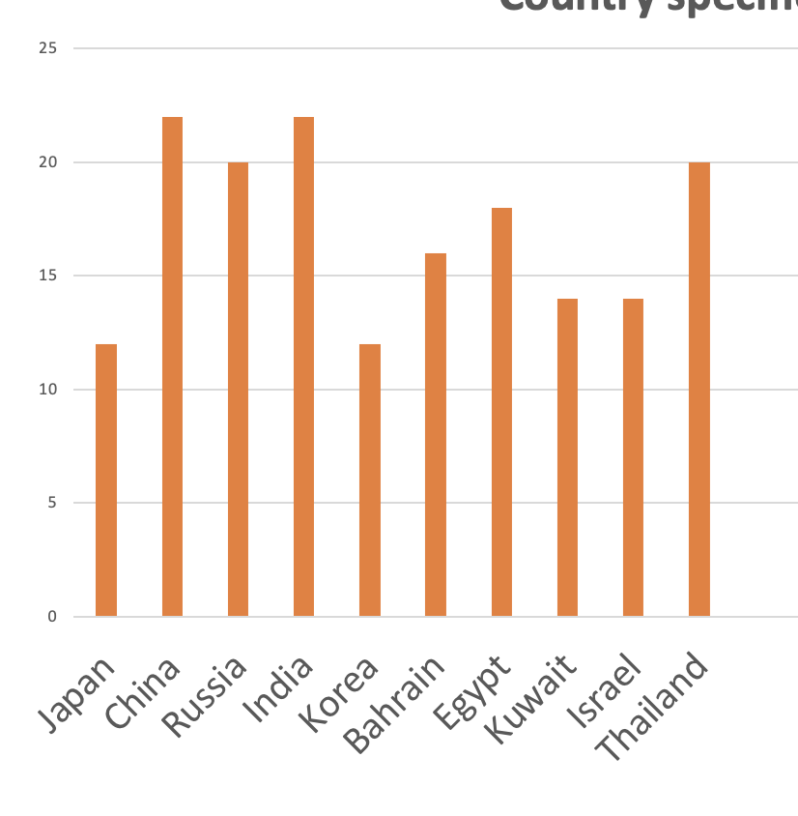
Acceptance of Email Addresses by Websites
EAI (in local language) Acceptance Rates in Form Fields on 1000 Local Websites
(data from 2025 study to be published at UASG.tech)

Slide 7
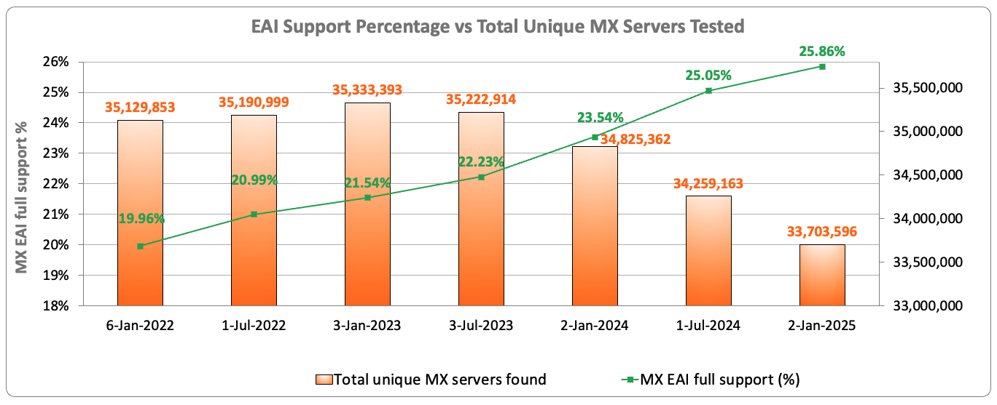
EAI Support Across Email Servers Under gTLDs
Out of the 33.7 million email servers tested in January 2025, only 25.86% show support for internationalized email addresses.
Source: https://ithi.research.icann.org/graph-eai.html
Notes:
Switching to a point per MX server - Multiple MX servers may resolve to the same IP addresses.
Full: All resolved IPs passed the tests
Partial: Some IP passed the tests, and some failed
None: All of the MX server IPs failed the tests
No IPs: No IPs could be resolved for the MX server (e.g. NXdomain)
Not tested: IPs could not be tested (e.g. timeout, refused connections, special use IPs, etc.)

Slide 8





Scope of UA Readiness for Programmers
Support all Domain Names including Internationalized Domain Names (IDNs) and all Email Addresses, including Internationalized Email Addresses (EAI):
Accept: The user can input characters from their local script into a text field.
Validate: The software accepts the characters and recognizes them as valid.
Process: The system performs operations with the characters.
Store: The database can store the text without breaking or corrupting.
Display: When fetched from the database, the information is correctly shown.
Accept
Validate
Process
Store
Display

Slide 9
Technology Stack for UA Consideration
Applications and Websites
- Wikipedia.org, ICANN.org, Amazon.com, custom websites globally
- PowerPoint, Google-Docs, Safari, Acrobat, custom apps
Social Media and Search Engines
- Chrome, Bing, Safari, Firefox, local (e.g., Chinese) browsers
- Facebook, Instagram, Twitter, Skype, WeChat, WhatsApp, Viber
Programming Languages and Frameworks
- JavaScript, Java, Swift, C#, PHP, Python
- Angular, Spring, .NET core, J2EE, WordPress, SAP, Oracle
Accept, validate, process, store and display
all domain names and email addresses.
Platforms, Operating Systems and Sytem Tools
- iOS, Windows, Linux, Android, App Stores
- Active Directory, OpenLDAP, OpenSSL, Ping, Telnet
Standards and Best Practices
- IETF RFCs, W3C HTML, Unicode CLDR, WHATWG
- Industry-based standards (health, aviation, ...)

Slide 10
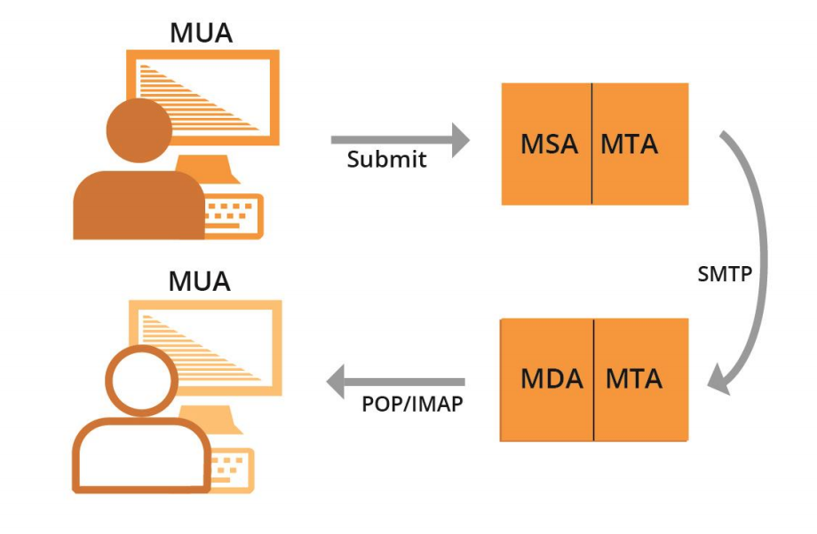
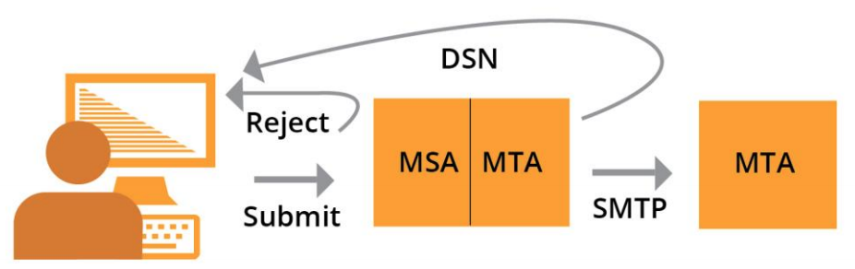
Email Systems and EAI Support
All email agents must be configured to send and receive internationalized email addresses. See EAI: A Technical Overview for details.
  MUA – Mail User Agent: A client program that a person uses to send, receive, and manage mail.
  MSA – Mail Submission Agent: A server program that receives mail from a MUA and prepares it for transmission and delivery.
  MTA – Mail Transfer Agent: A server program that sends and receives mail to and from other Internet hosts. An MTA may receive mail from an MSA and/or deliver mail to an MDA.
  MDA – Mail Delivery Agent: A server program that handles incoming mail and typically stores it in a mailbox or folder.

Slide 11
Fundamentals of Unicode

Slide 12
Character and Character Set
A label or string such as أهلا, नमस्ते, Hello is formed of characters.
  Hello 🡪 H e l l o
A character is unit of information used for the organization, control, or representation of textual data.
Examples of character:
  Letters
  Digits
  Special characters i.e. Mathematical symbols , punctuation marks
  Control Characters - typically not visible
American Standard Code for Information Interchange (ASCII) encodes characters used in computing including letters a-z, digits 0-9 and others.

Slide 13
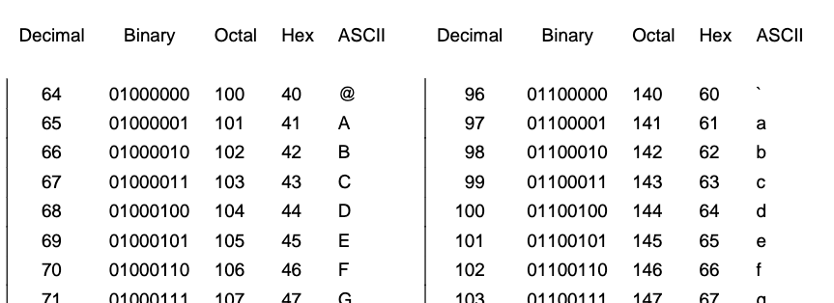
Code Point
Code point is a value, or a position, for a character, in any coded character set.
Code point is a number assigned to represent an abstract character in a system for representing text.
Notes:
https://bournetocode.com/projects/GCSE_Computing_Fundamentals/pages/3-3-5-ascii.html

Slide 14
Code Point
Code point is a value, or a position, for a character, in any coded character set.
Code point is a number assigned to represent an abstract character in a system for representing text.
Notes:
https://bournetocode.com/projects/GCSE_Computing_Fundamentals/pages/3-3-5-ascii.html

Slide 15
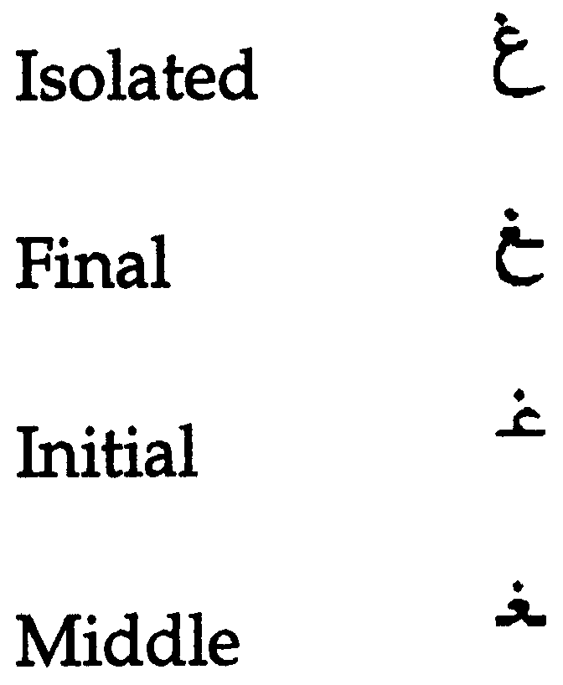
Glyph
A typographic representation of a character is called a glyph.
  English: a, a
  Each Arabic letters often have four glyphs based on where they occur in a string. For example, for the ARABIC LETTER GHAIN the four glyphs are:
  Languages may be written/displayed in right-to-left and left-to-right order but reading of data is on the basis of key press order in a file and not dependent on writing direction.

Slide 16
Character Encoding
Character encoding is mapping from a character set definition to the actual code units used to represent the data.
An encoding describes how to encode code points to bytes and how to decode bytes to code points.

Slide 17
A Brief History
Basic ASCII single 7-bit character, limited to a maximum of 128 characters.
Extended ASCII single 8-bit character, limited to a maximum limit of 256 characters.
ASCII encoding could not contain enough characters to cover all the languages.
So, different encoding systems were developed for assigning numbers to characters for different languages and scripts, which created interoperability problems.

Slide 18
Unicode Standard
The standard for digital representation of the characters used in writing all of the world's languages.
Organized characters at script level.
Unicode provides a uniform means for storing, searching, and interchanging text in any language.
It is used by all modern computers and is the foundation for processing text on the Internet.
Number of slots to represent world languages is 0000 – 10FFFF. See https://unicode.org/charts/ to see script coverage and encoding ranges.

Slide 19
Unicode Encoding
Unicode can be implemented by different character encodings.
  UTF-8
  UTF-16
  UTF-32
UTF-8 encoding is generally used in domain name system.
UTF-8 is variable length character encoding.
UTF-8 encodes code points in one to four bytes, read one byte at a time:
  For ASCII characters 1 byte is used.
  For Arabic characters 2 bytes are used.
  For Devanagari characters 3 bytes are used.
  For Chinese characters 4 bytes are used.
So, for byte level reading, we need to specify encoding before file reading.

Slide 20
Normalization
There are multiple ways to encode certain glyphs in Unicode:
  è = U+00E8
  e + ` = è = U+0065 + U+0300
  آ = U+0622
  ٓ + ا = آ =U+0627 U+0653
The following string can exist in corpus in the form of first string below, whereas input string is in the form of second string, below. So, search result will be empty.
  آدم (U+0622 U+062F U+0645)
  آدم (U+0627 U+0653 U+062F U+0645)
For searching , sorting and any string operations we need normalization.
Normalization ensures that the end representation is the same, even if users type differently

Slide 21
Normalization
Different normalization forms defined by Unicode are listed below:
  Normalization Form D (NFD)
  Normalization Form C (NFC)
  Normalization Form KD (NFKD)
  Normalization Form KC (NFKC)
In domain names NFC is used.

Slide 22
Internationalized Domain Names

Slide 23
Domain Names
A domain name is an ordered set of labels or strings: www.example.co.uk.
  The top-level domain (TLD) is the rightmost label: ”uk”.
  Second-level domain: “co”.
  Third-level domain: “example”.
Initially, TLDs were only two or three characters long (e.g., .ca, .com).
Now TLDs can be longer strings (e.g., .info, .google, .engineering).
TLDs delegated in the root zone can change over time, so a fixed list can get outdated.
Each label is 63 Octet.
Total domain name length cannot be more than 255 (including separators).

Slide 24
Internationalized Domain Names (IDNs)
Domain names can also be internationalized when one of the labels contains at least one non-ASCII character.
  For example: www.exâmple.ca , 普遍接受-测试.世界. , صحة.مصر, ทัวร์เที่ยวไทย.ไทย
There are two equivalent forms of IDN domain labels: U-label and A-label.
  Human users use the IDN version called U-label (using UTF-8 format): exâmple
  Applications or systems internally use an ASCII equivalent called A-label:
    Take user input and normalize and check against IDNA2008 to form IDN U-label.
    Convert U-label to punycode (using RFC3492).
    Add the “xn--” prefix to identify the ASCII string as an IDN A-label.
      exâmple => exmple-xta => xn--exmple-xta
      普遍接受-测试 => --f38am99bqvcd5liy1cxsg => xn----f38am99bqvcd5liy1cxsg
Use the latest IDN standard called IDNA2008 for IDNs.
  Do not use libraries for the outdated IDNA2003 version.

Slide 25
Email Address Internationalization (EAI)

Slide 26
Email Address
Email address syntax: mailboxName@domainName.
  Email has a mailboxName.
  Email has a domainName.
    The domainName can be ASCII or IDN.
    For example:
      myname@example.org
      myname@xn--exmple-xta.ca

Slide 27
EAI
EAI has the mailboxName in Unicode (in UTF-8 format).
The domainName can be ASCII or IDN.
  For example:
    kévin@example.org
    すし@ xn--exmple-xta.ca
    すし@快手.游戏.

Slide 28
Email Addresses Form
name@exâmple.ca and name@xn--exmple-xta.ca represent equivalent email address.
Application should be able to treat both forms as equivalent.
Internally consistently use A-label or U-label, but don’t mix A-label and U-label.
Technical Recommendation: Backend processing should be in A-label, and U-label for visual inspection.
For example, new user registration in application with equivalent A-label.

Slide 29
Sending and Receiving
We need to be able to send to either form:
  mailboxName-UTF-8@A-labelform.
  mailboxName-UTF-8@U-labelform.
We need to be able to receive to either form:
  mailboxName-UTF-8@A-labelform.
  mailboxName-UTF-8@U-labelform.
Storage of email should be consistent with domain name in either A-label or U-label form.
Backend send/receive should be managed by mail server.
Handover process (Front end application 🡪 email server).
  Libraries used in handover process should be EAI Compliant.
  Mail server should also be EAI compatible.
    How to make mail server EAI compatible is out of scope of this training?

Slide 30
Conclusion

Slide 31
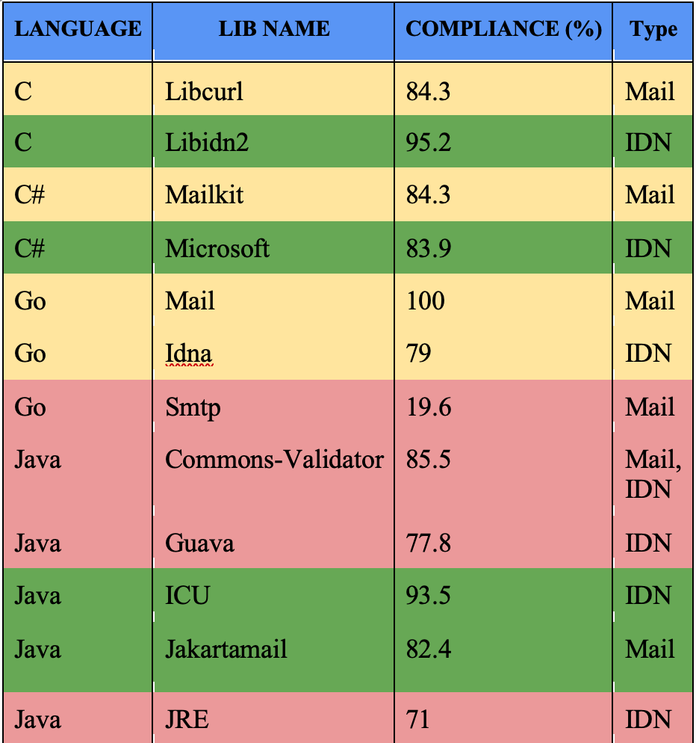
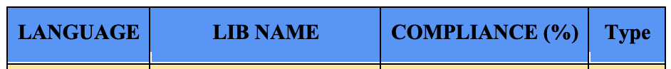
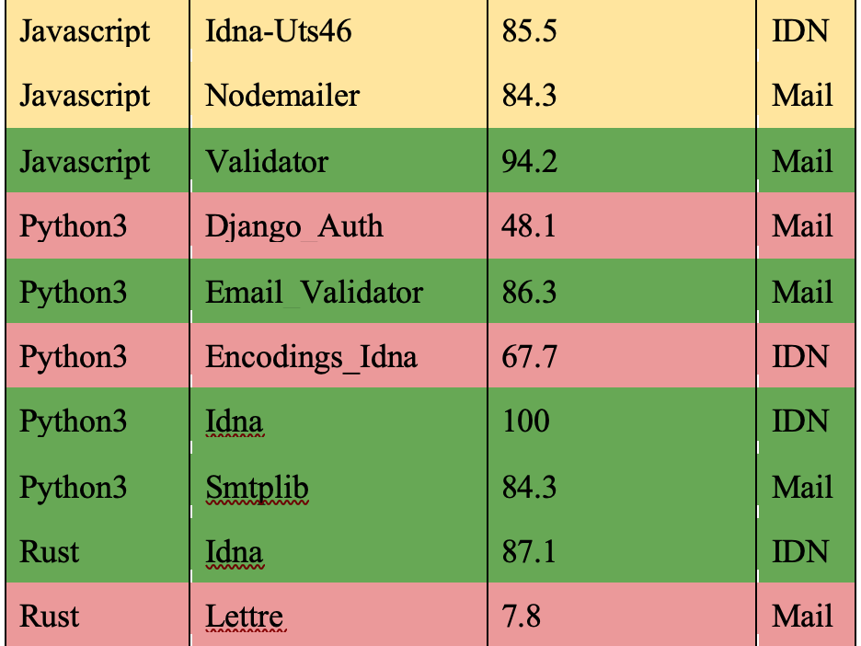
Prog. Languages Support
UASG018A

Slide 32
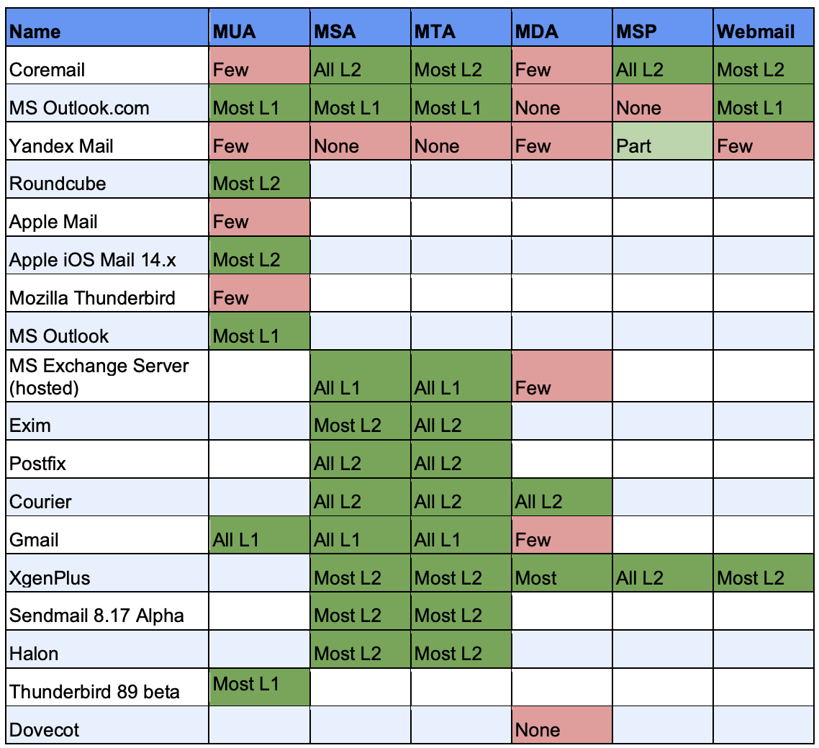
EAI Support by Email Tools and Services
See detailed testing results in UASG030A: EAI Software Test Results

Slide 33
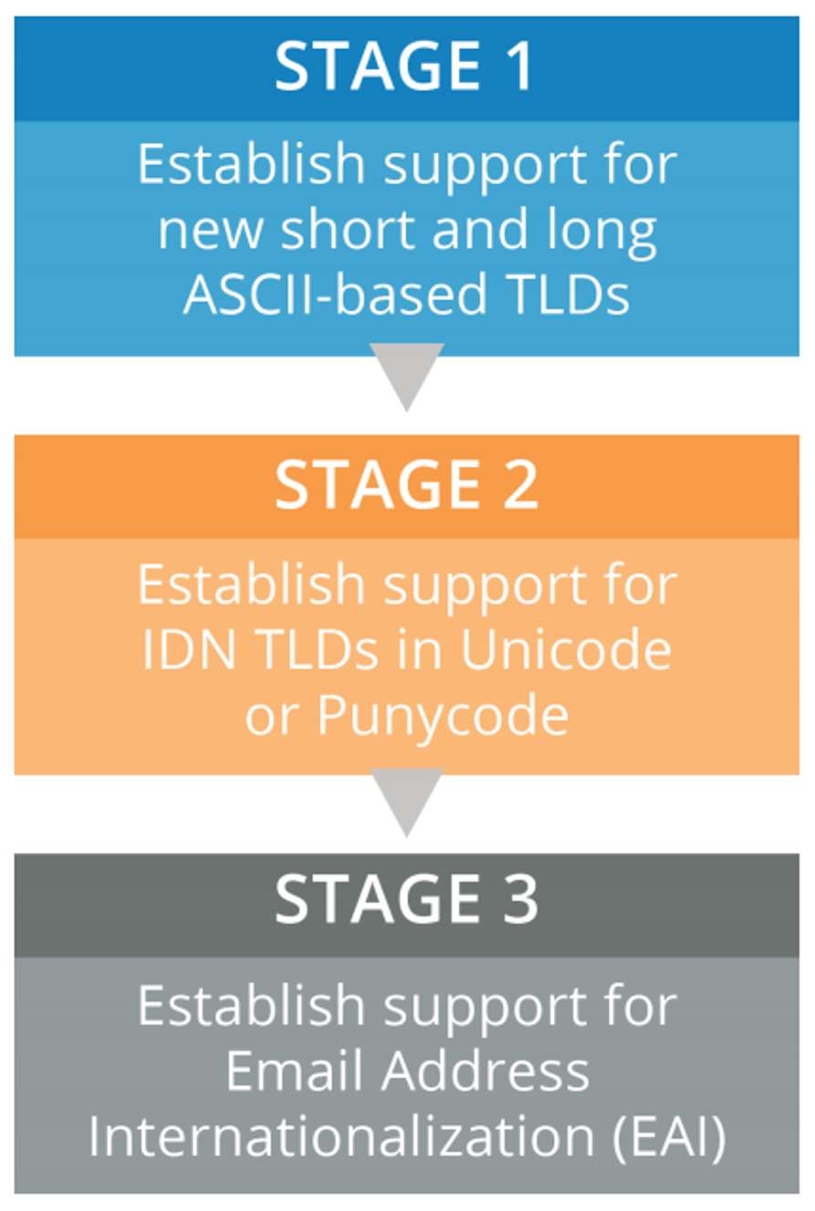
ICANN’s Journey to UA Readiness - Model
Stage 1: Update services to support both new short and long ASCII TLDs.
Stage 2: Update services to support non-ASCII Internationalized Domain Names (IDNs) in Unicode (U-label), and ASCII-based IDN representations in Punycode (A-label).
Stage 3: Update infrastructure and services to support non-ASCII email addresses.
  Note: all components must support Email Address Internationalization (EAI) before infrastructure is compliant.
See details in ICANN’s Case Study

Slide 34
Free Servers With EAI Support
For a ready made server including popular software, please email UAProgram@icann.org :
  Popular, stable software packages
  All configured to support EAI
Example of another all-in-one mail server: xmox.nl
  Version 0.x, not yet 1.0
  Strong emphasis on working out of the box, with EAI, DKIM, DMARC, DANE etc
Both need a linux server and a global IP address
  Very low resource usage
  Low-cost virtual server is adequate

Slide 35

EAI Self-Certification
UASG has developed detailed requirements for EAI support.
  Detailed checklist.
  Easy to use for verifying that a product/service supports EAI, including peripheral functions like an address book.
  Has been used by service providers’ QA teams to check service.
Available at uasg.tech/eai-certification.

Slide 36
Get Involved!
For more information on UA, email info@uasg.tech or UAProgram@icann.org
Access all UASG documents and presentations at: https://uasg.tech and https://icann.org/ua

Slide 37
Some Relevant Materials
See https://uasg.tech for a complete list of reports.
  Universal Acceptance Quick Guide: UASG005
  Introduction to Universal Acceptance: UASG007
  Quick Guide to EAI: UASG014
  EAI – A Technical Overview: UASG012
  UA Compliance of Some Programming Language Libraries and Frameworks – UASG018A
  EAI – Evaluation of Major Email Software and Services: UASG021B
  Universal Acceptance Readiness Framework: UASG026
  Considerations for Naming Internationalized Email Mailboxes: UASG028
  Evaluation of EAI Support in Email Software and Services Report: UASG030
  UA of Content Management Systems (CMS) Phase 1 – WordPress: UASG032
  UA-Ready Code Samples in Java, Python, and JavaScript - UASG043

Slide 38
Engage with ICANN – Thank You and Questions
Email: sarmad.hussain@icann.org

